Slide 1

Scheduling and Analysis of Limited-Preemptive Moldable Gang Tasks Weekly Meeting
Joan Marcè i Igual
25th of March, 2020

Slide 2
To discuss today
Done
New tests
LPMGRS scheduler algorithm
Formalisation
Task generation formalisation
Results
Notation
To do
Tasks with precedence constraints generation
Notes:
First of all, let’s explain what gang scheduling is.
<click>
Let’s say that we have multiple threads that we want to schedule. If we want to convert them to a gang task we would put them together as a “gang” <click> and then we would schedule as a single task<click> so the execution would not start until there are enough free cores.

Slide 3
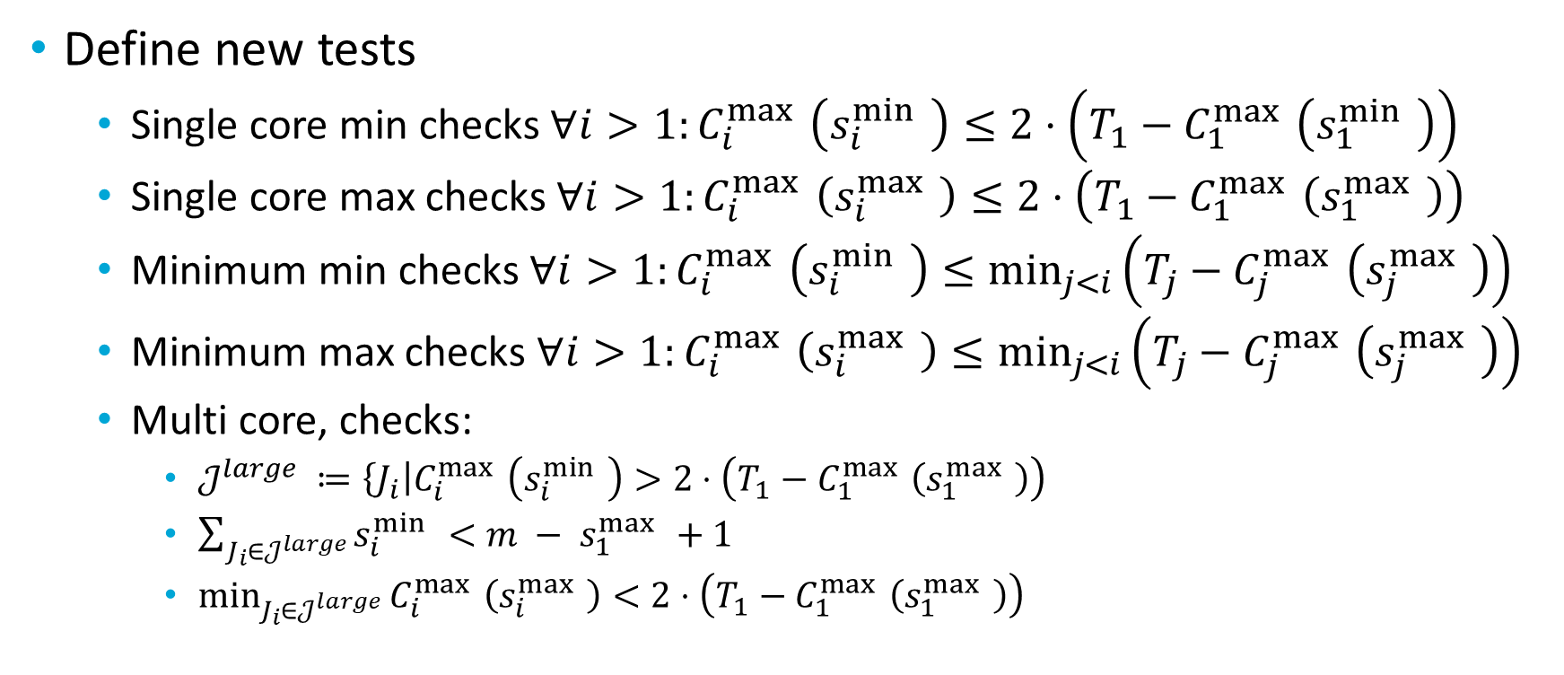
What has been done?
Define new tests
Single core min checks $∀i>1:C_{i}^{\max{ }}\left(s_{i}^{\min{ }}\right)≤2⋅\left(T_{1}−C_{1}^{\max{ }}\left(s_{1}^{\min{ }}\right)\right)$
Single core max checks $∀i>1:C_{i}^{\max{ }}\left(s_{i}^{\max{ }}\right)≤2⋅\left(T_{1}−C_{1}^{\max{ }}\left(s_{1}^{\max{ }}\right)\right)$
Minimum min checks $∀i>1:C_{i}^{\max{ }}\left(s_{i}^{\min{ }}\right)≤\min_{j<i}\left(T_{j}−C_{j}^{\max{ }}\left(s_{j}^{\max{ }}\right)\right)$
Minimum max checks $∀i>1:C_{i}^{\max{ }}\left(s_{i}^{\max{ }}\right)≤\min_{j<i}\left(T_{j}−C_{j}^{\max{ }}\left(s_{j}^{\max{ }}\right)\right)$
Multi core, checks:
$𝒥^{large} ≔\left\{J_{i}\right|C_{i}^{\max{ }}\left(s_{i}^{\min{ }}\right)>2⋅\left(T_{1}−C_{1}^{\max{ }}\left(s_{1}^{\max{ }}\right)\right)$
$\sum_{J_{i}∈𝒥^{large}}{s_{i}^{\min{ }}}<{m − s}_{1}^{\max{ }}+1$
$\min_{J_{i}∈𝒥^{large}}{C_{i}^{\max{ }}\left(s_{i}^{\max{ }}\right)<2⋅\left(T_{1}−C_{1}^{\max{ }}\left(s_{1}^{\max{ }}\right)\right)}$
Notes:
First of all, let’s explain what gang scheduling is.
<click>
Let’s say that we have multiple threads that we want to schedule. If we want to convert them to a gang task we would put them together as a “gang” <click> and then we would schedule as a single task<click> so the execution would not start until there are enough free cores.

Slide 4
What has been done?
Fix bugs
When running nptest tool the number of cores was not set properly
After fixing execution takes a reasonable amount of time. Do we have a computing cluster/machine?
Some tasks where created with utilization 0
Generate new task sets
New LPMGRS scheduler implemented
Not so good results
Results
SAG shows similar results to simulation 😀
Notes:
First of all, let’s explain what gang scheduling is.
<click>
Let’s say that we have multiple threads that we want to schedule. If we want to convert them to a gang task we would put them together as a “gang” <click> and then we would schedule as a single task<click> so the execution would not start until there are enough free cores.

Slide 5
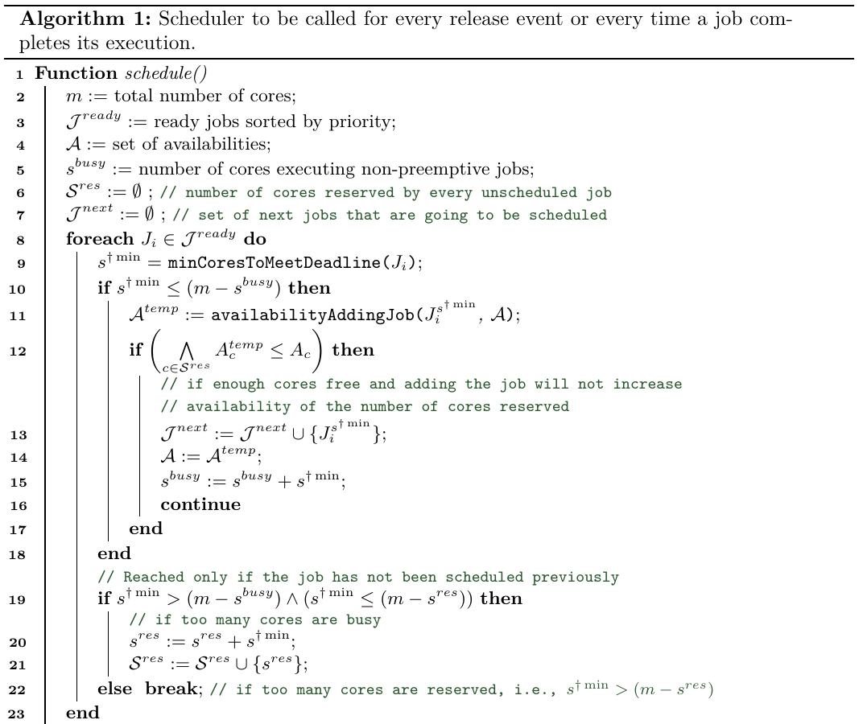
Algorithm change

Slide 6
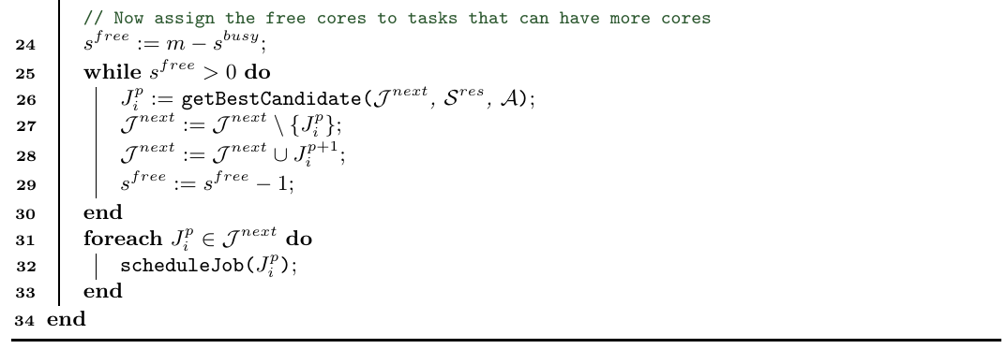
Algorithm change

Slide 7
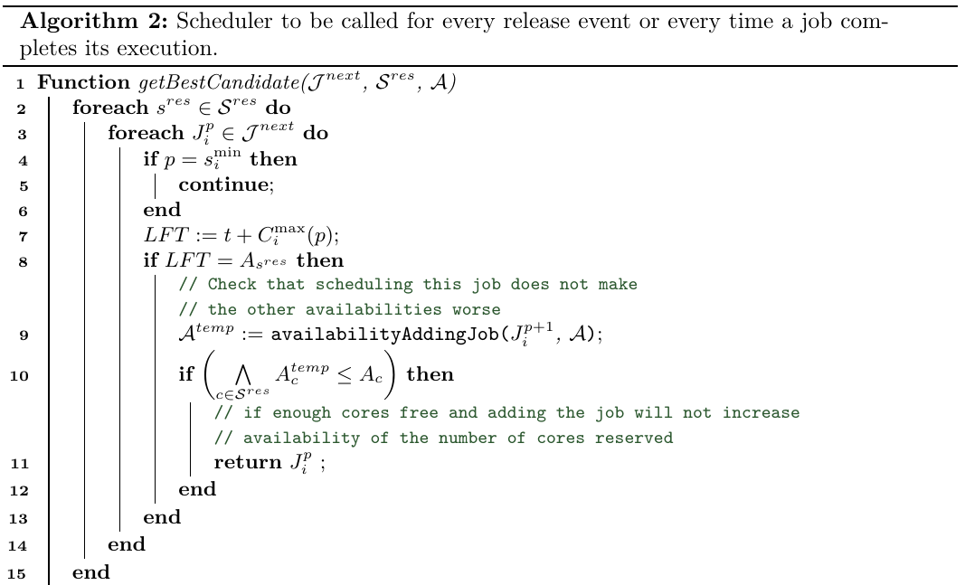
Algorithm change

Slide 8
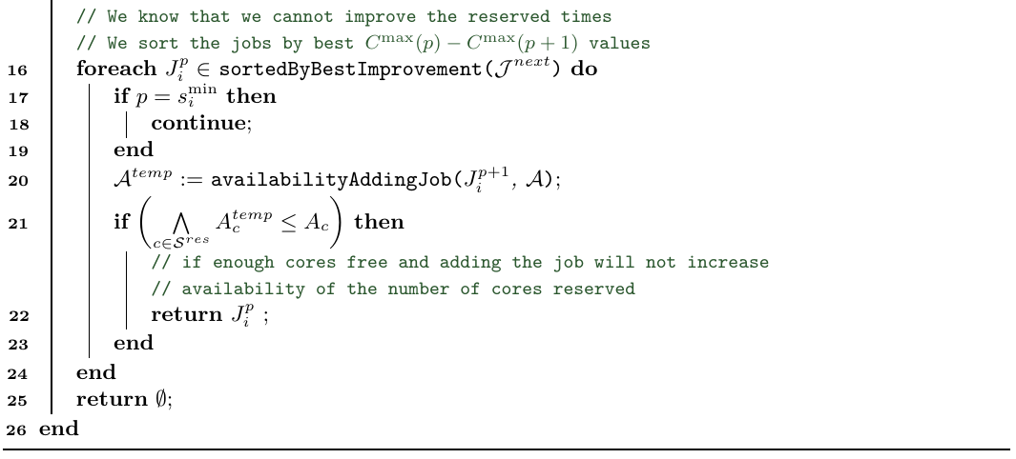
Algorithm change

Slide 9
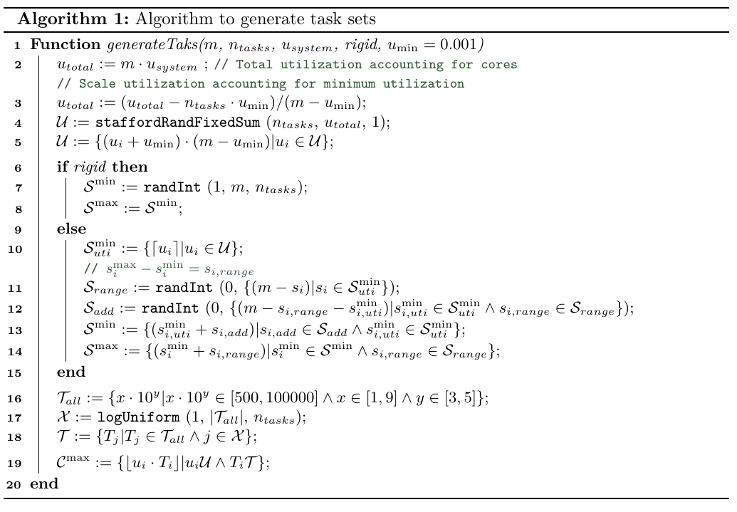
Task generation

Slide 10
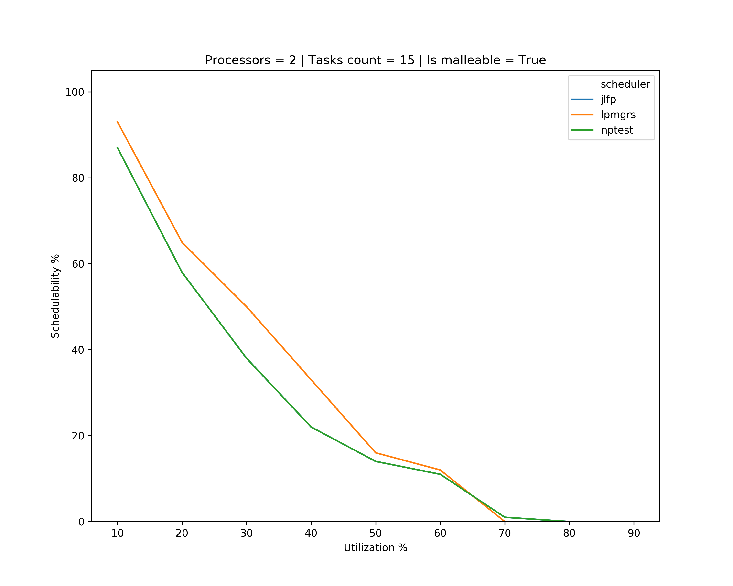
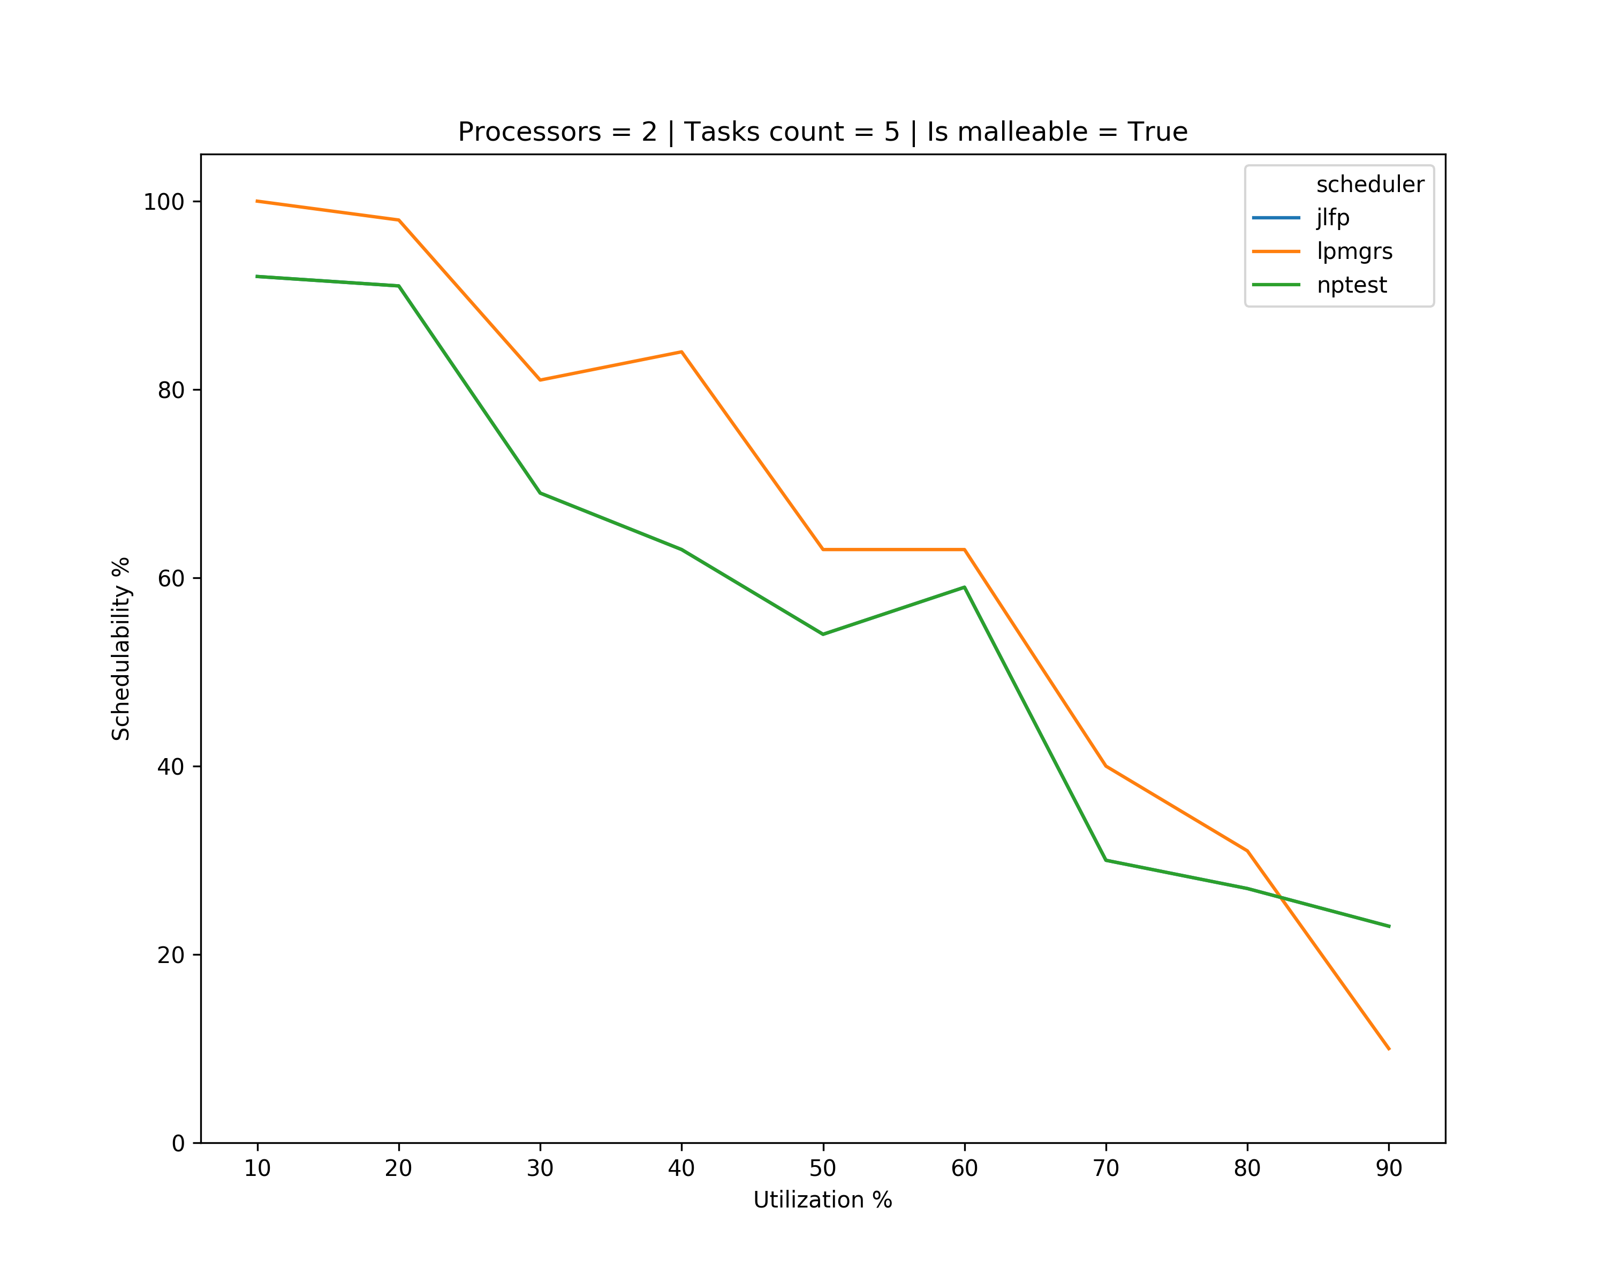
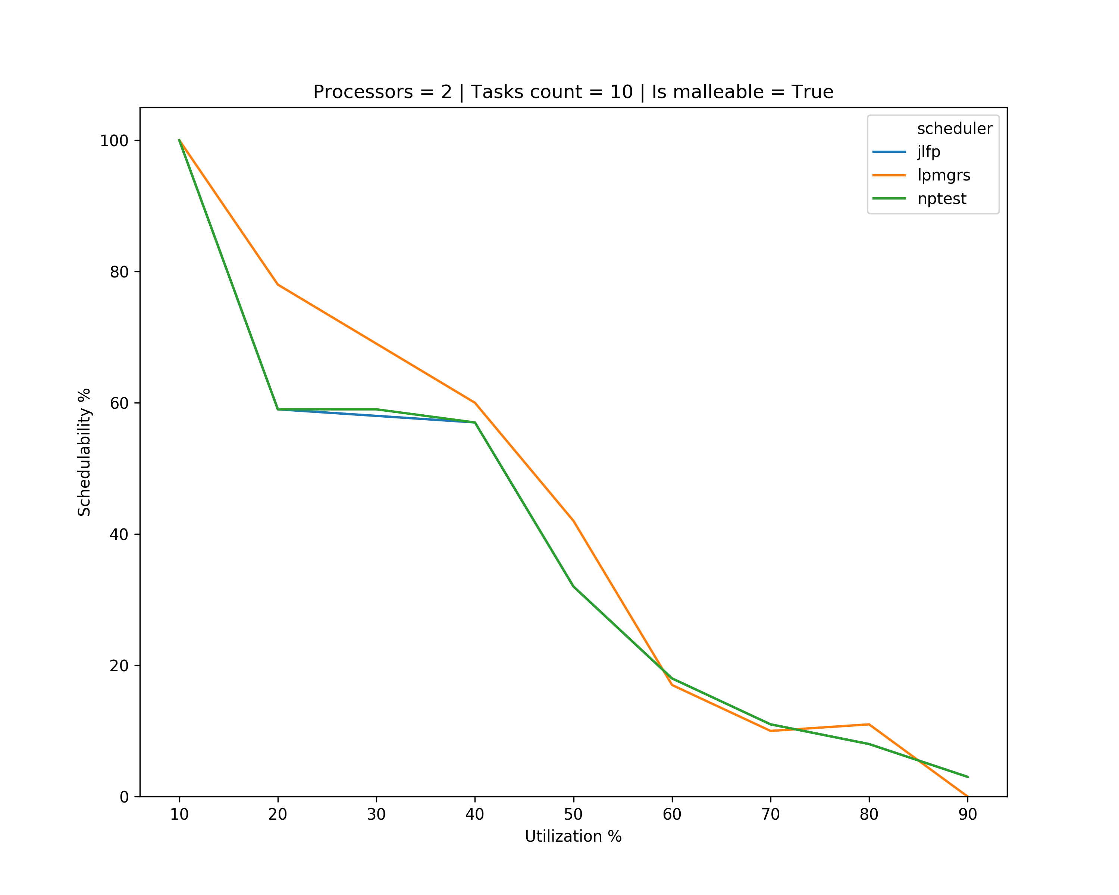
Results – single core min

Slide 11
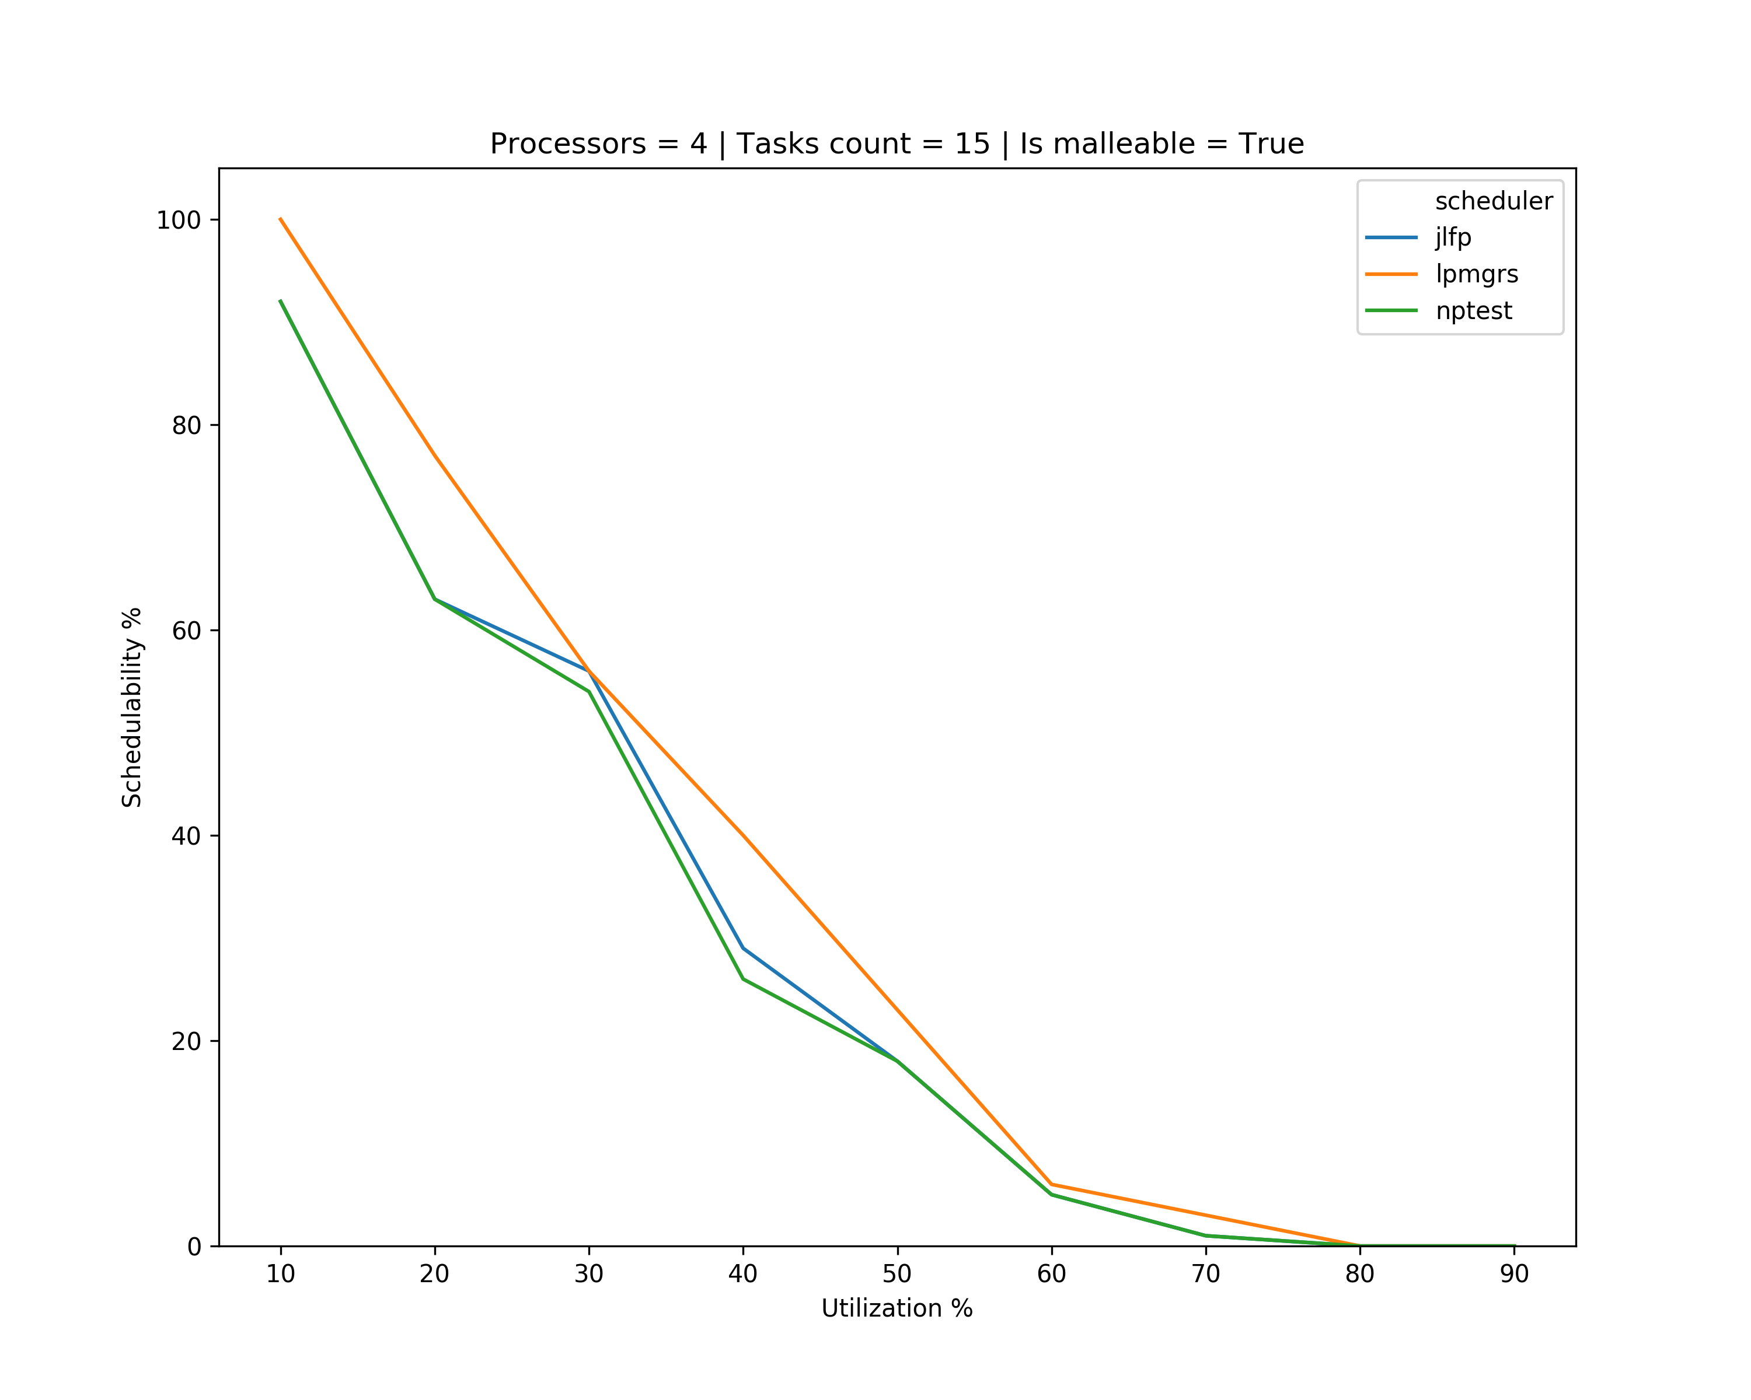
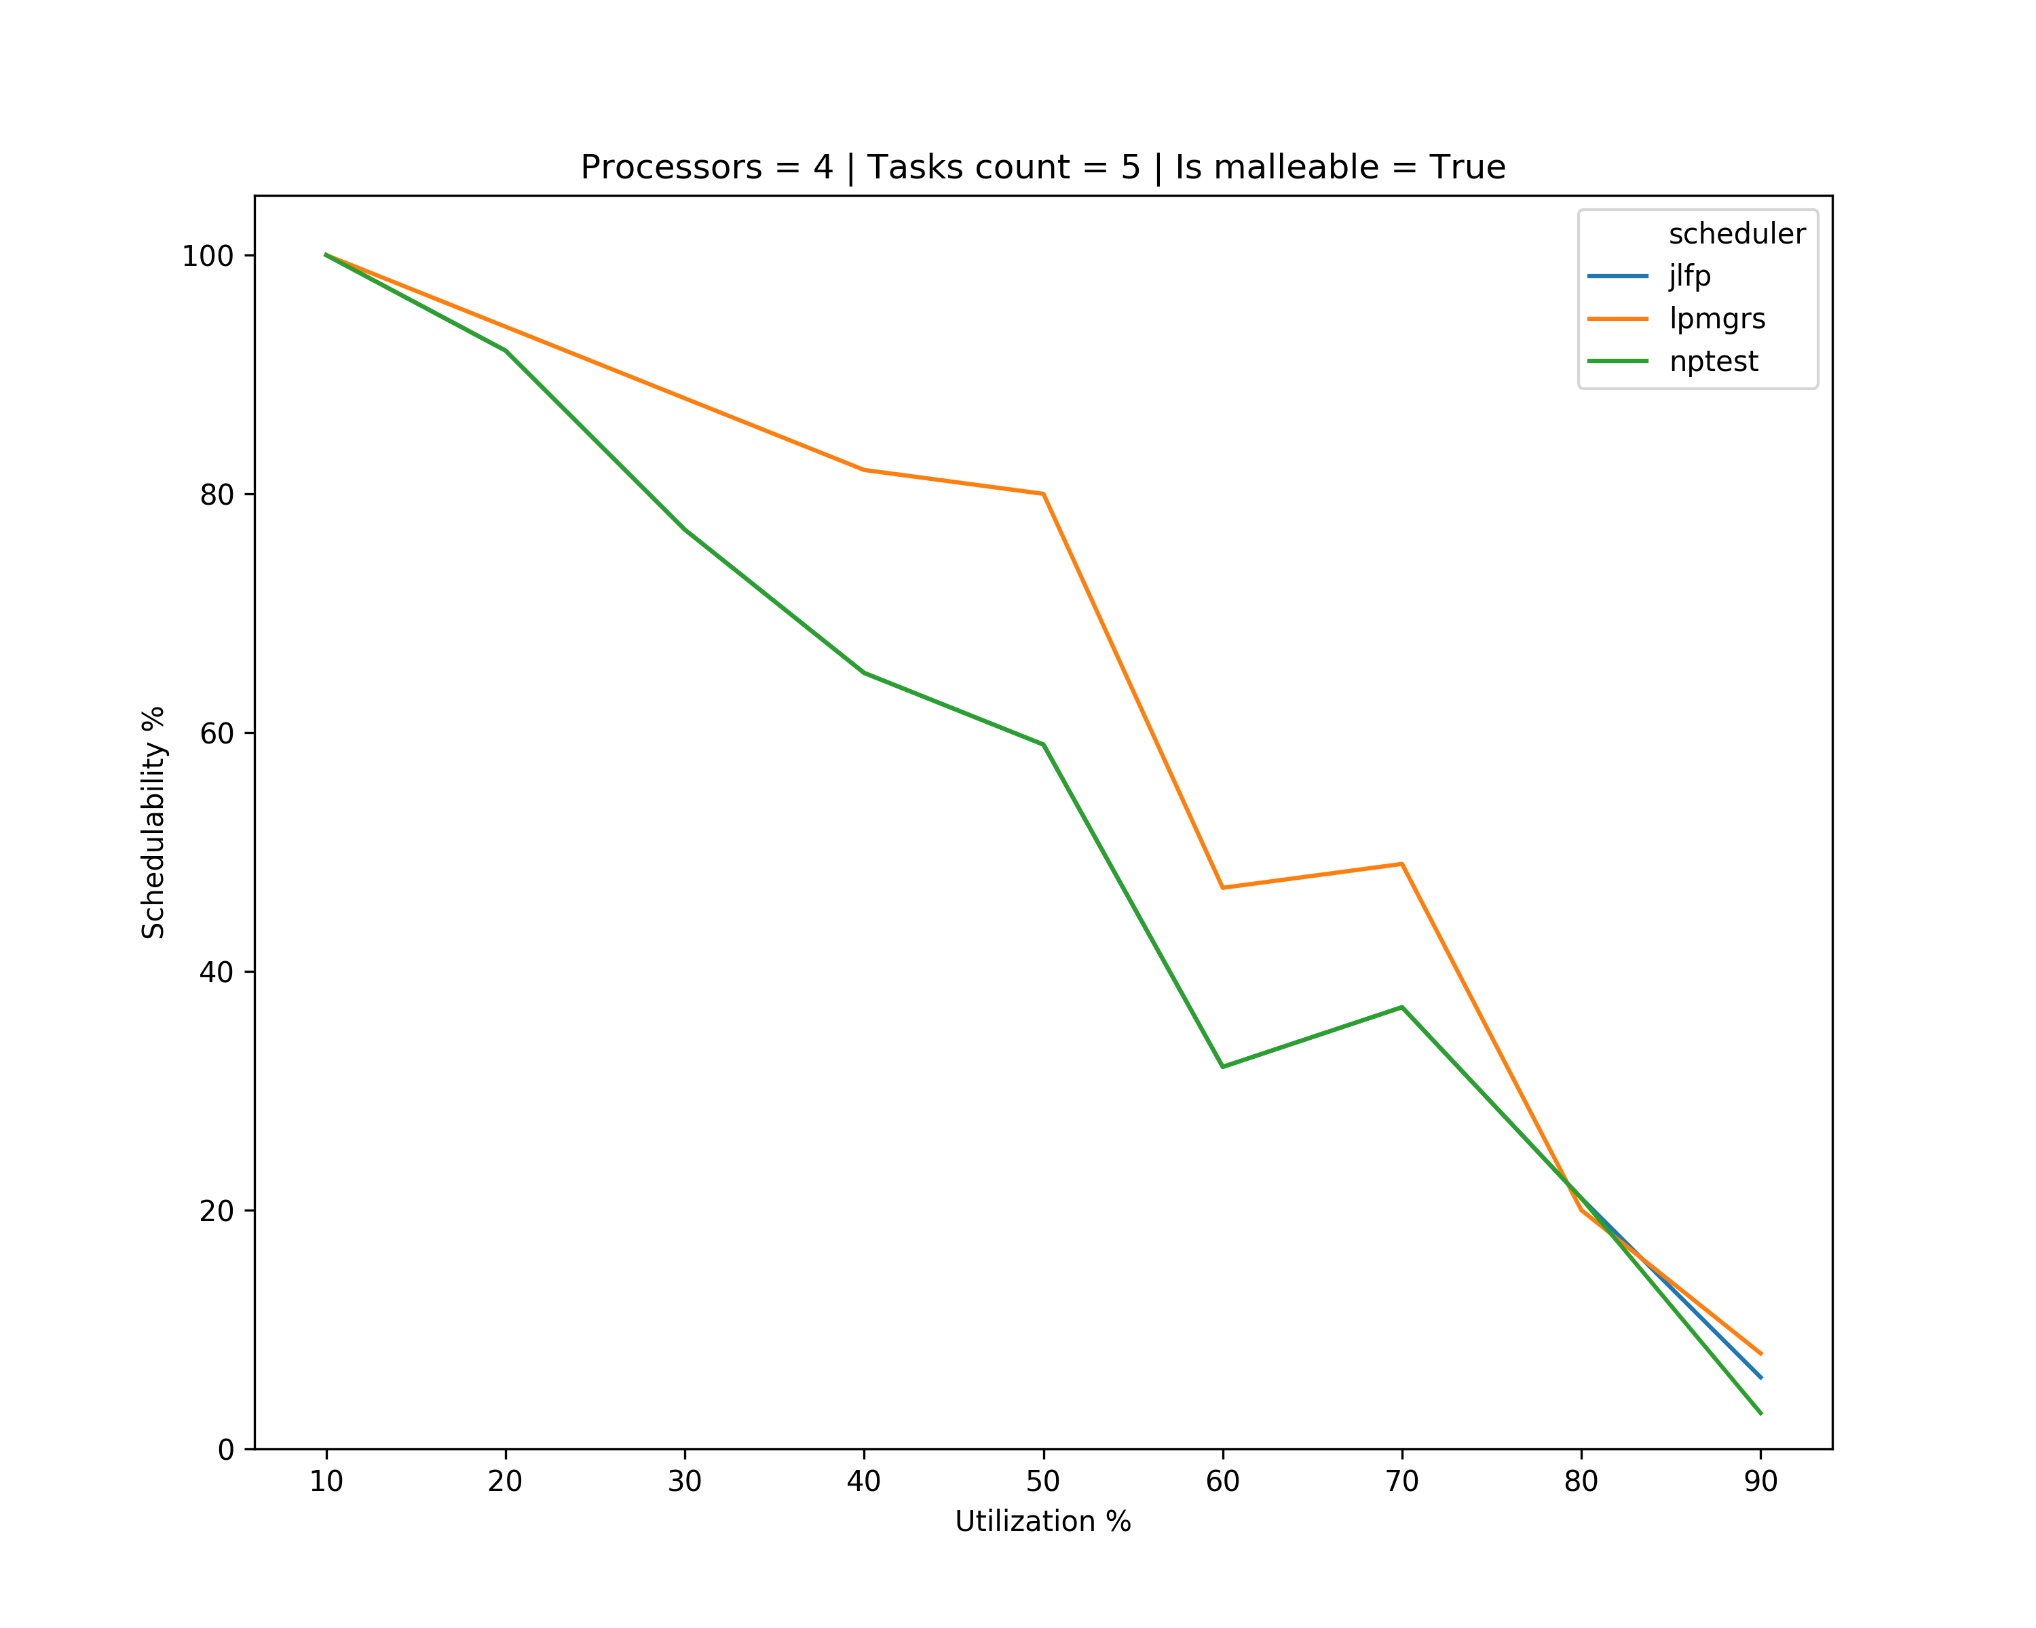
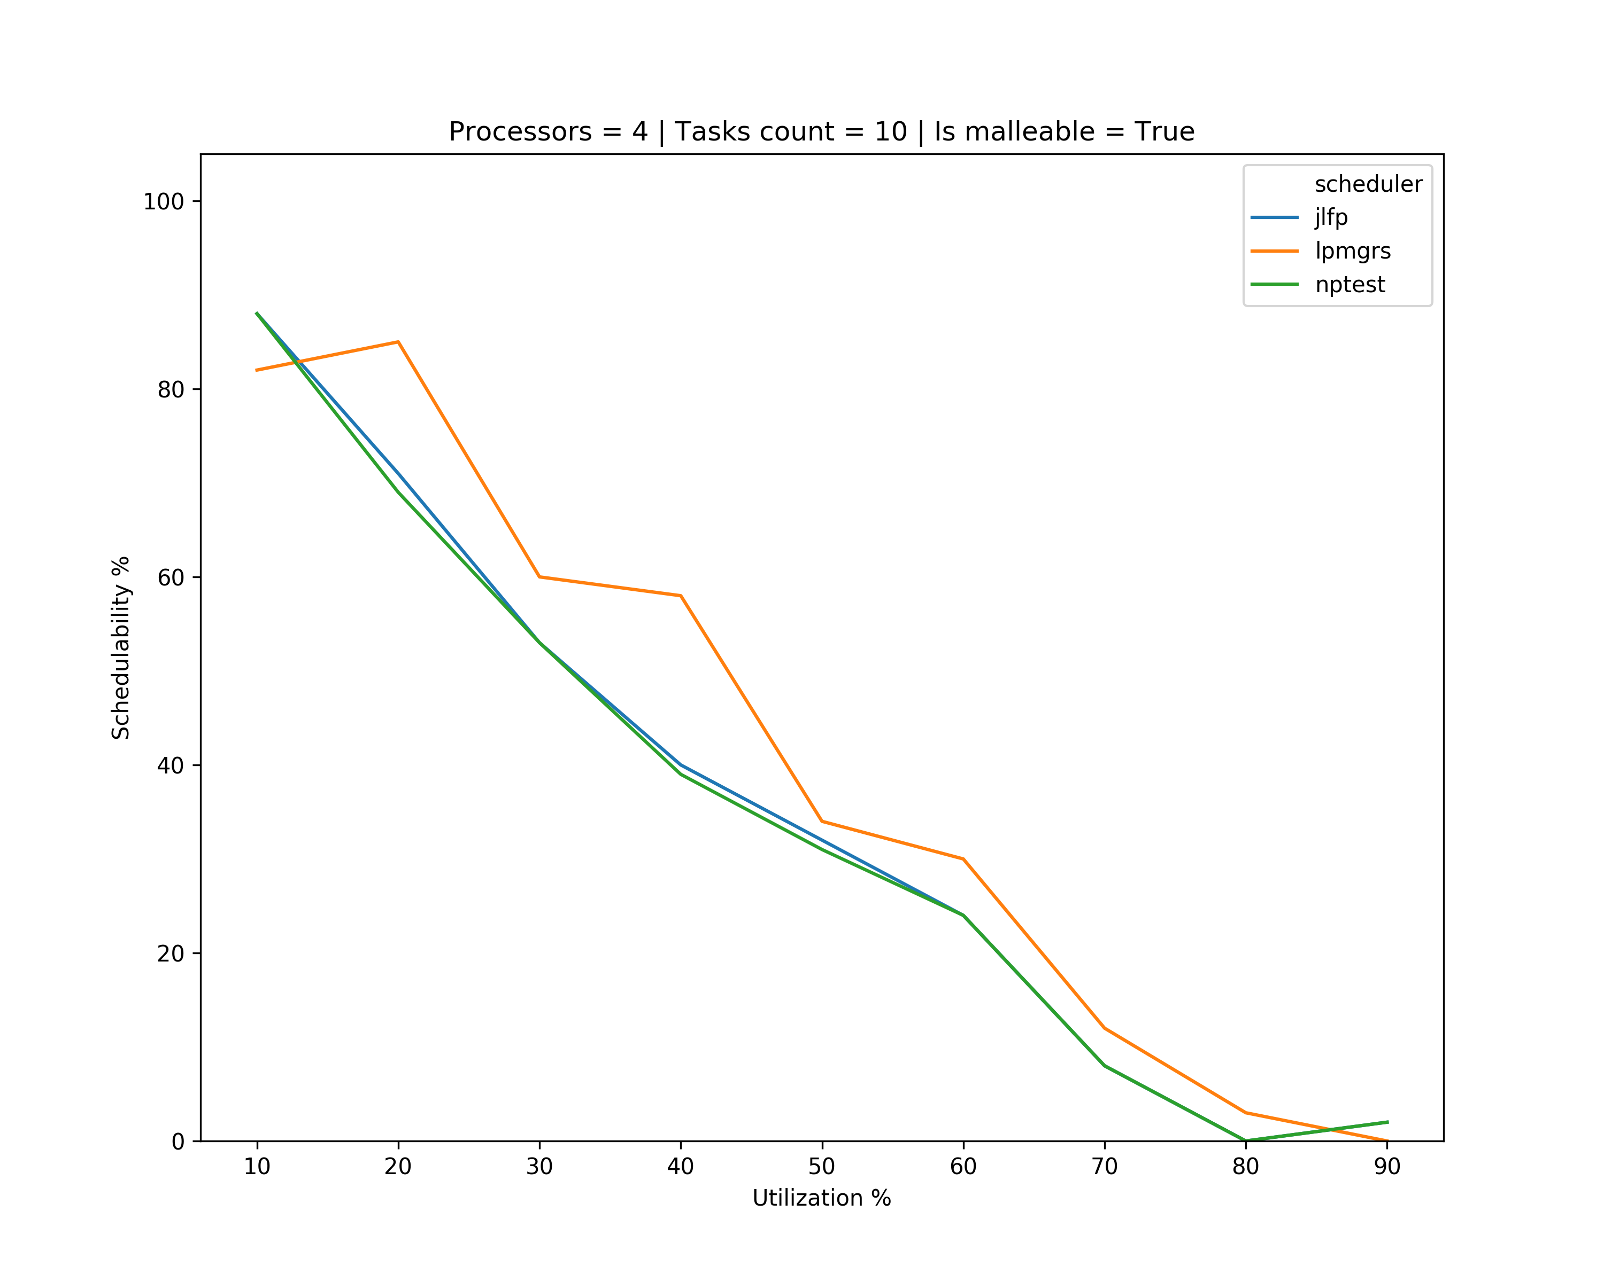
Results – single core min

Slide 12
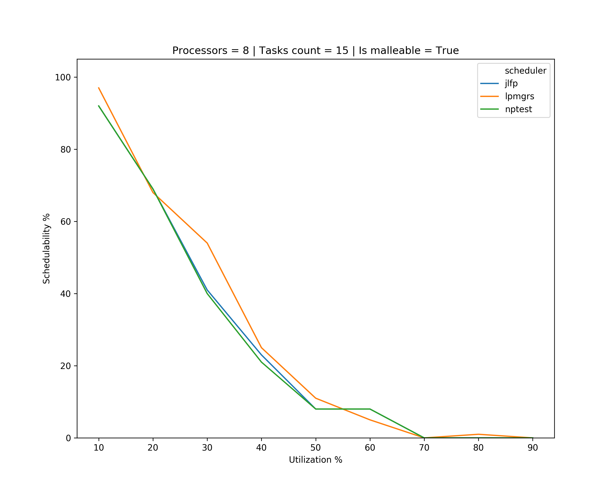
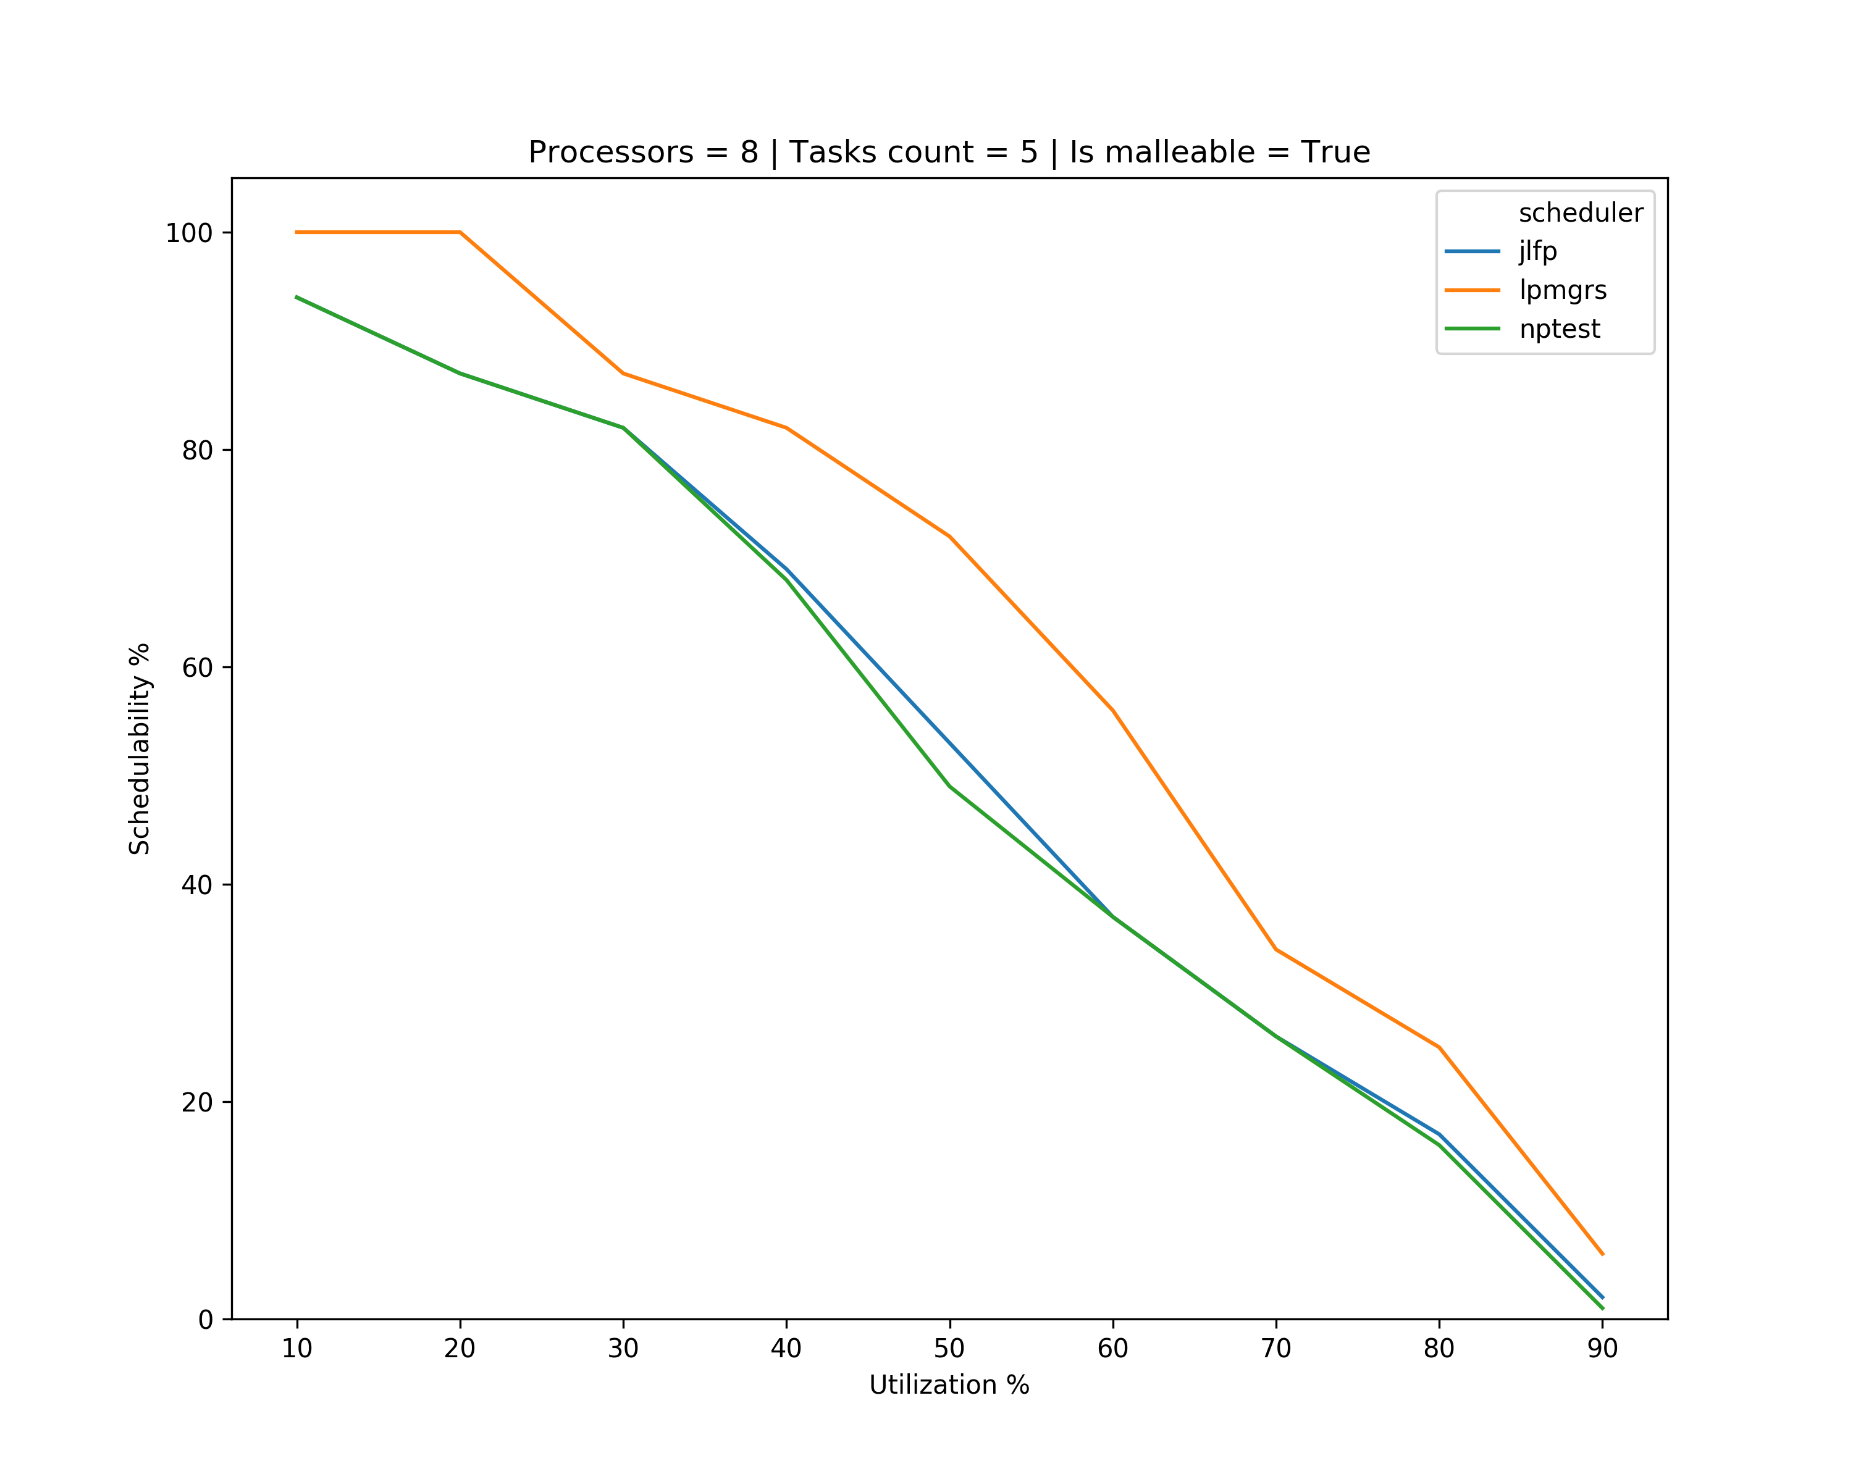
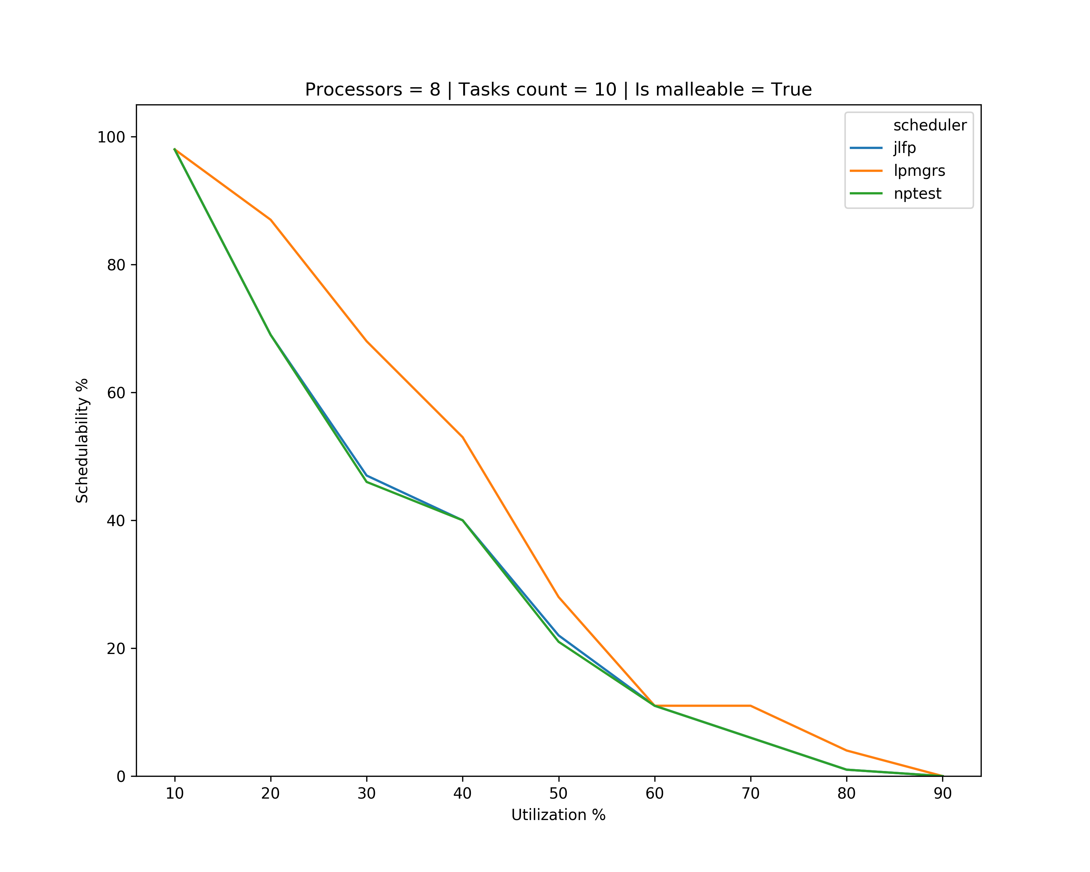
Results – single core min

Slide 13
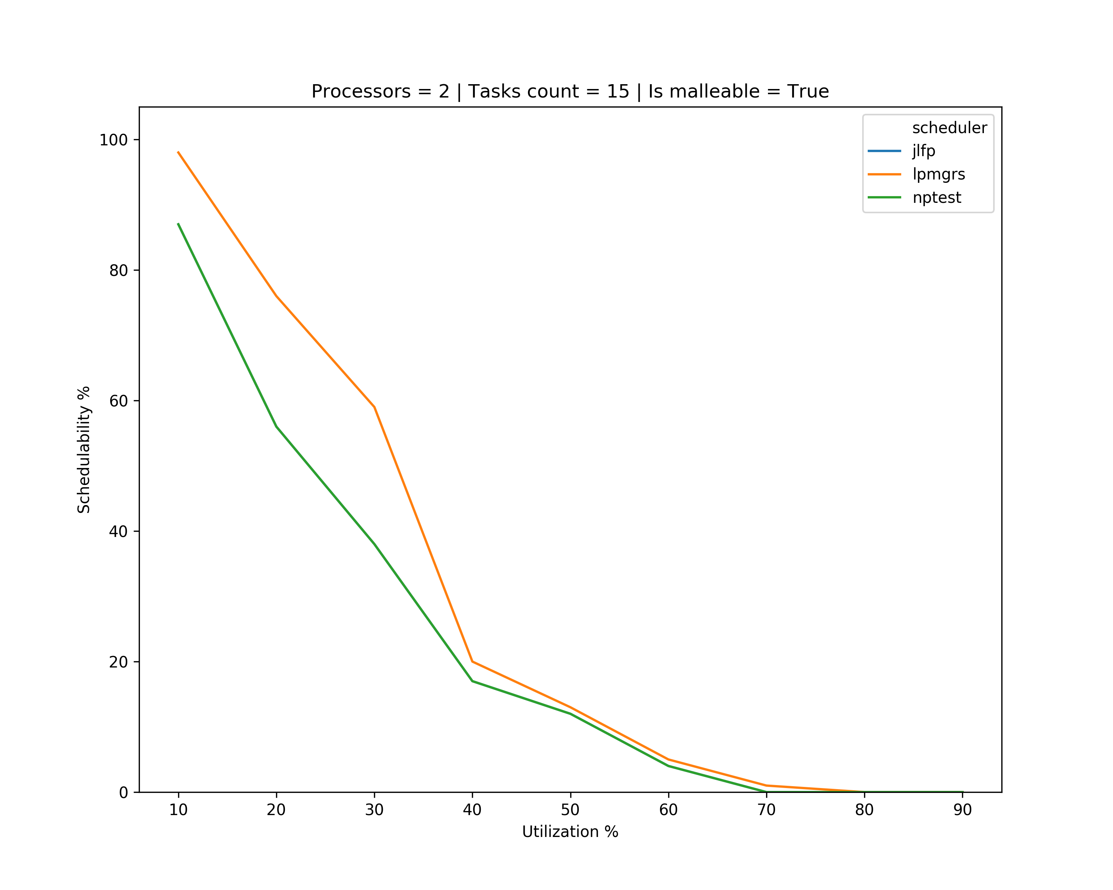
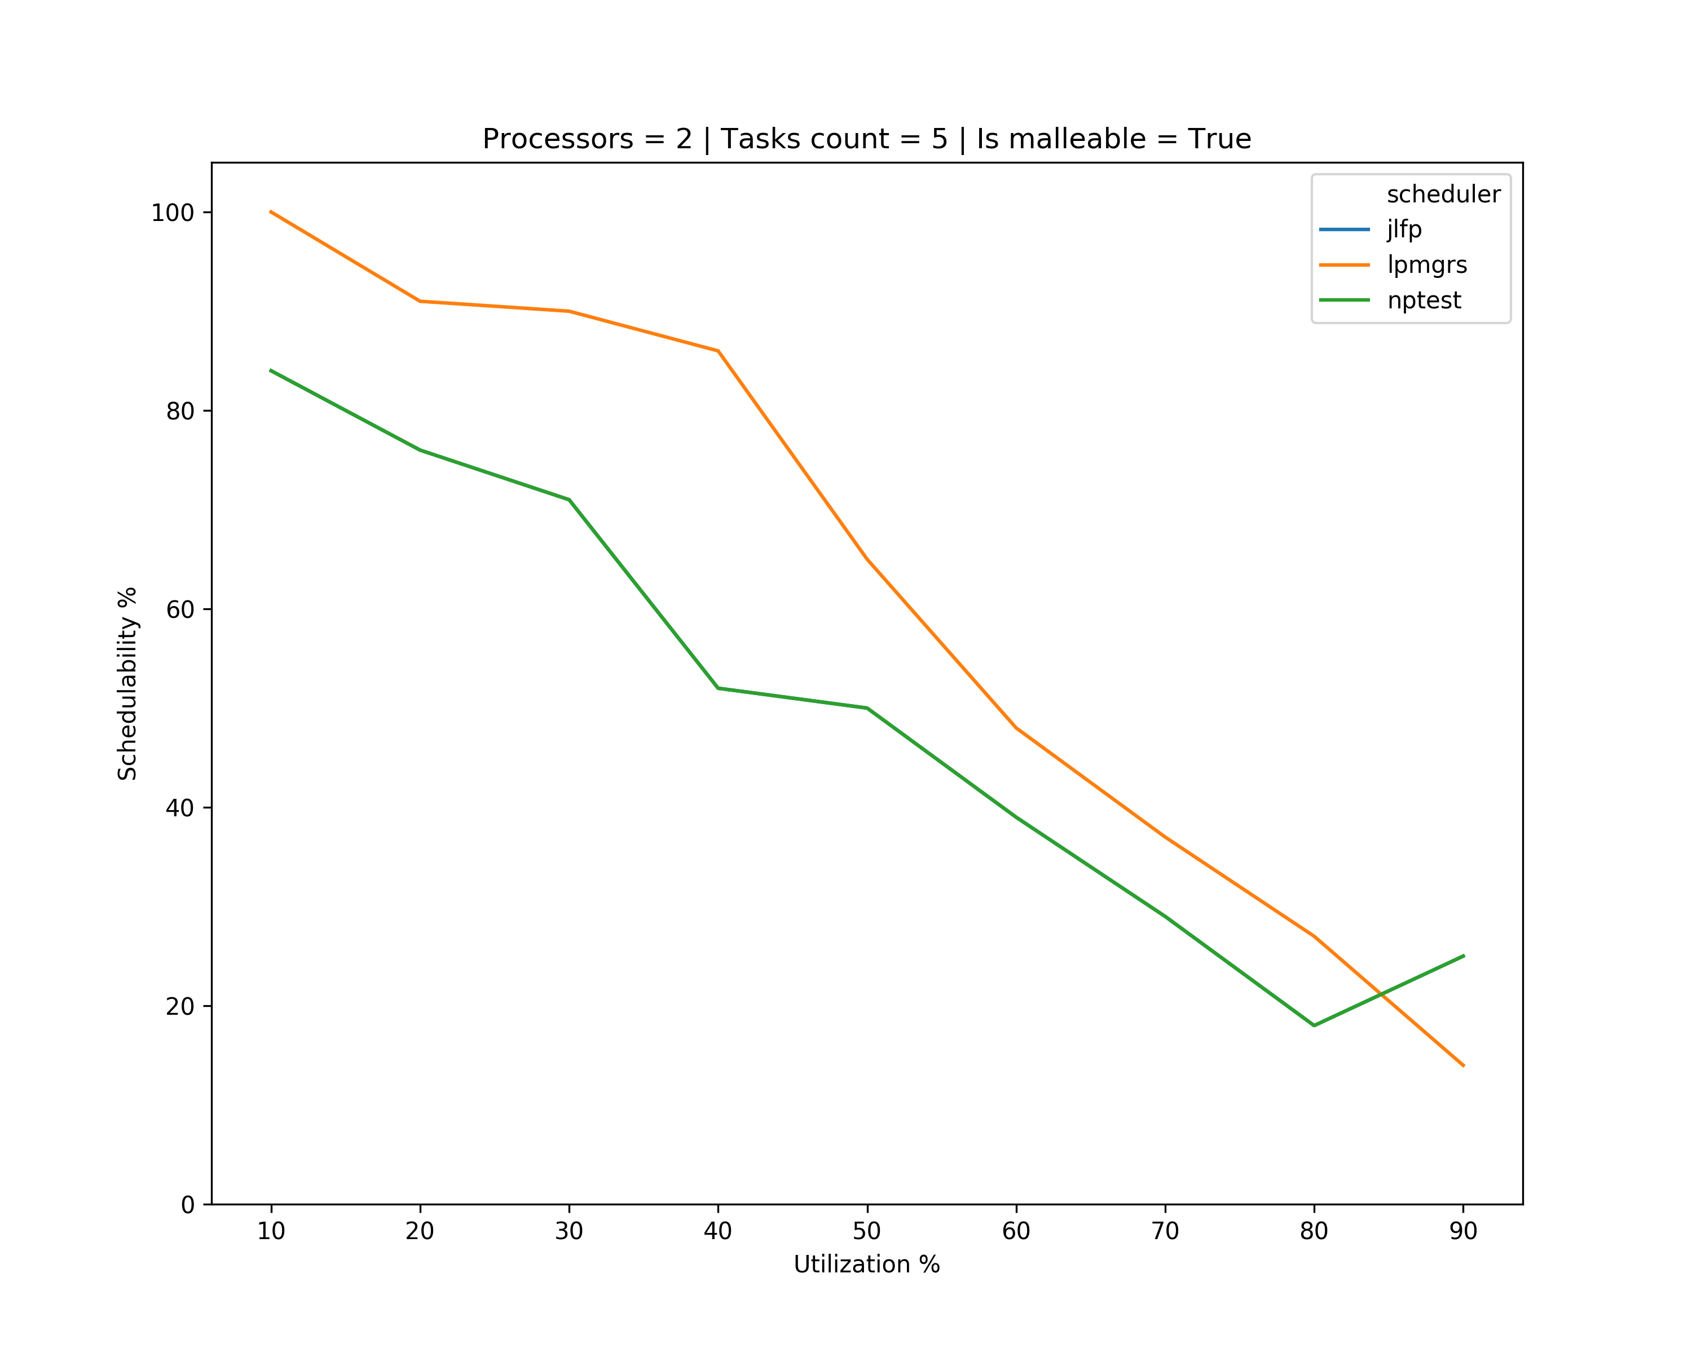
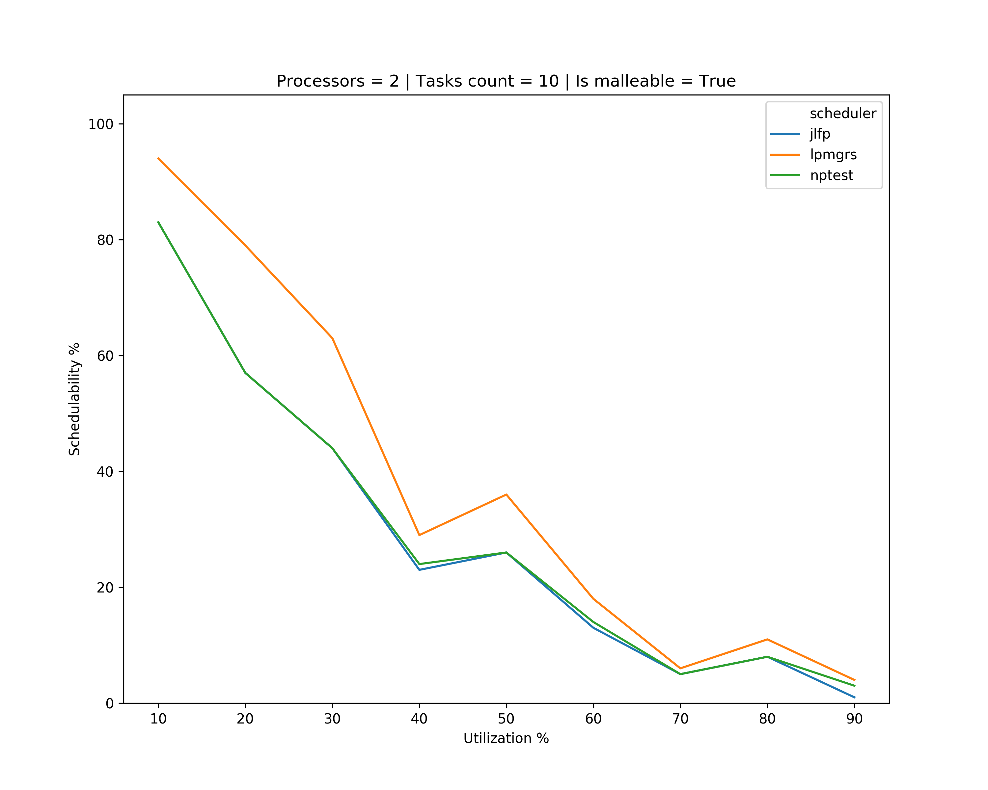
Results – single core max

Slide 14
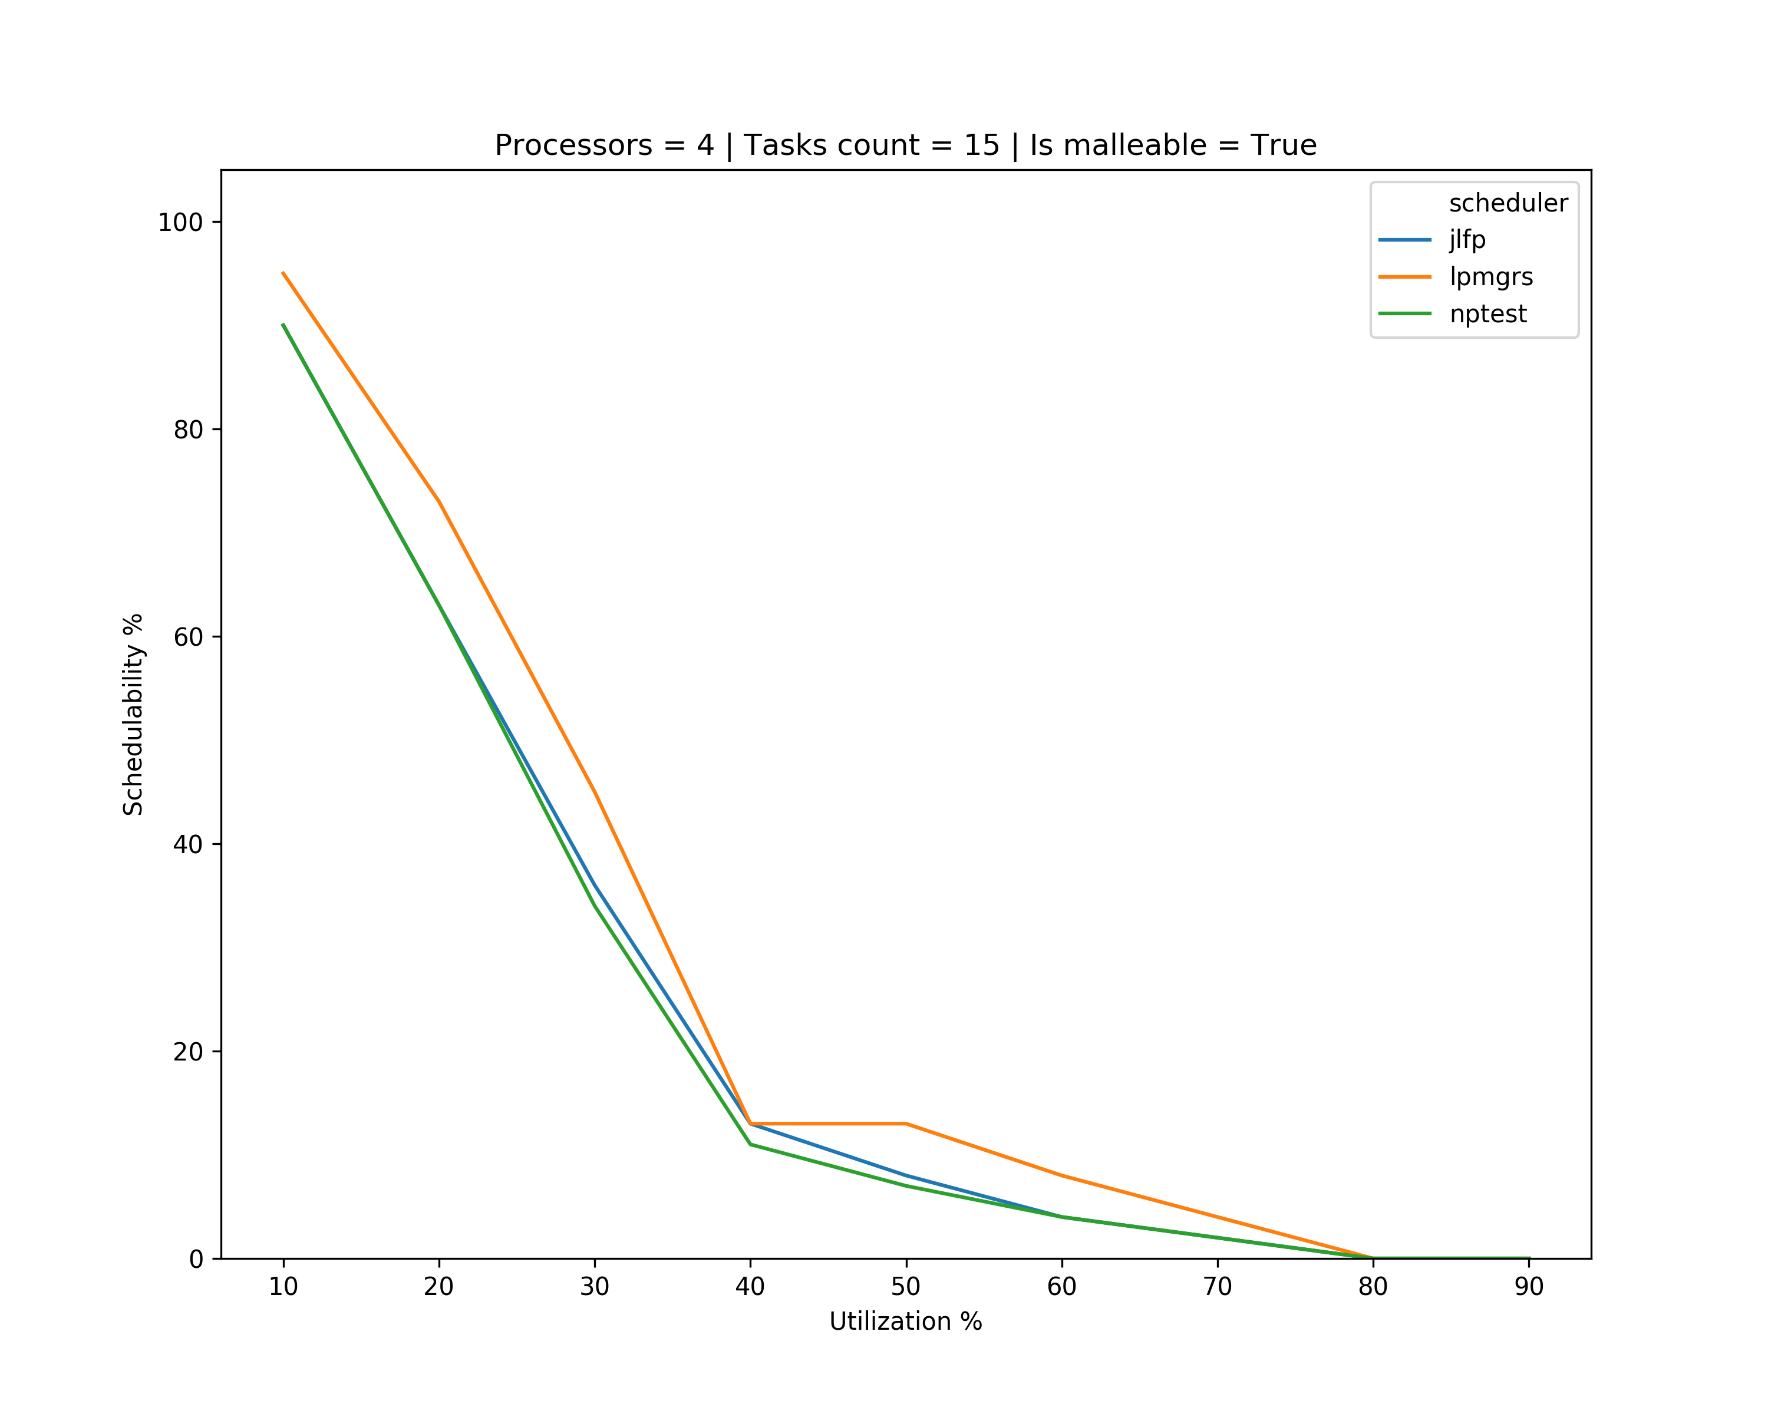
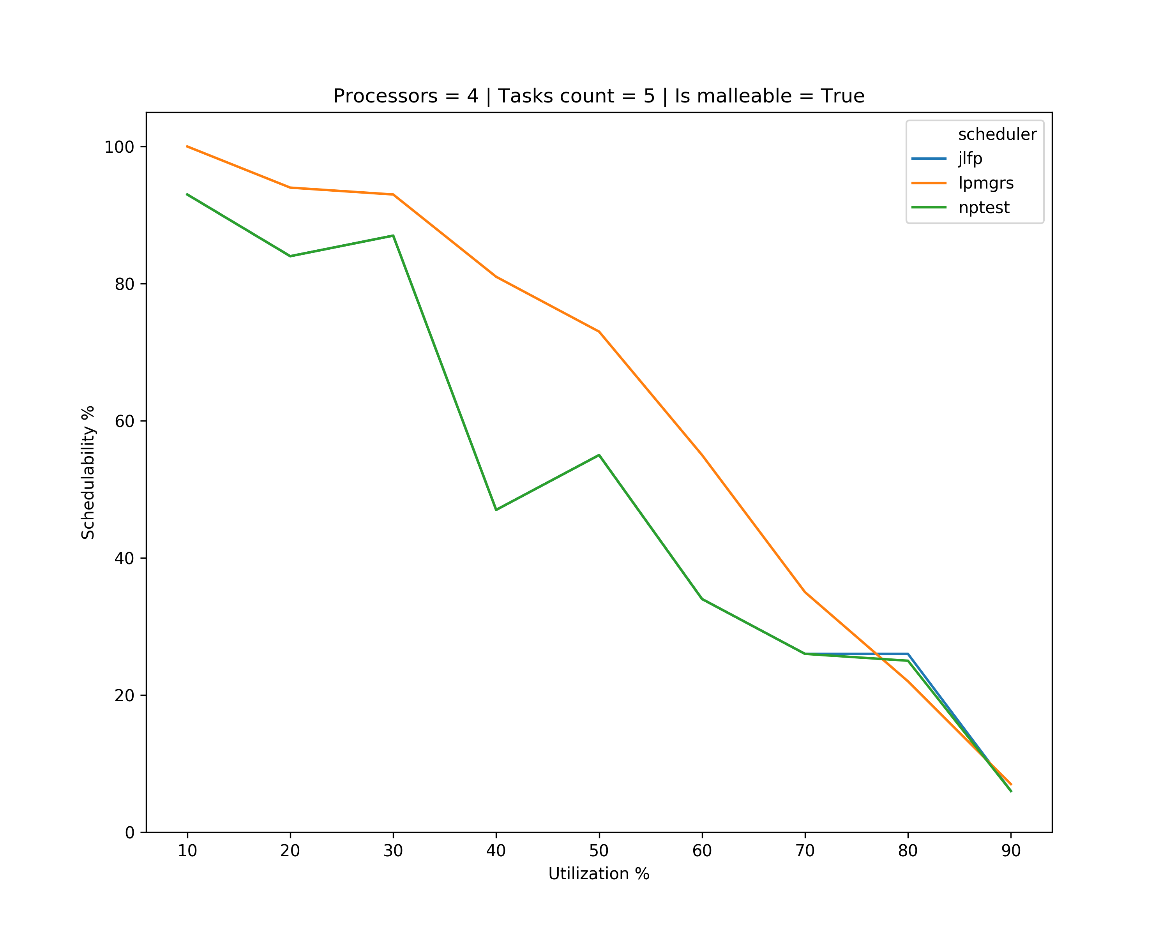
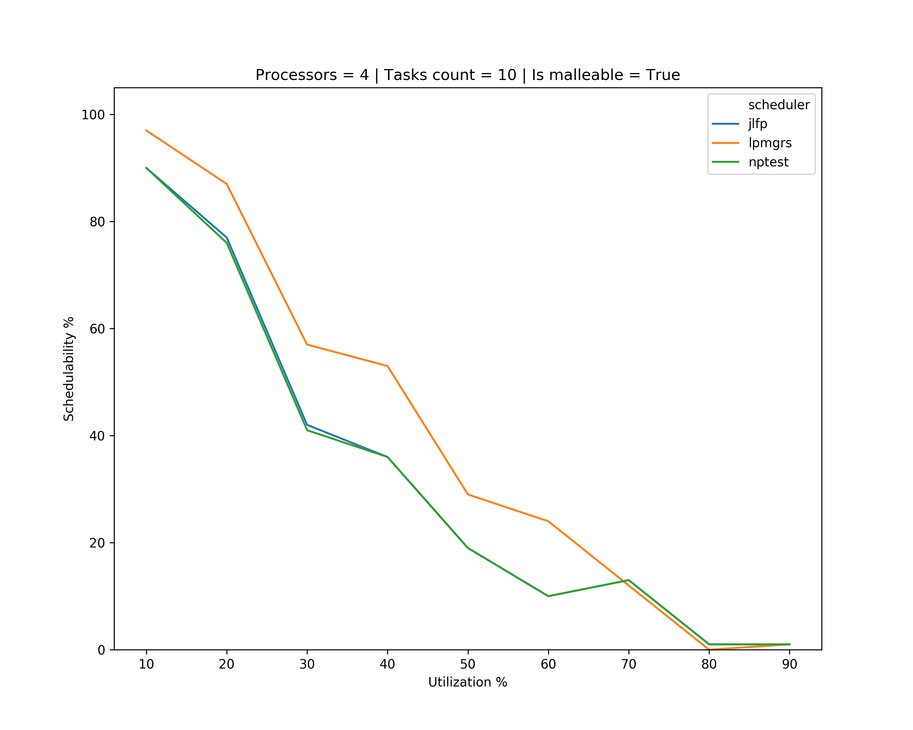
Results – single core max

Slide 15
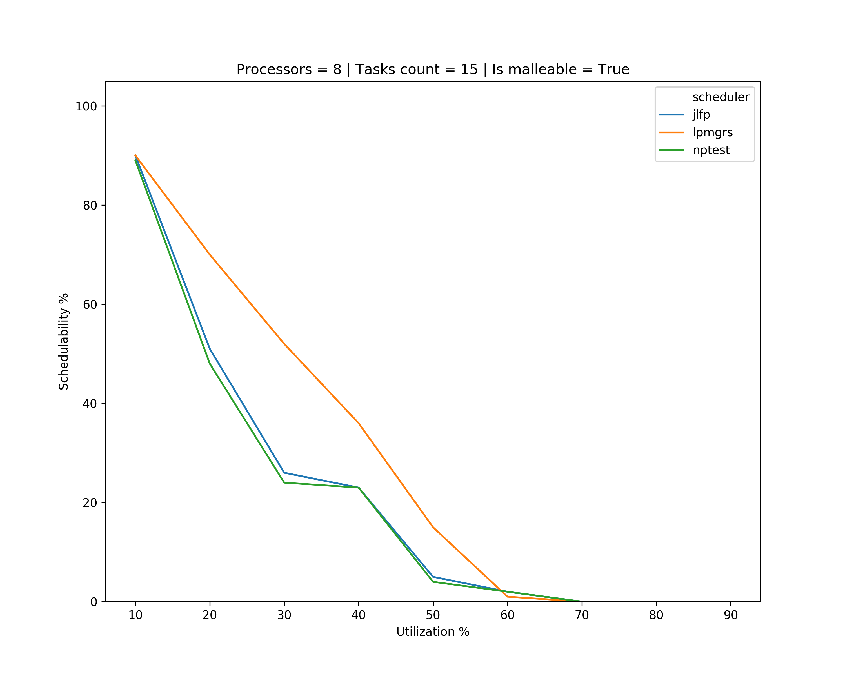
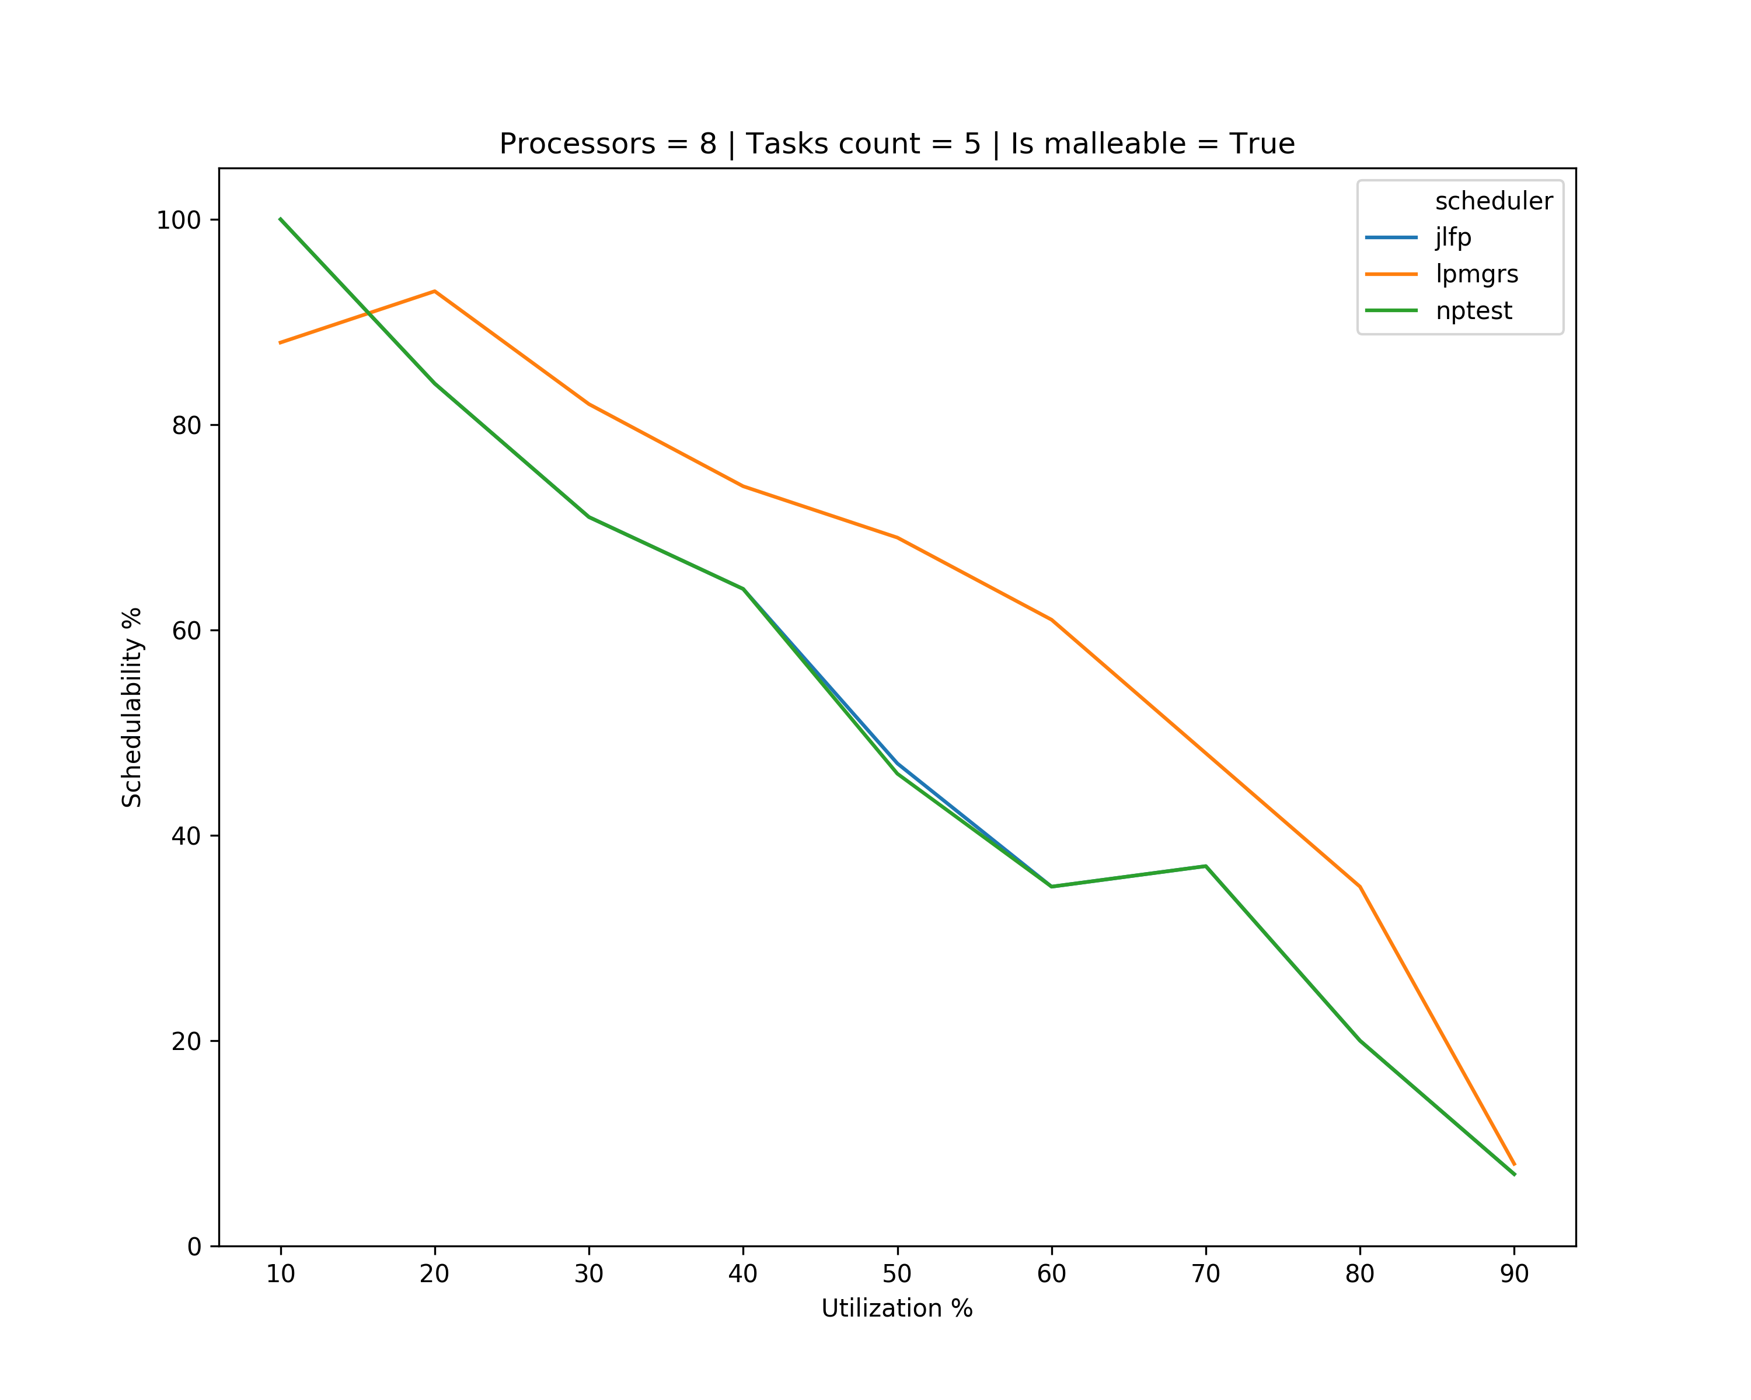
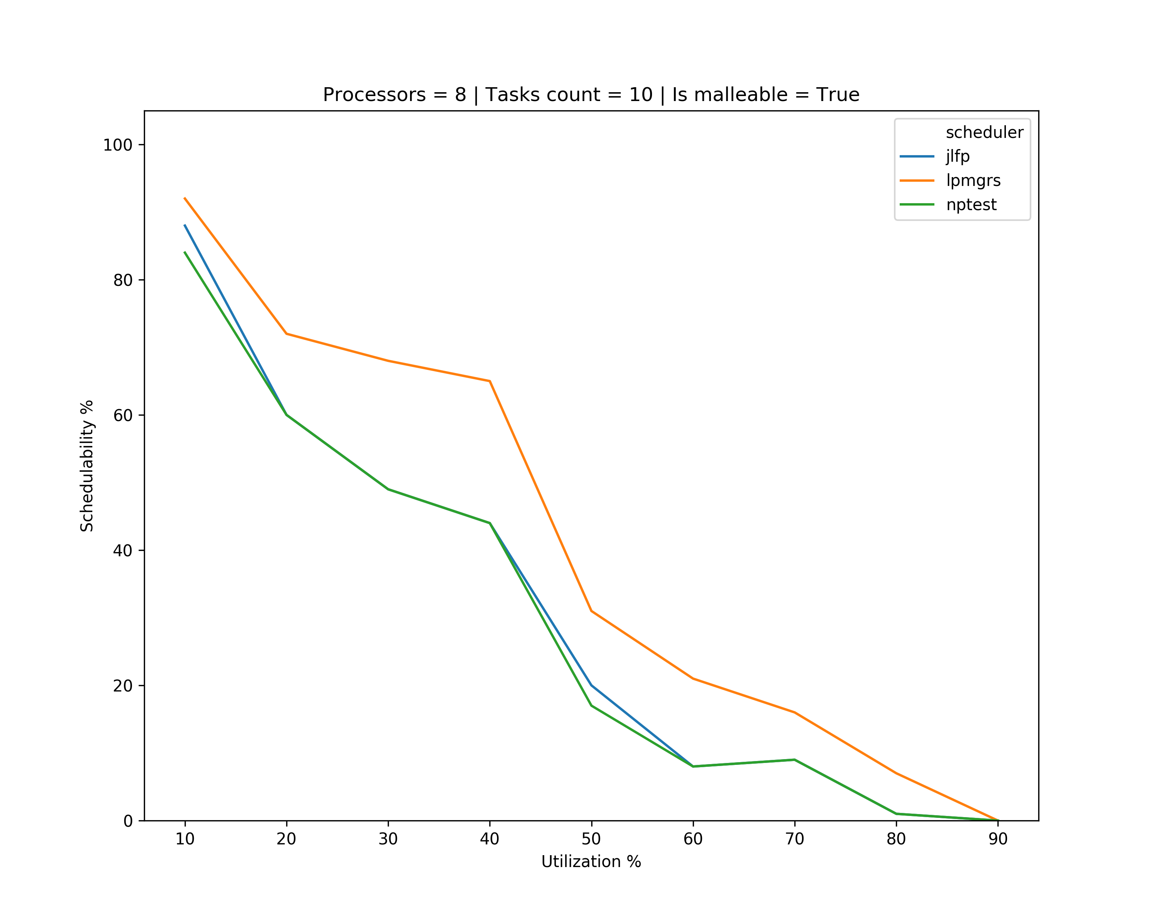
Results – single core max

Slide 16
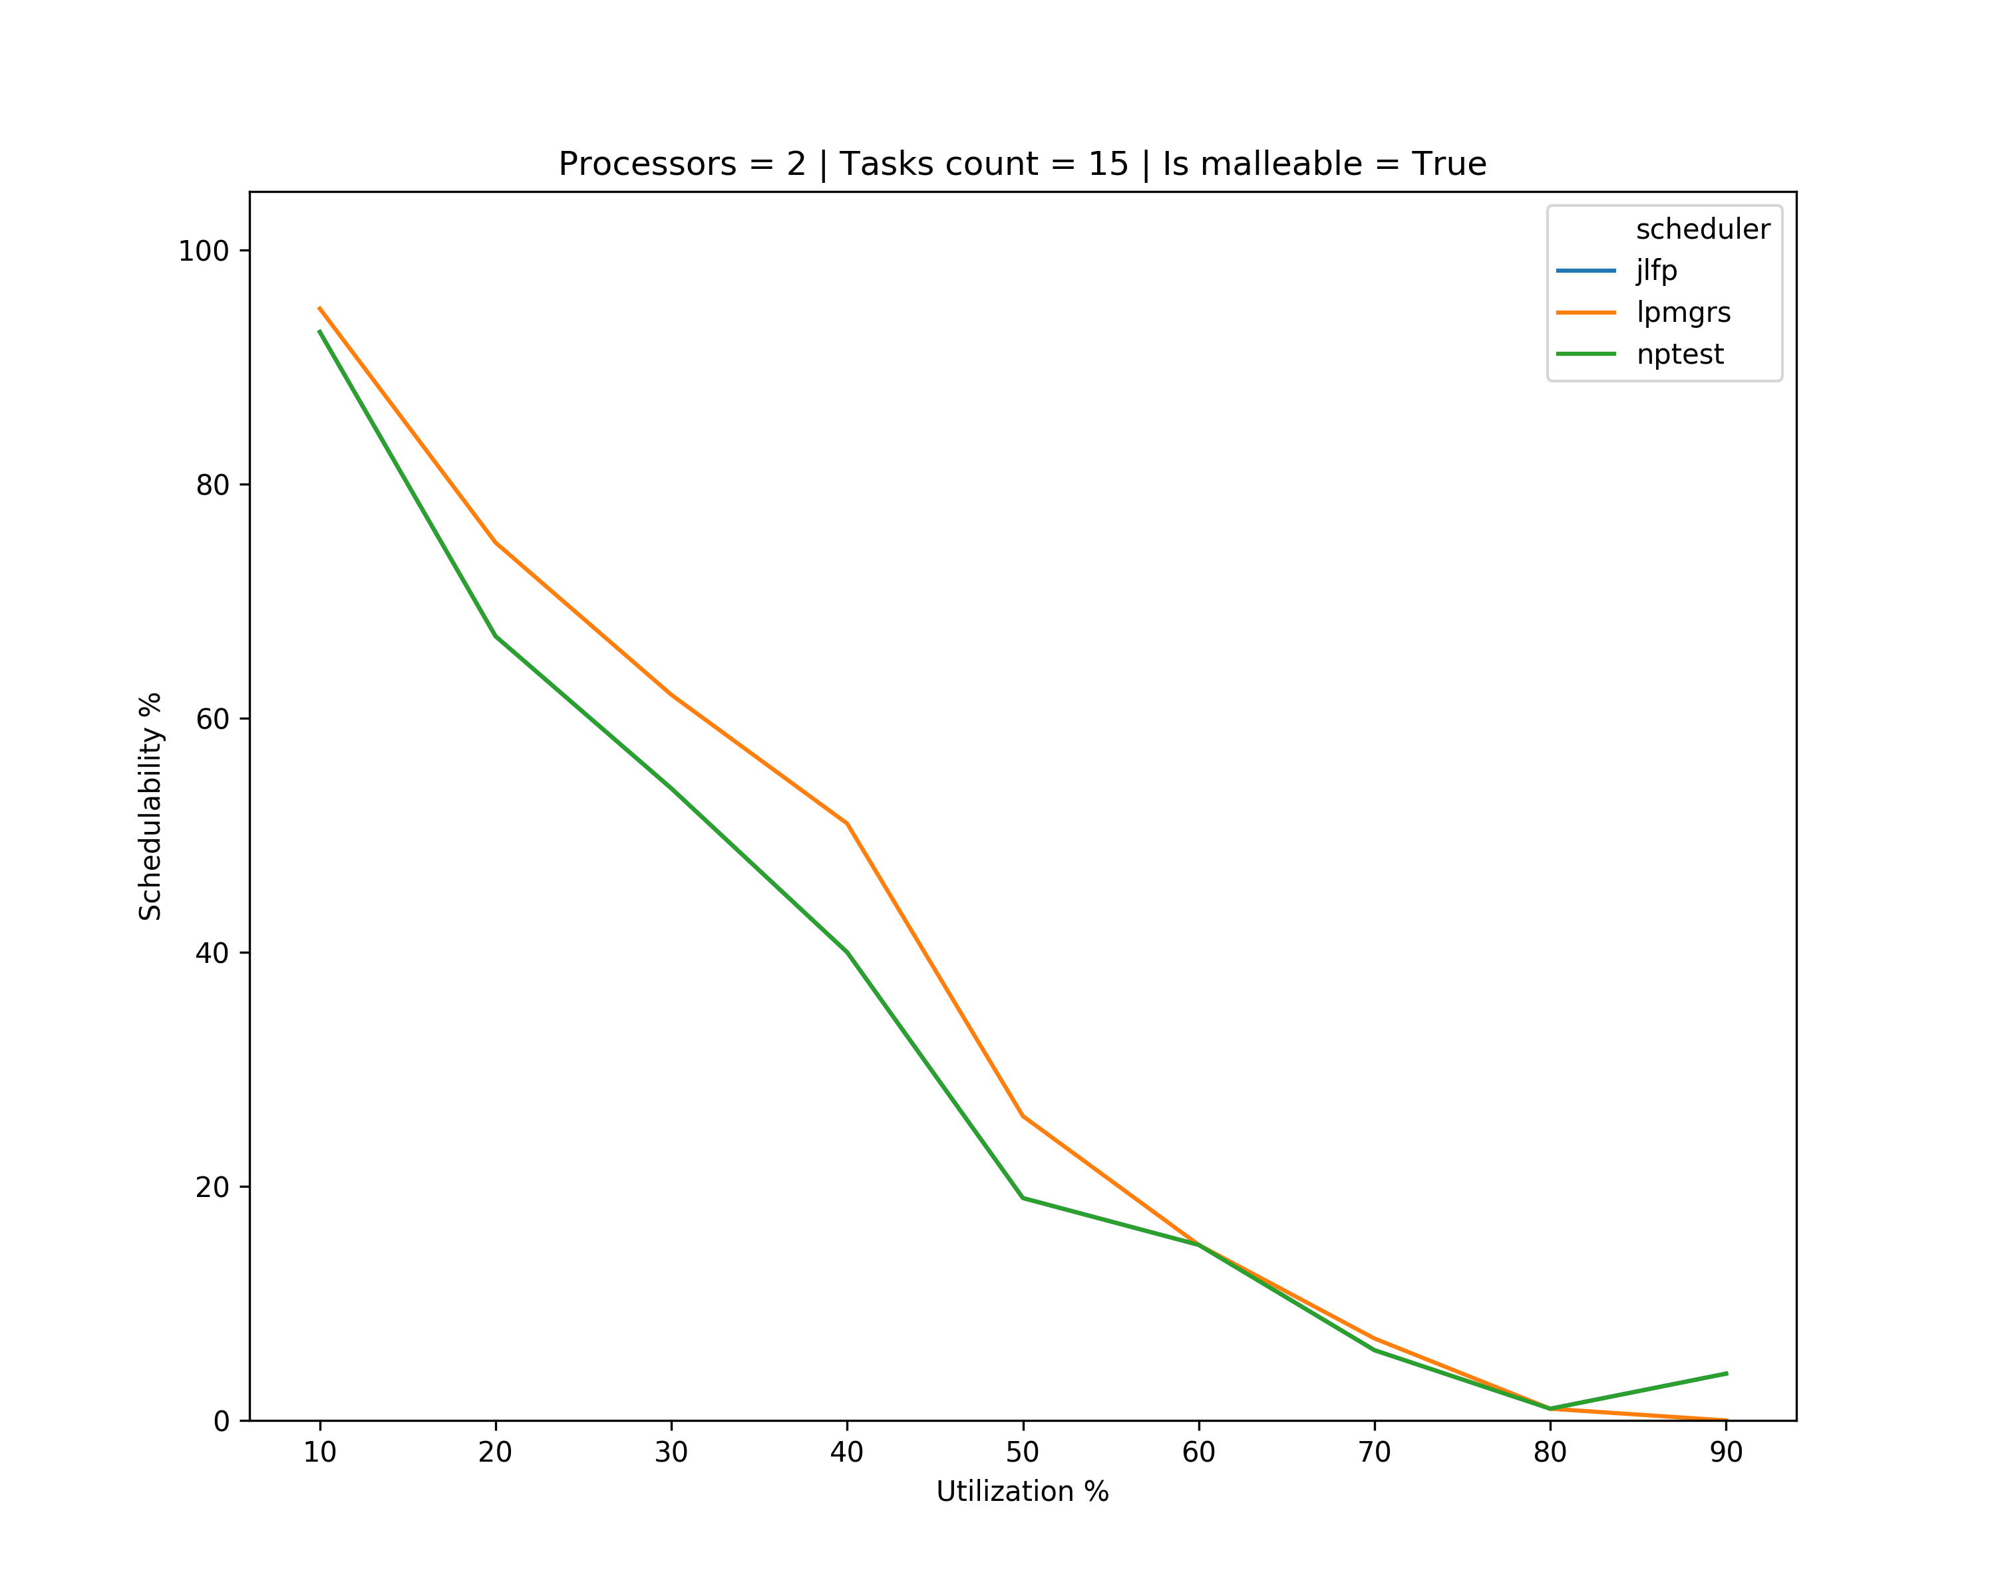
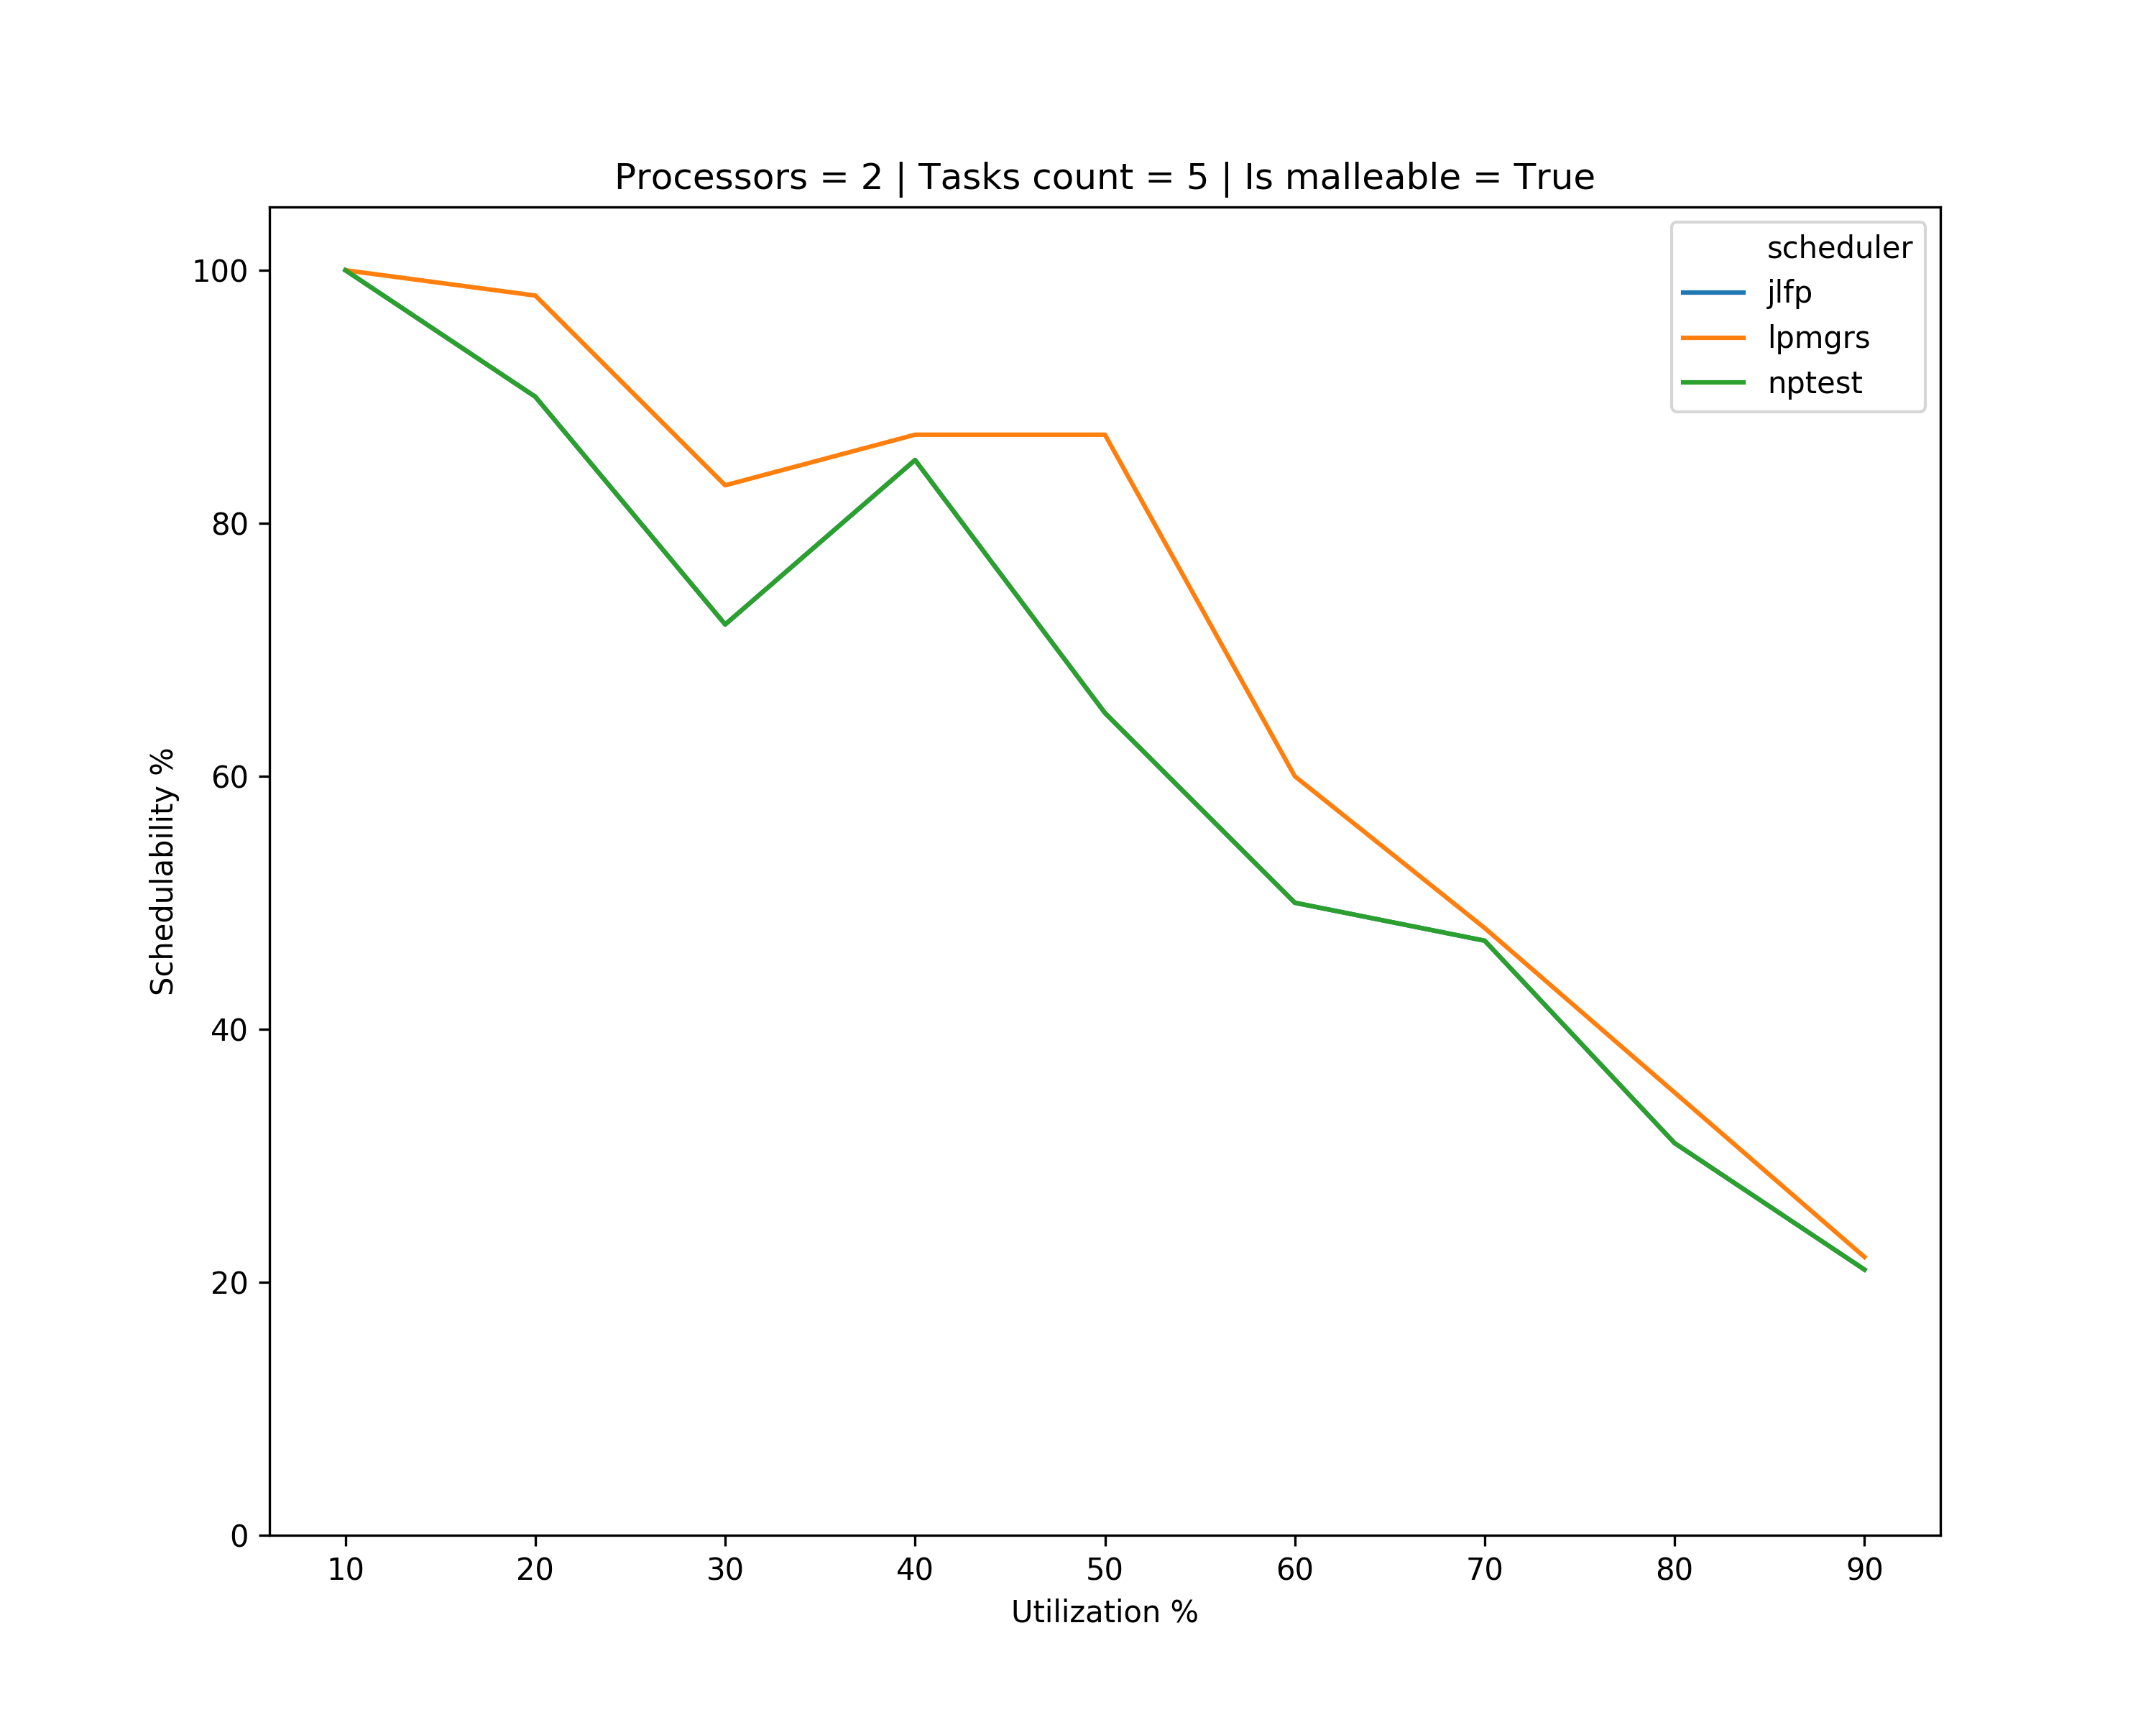
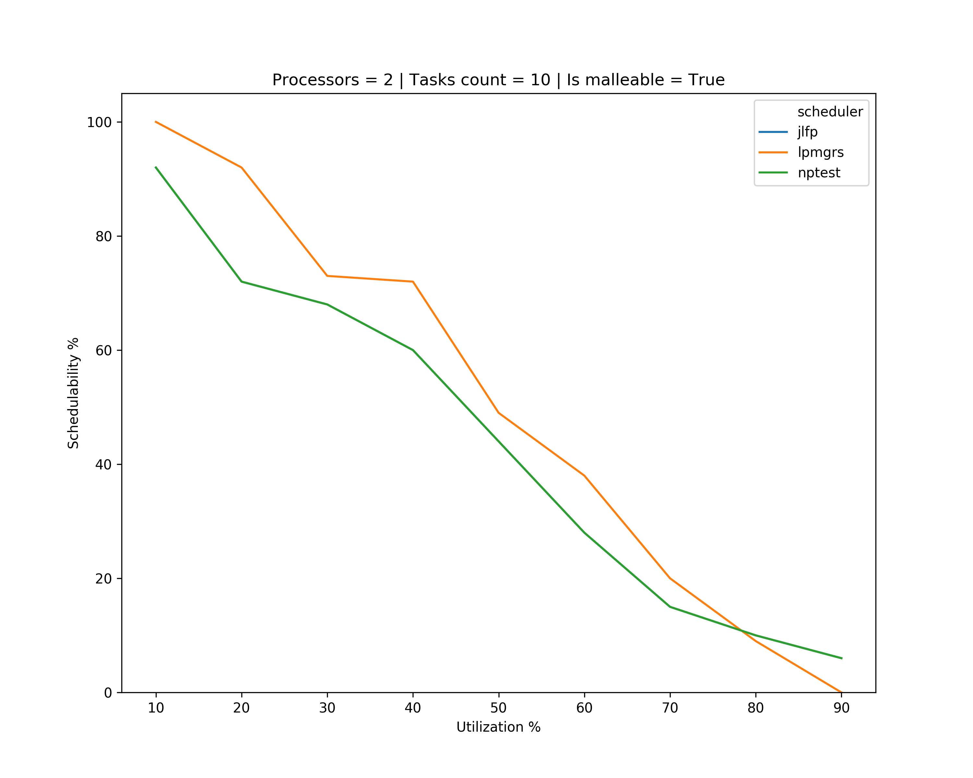
Results – minimum min

Slide 17
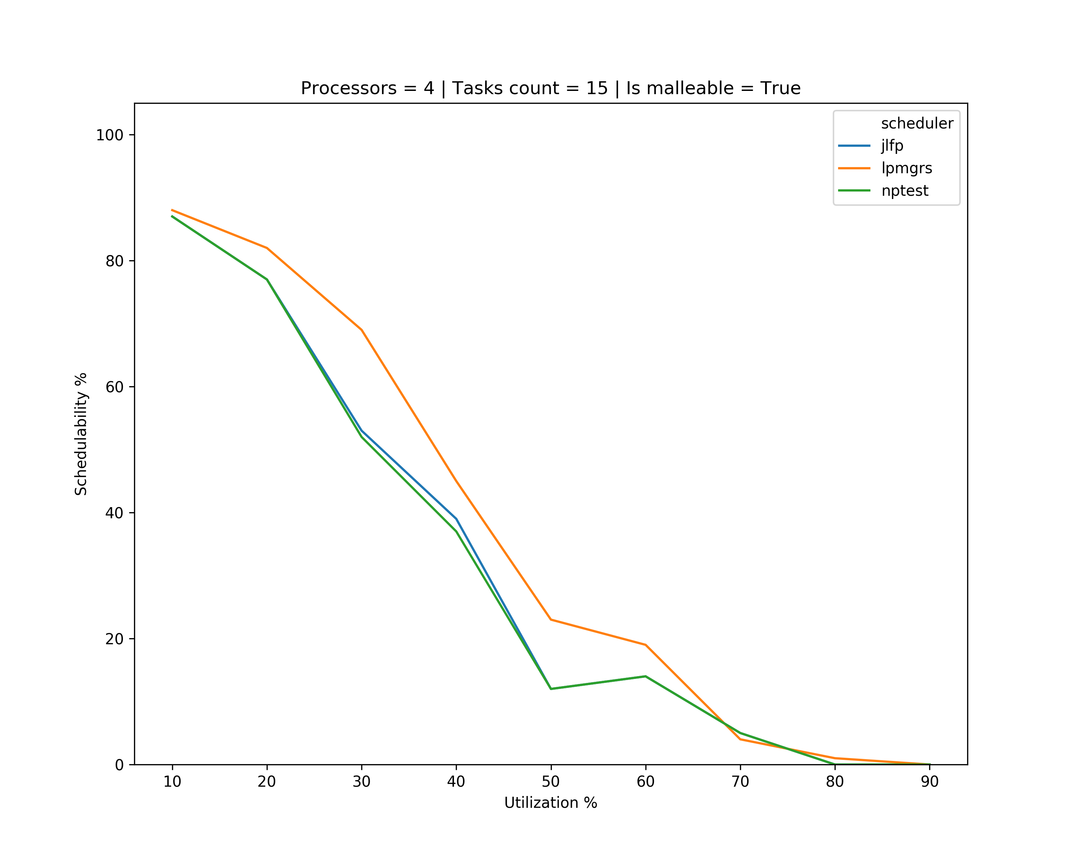
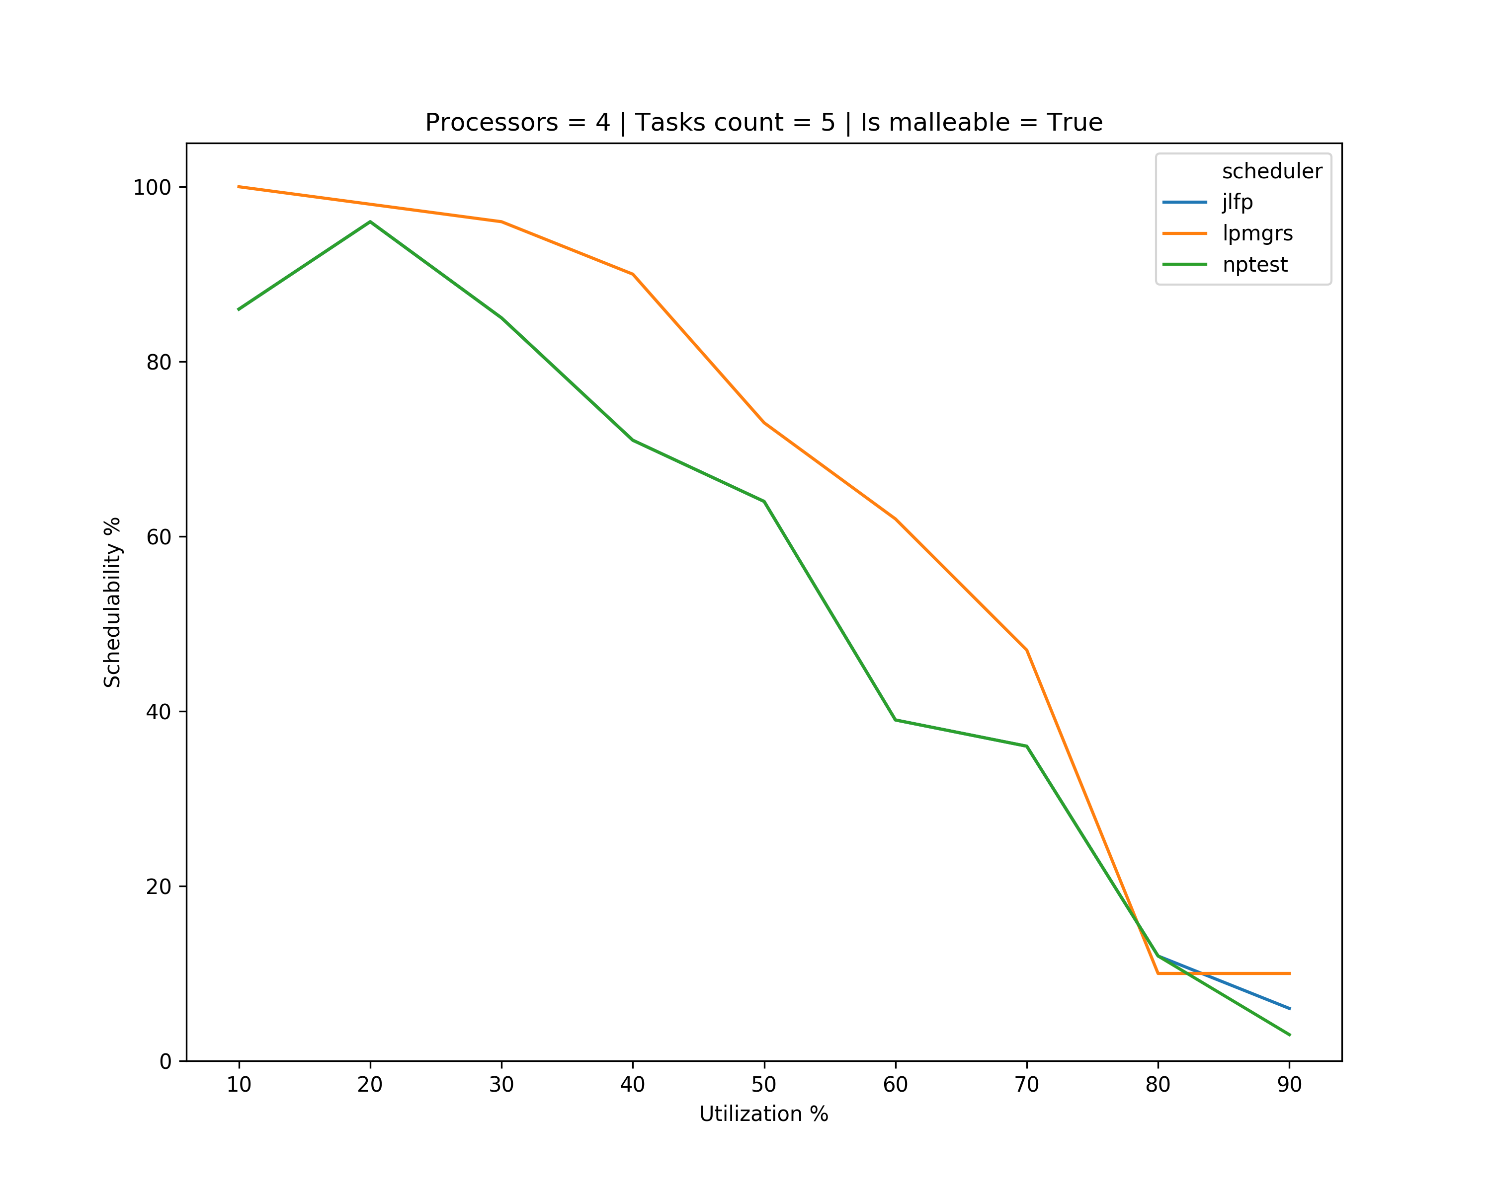
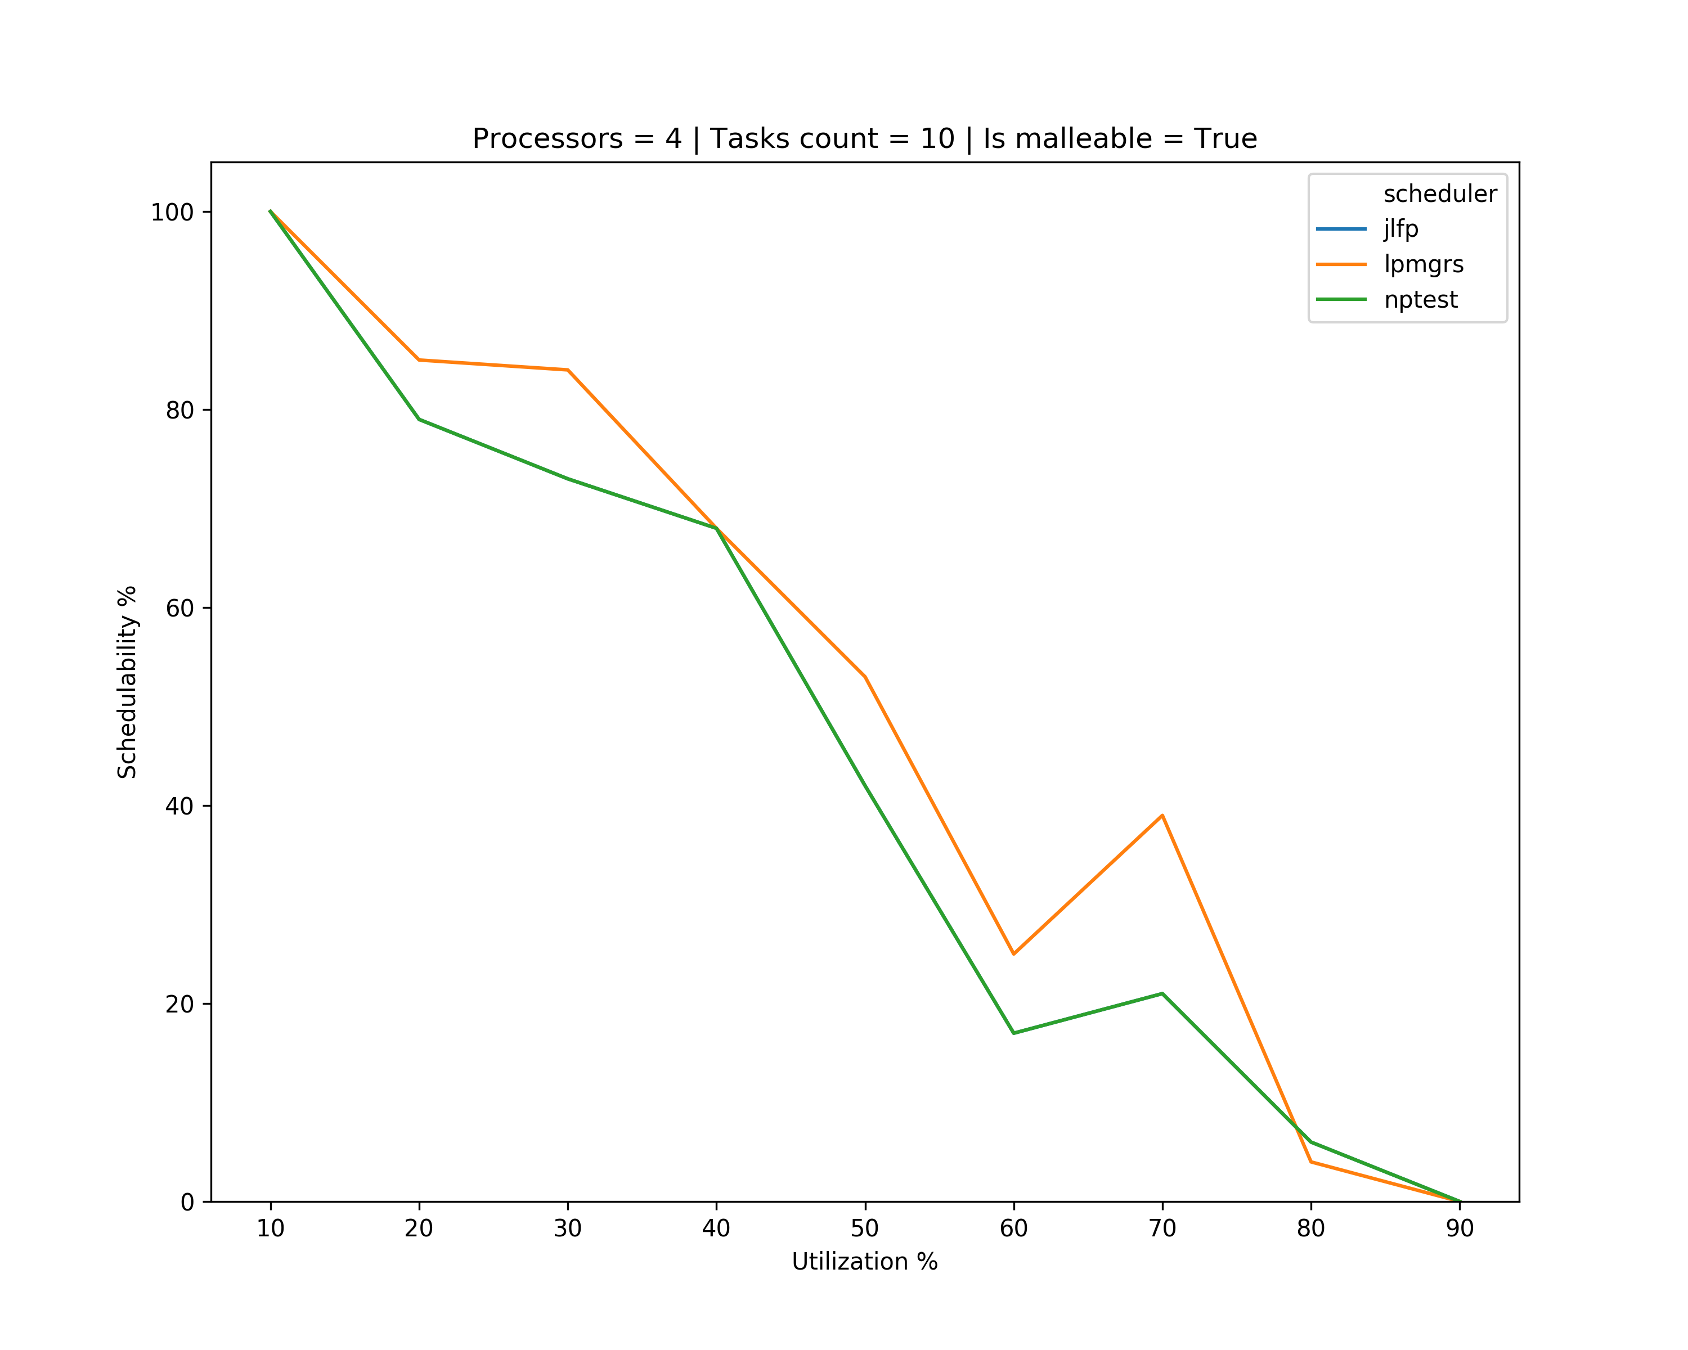
Results – minimum min

Slide 18
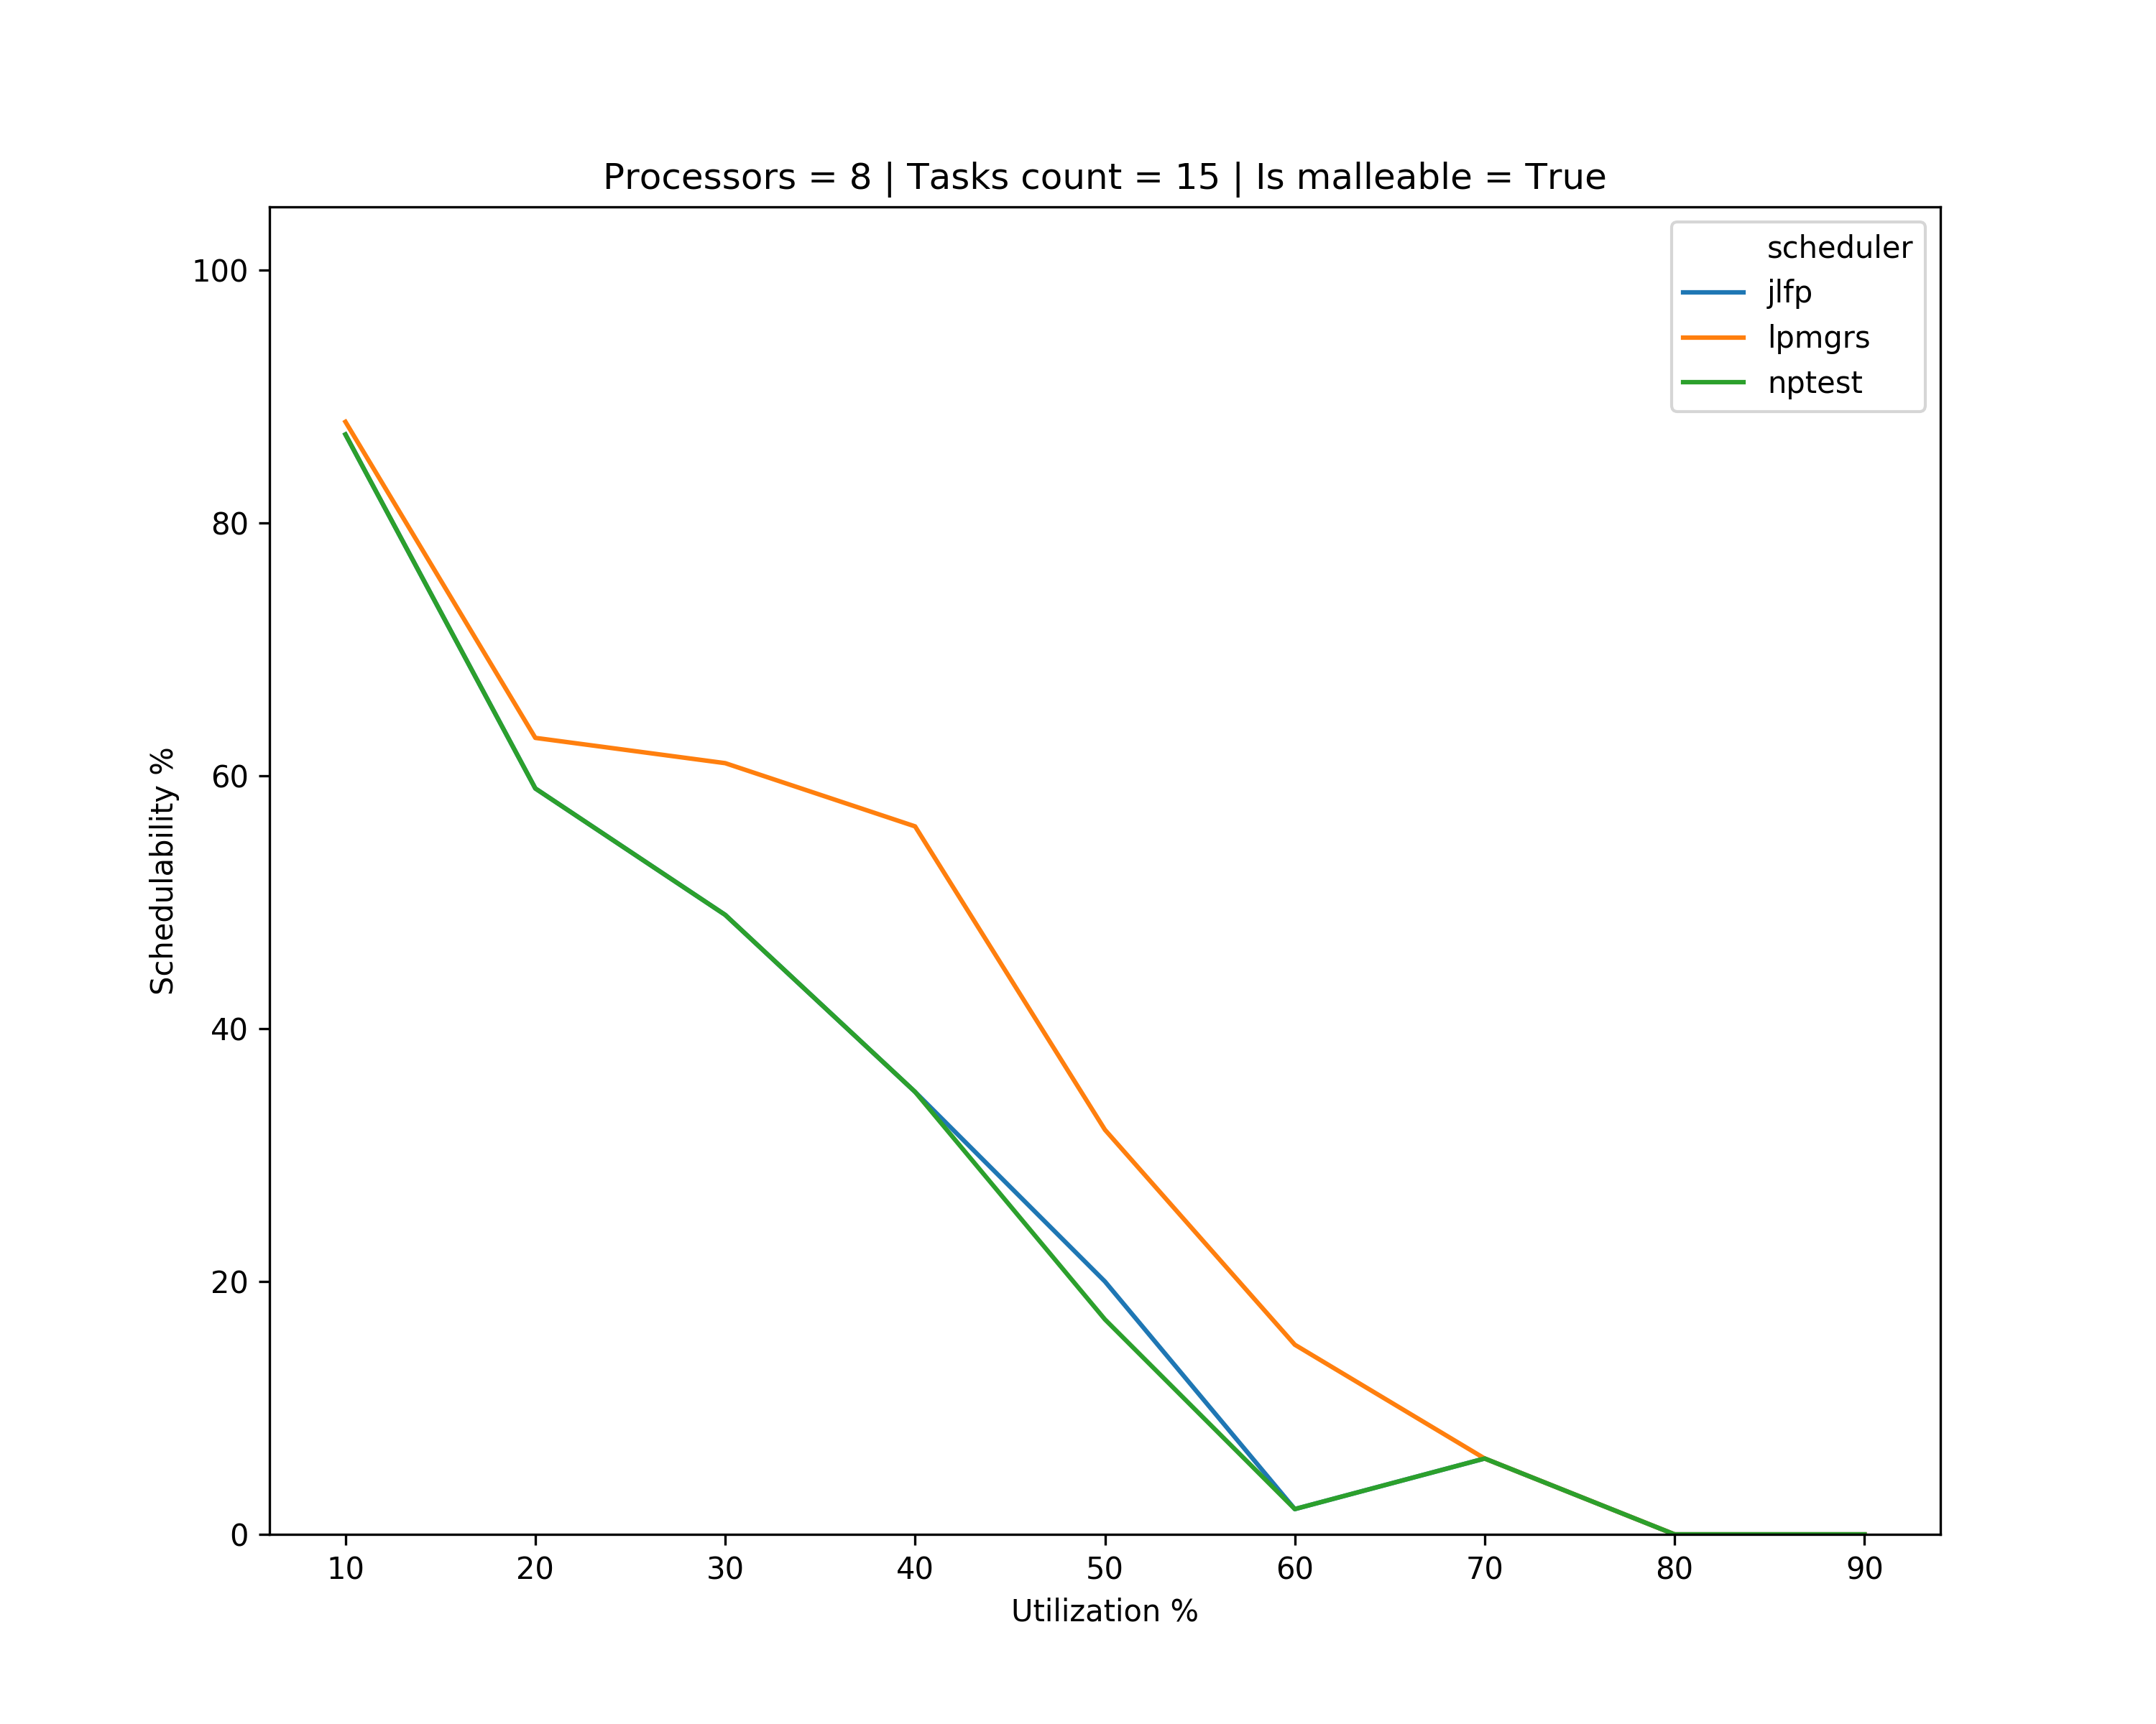
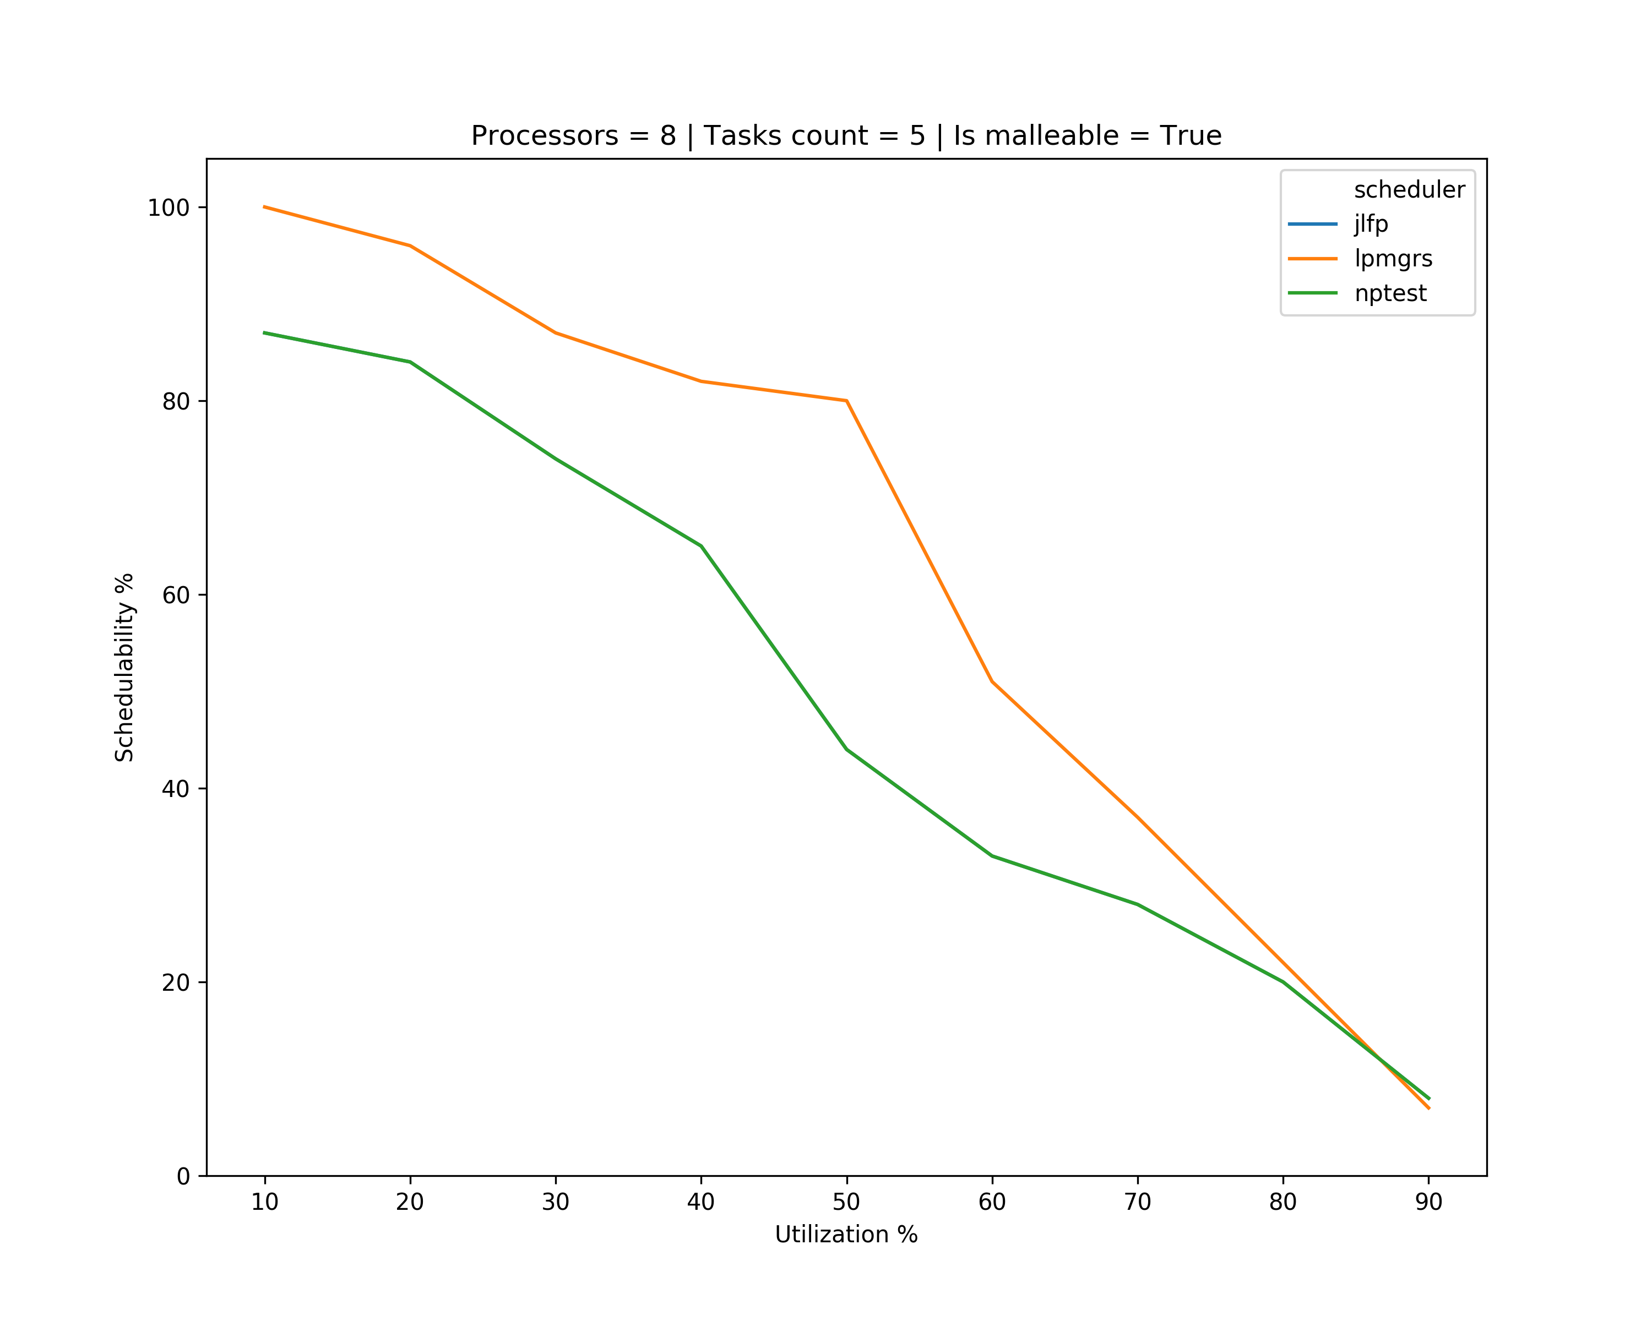
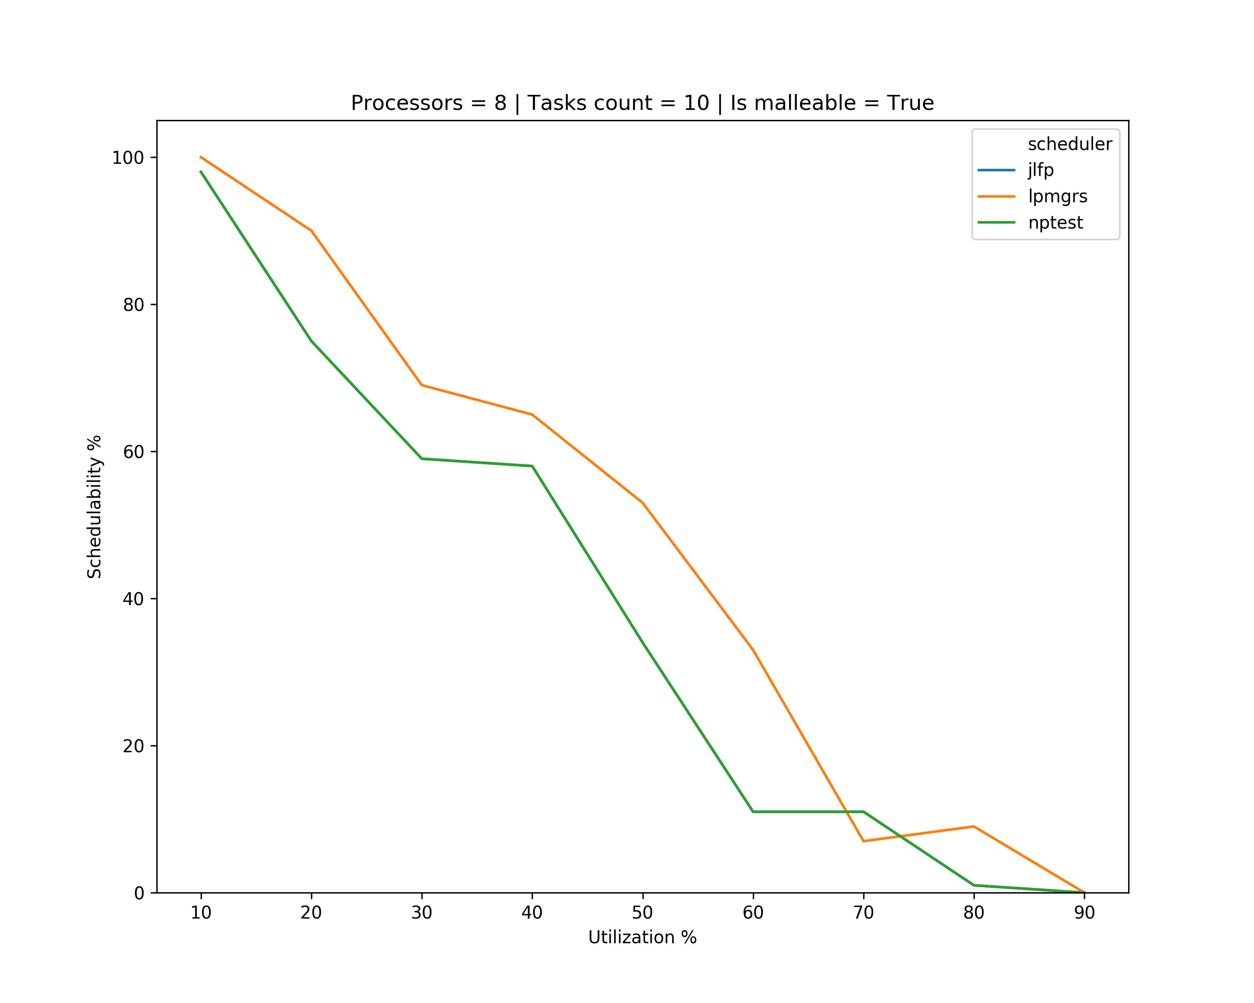
Results – minimum min

Slide 19
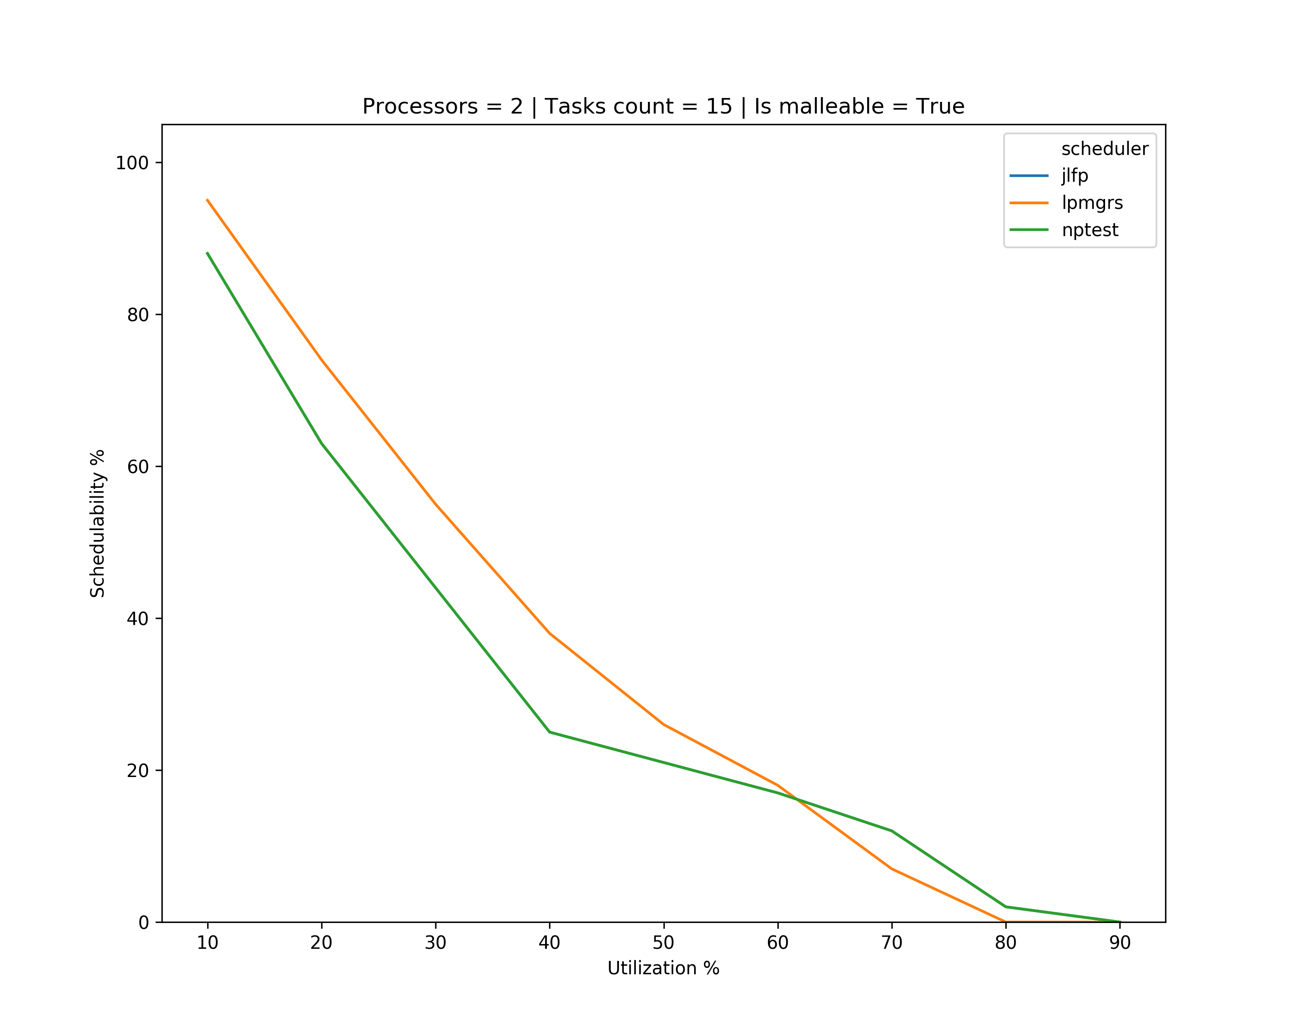
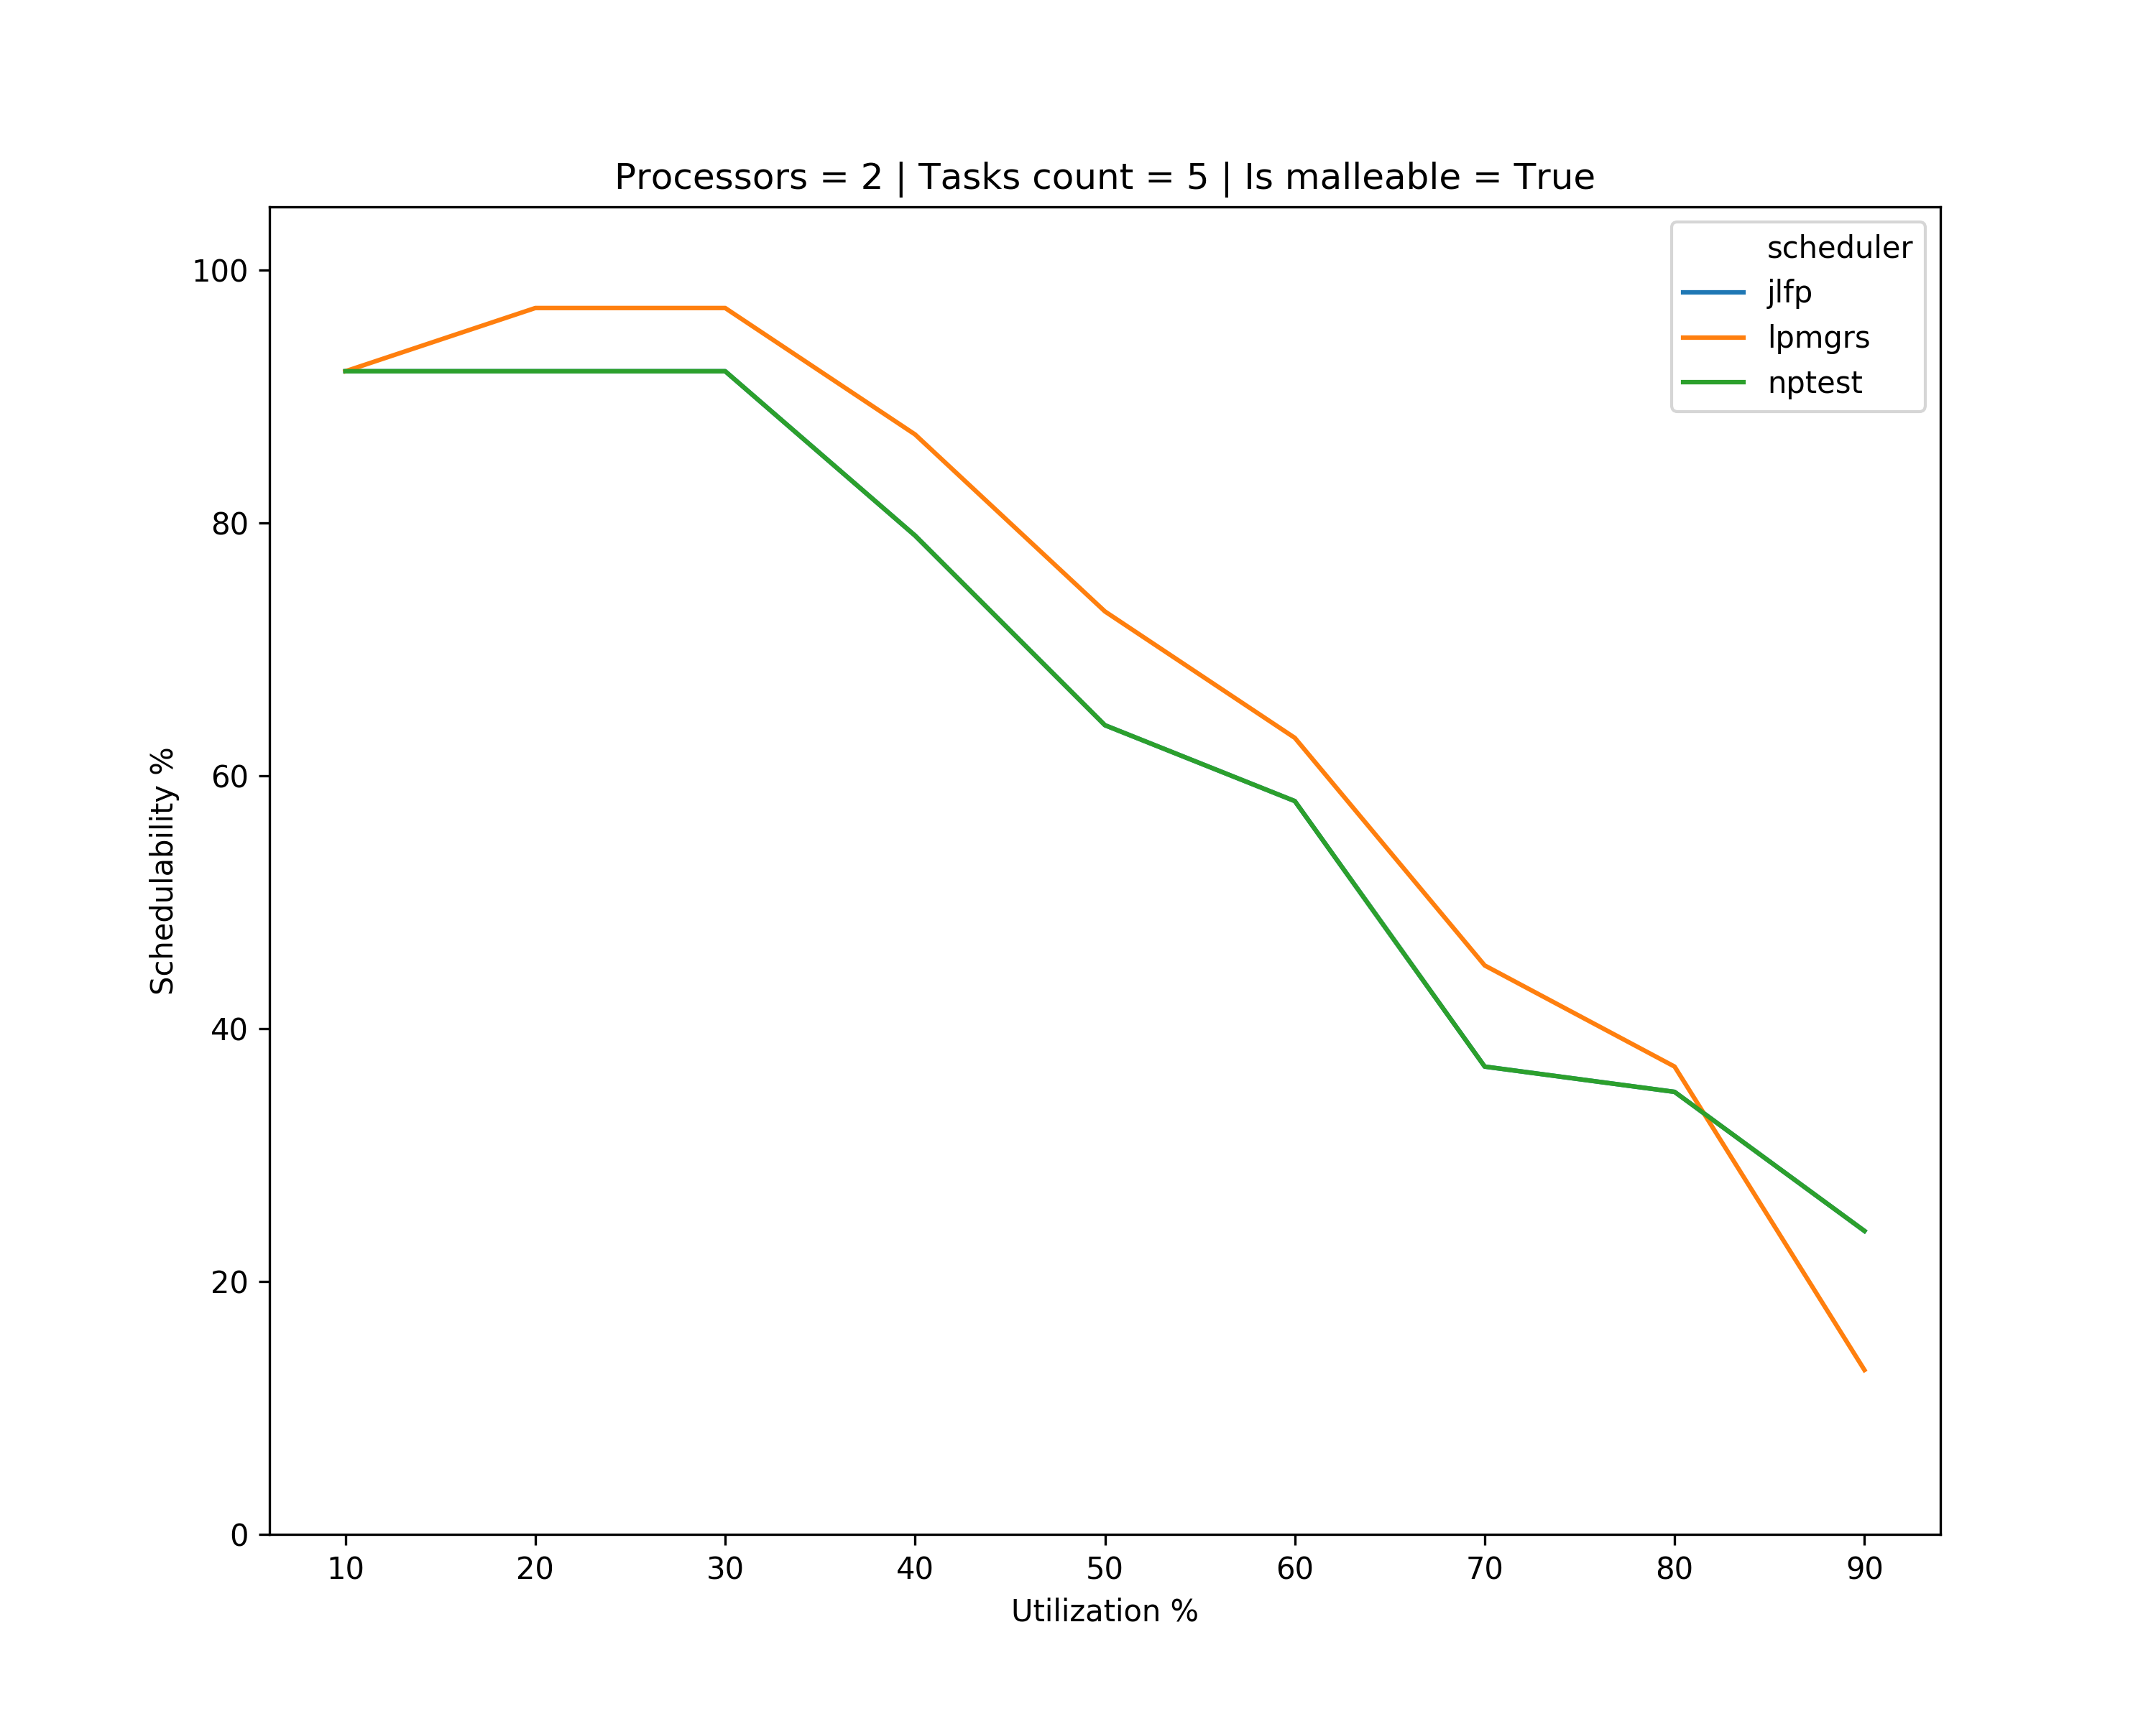
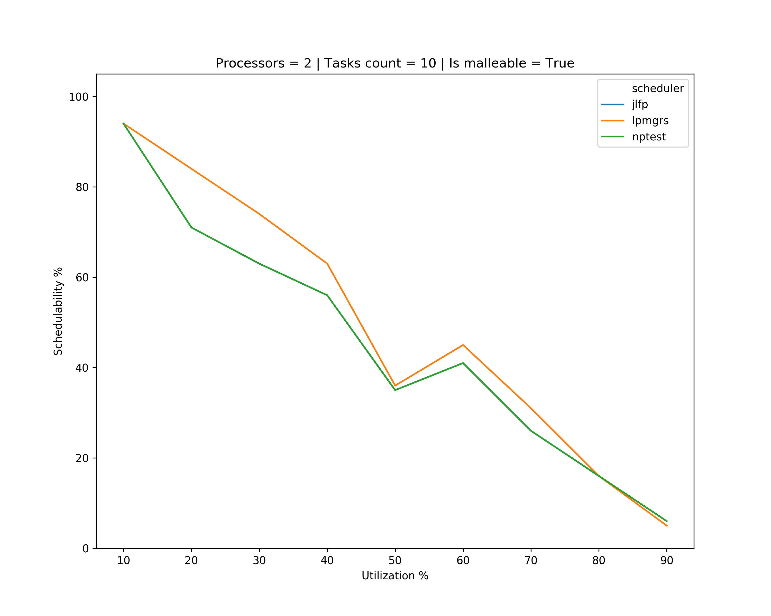
Results – minimum max

Slide 20
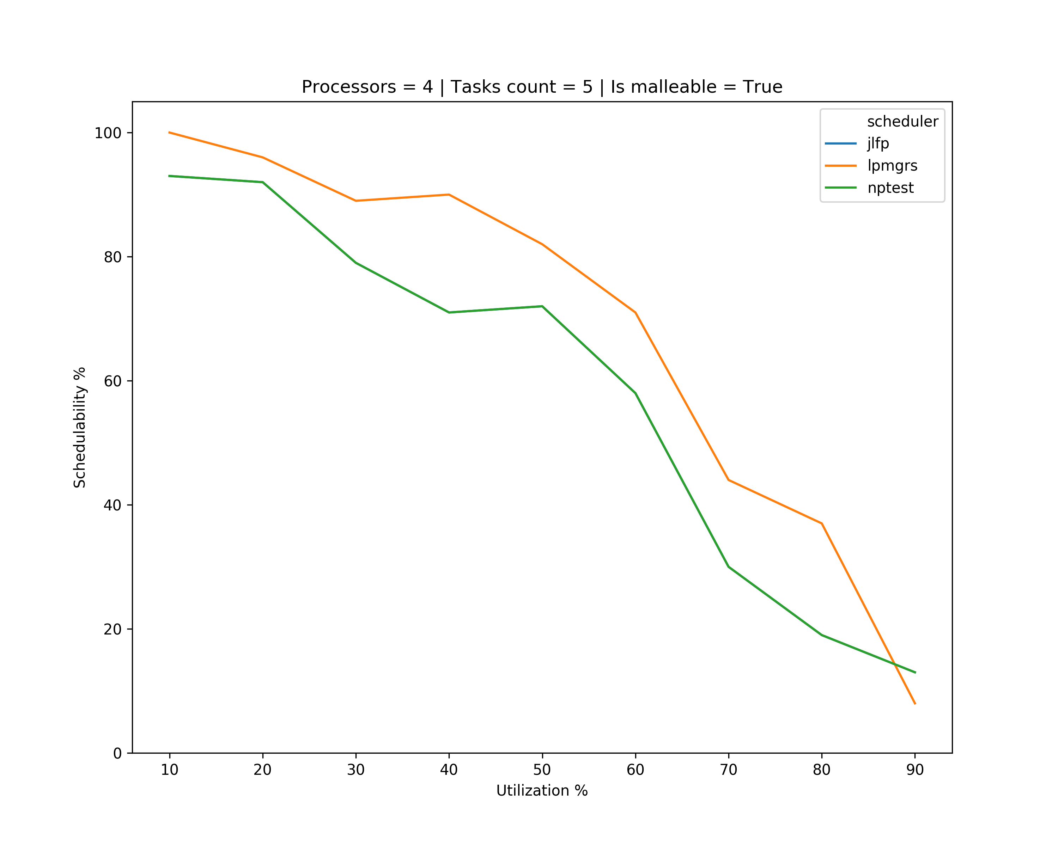
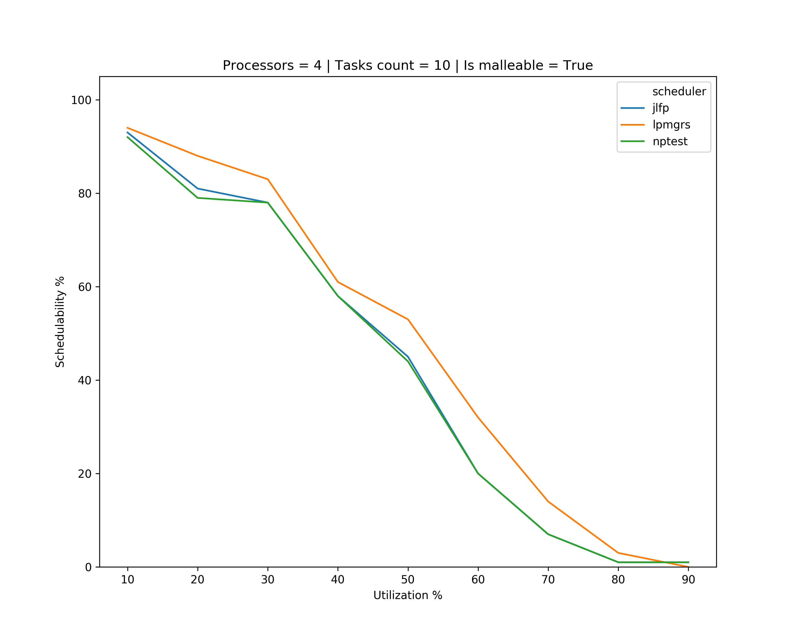
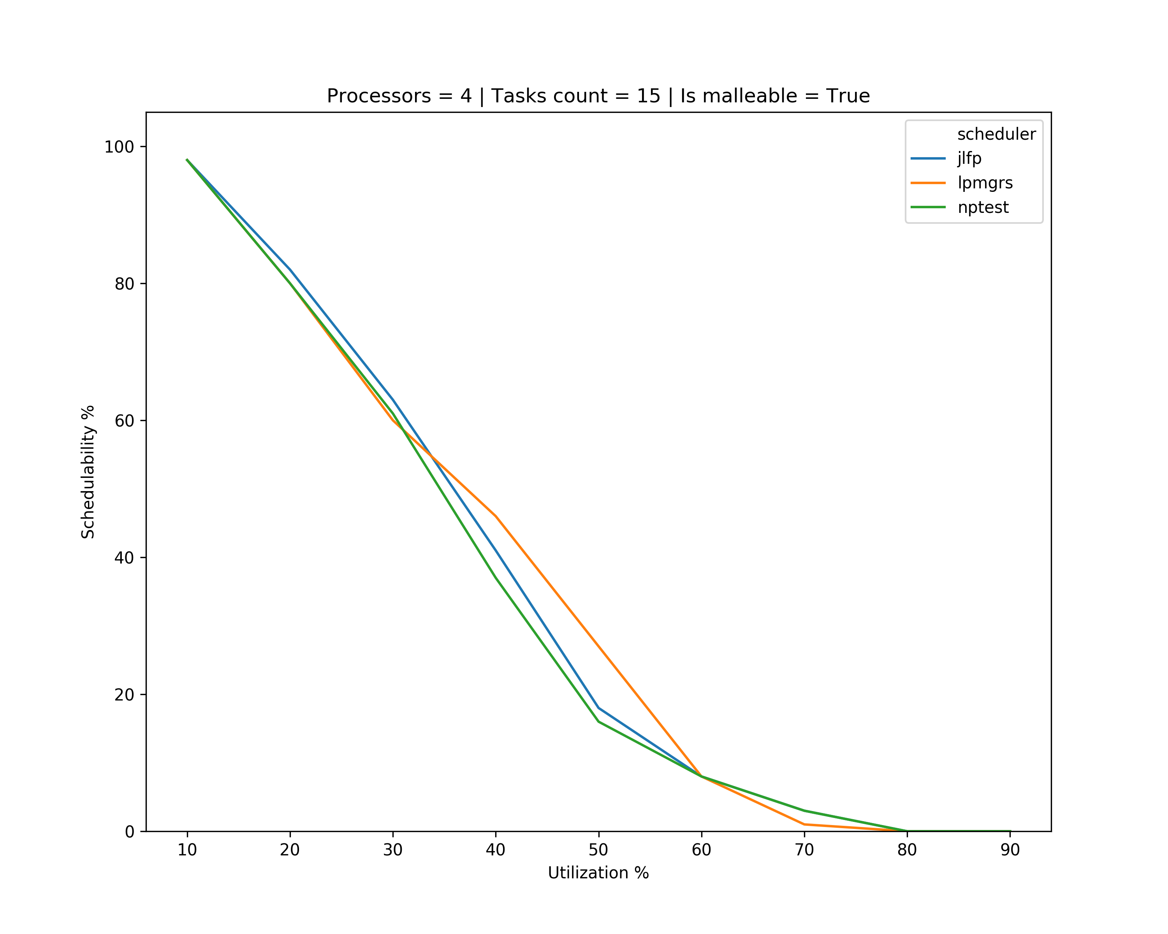
Results – minimum max

Slide 21
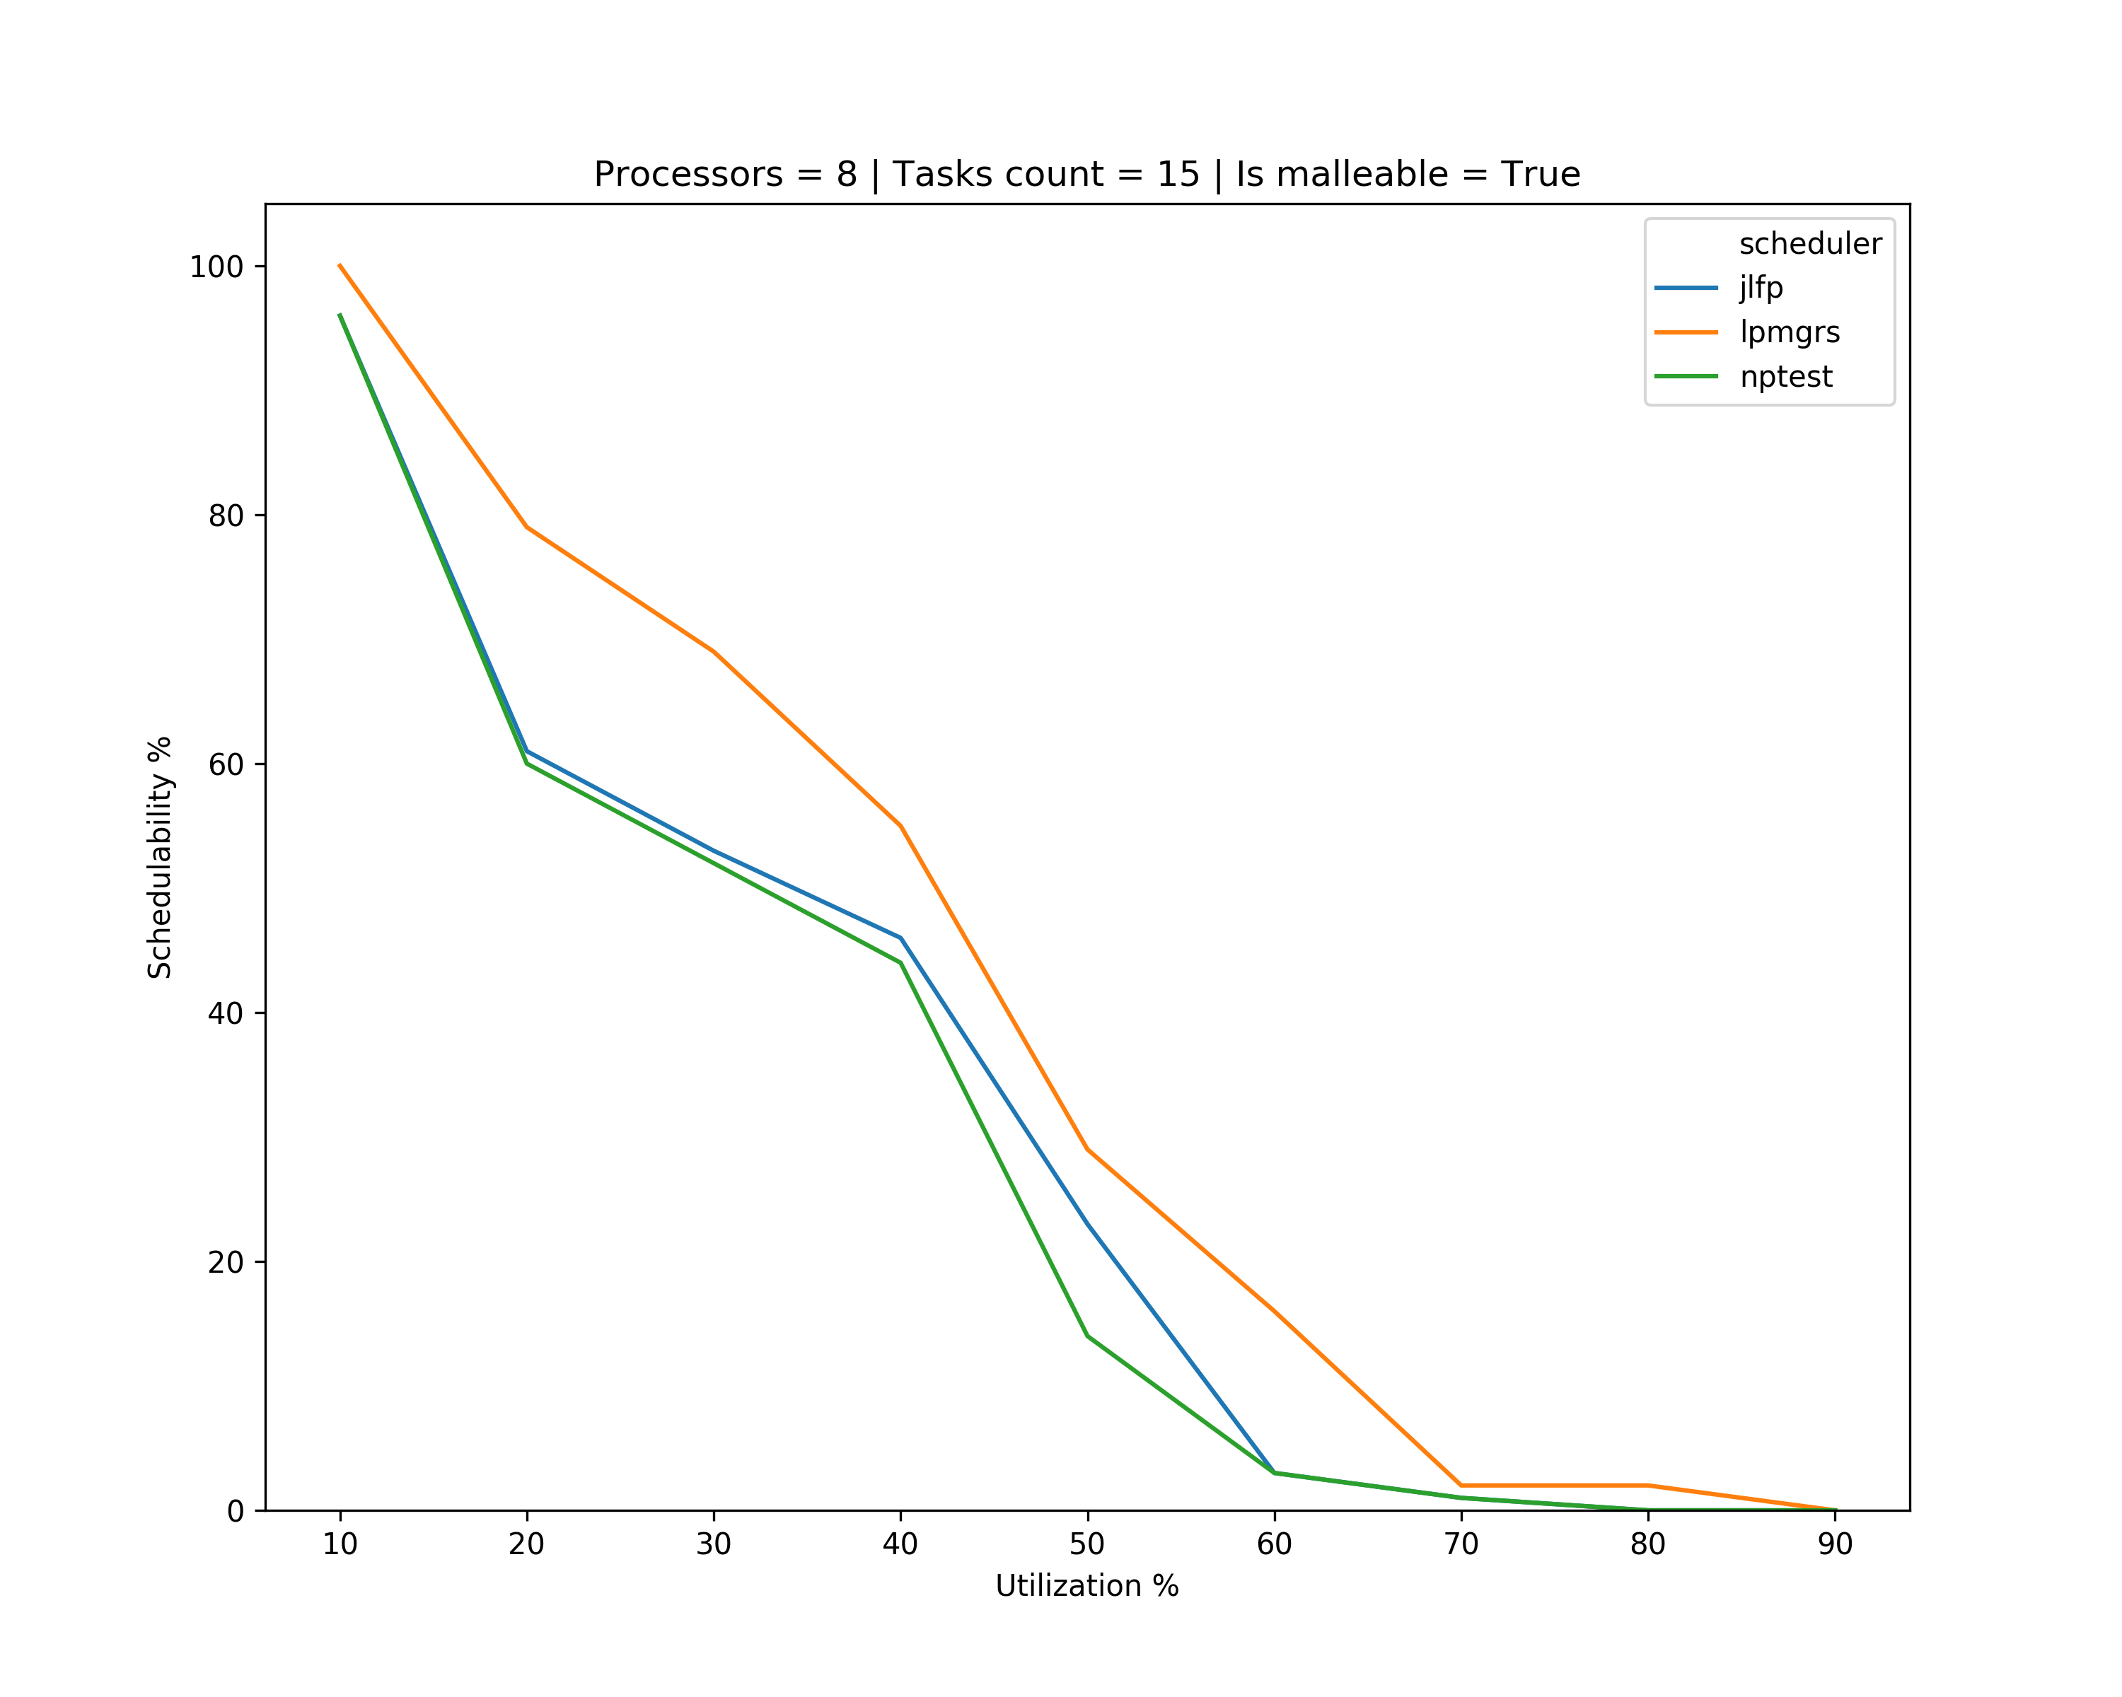
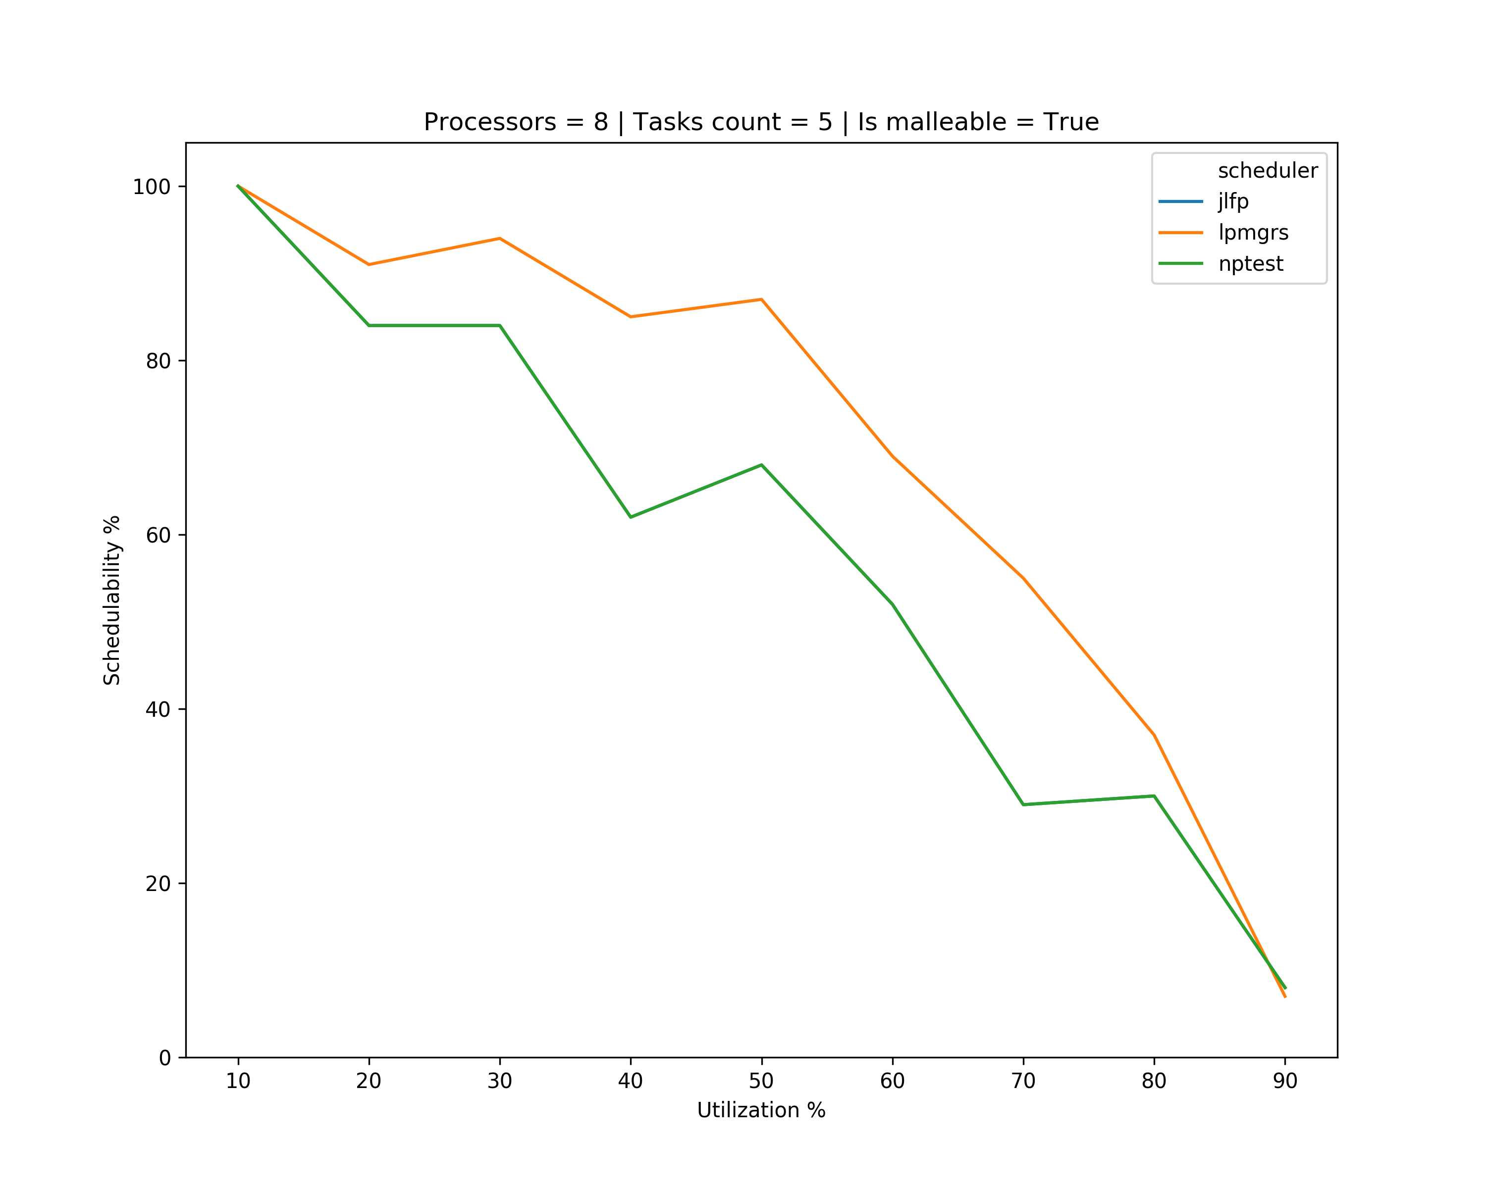
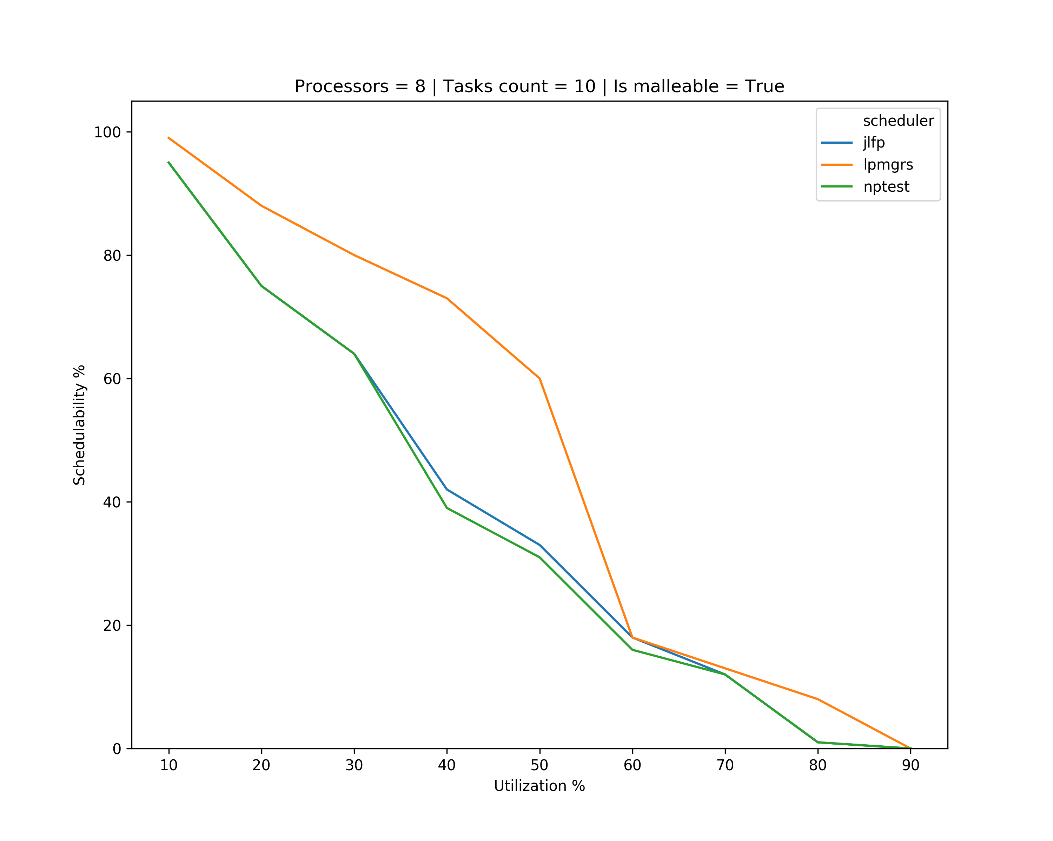
Results – minimum max

Slide 22
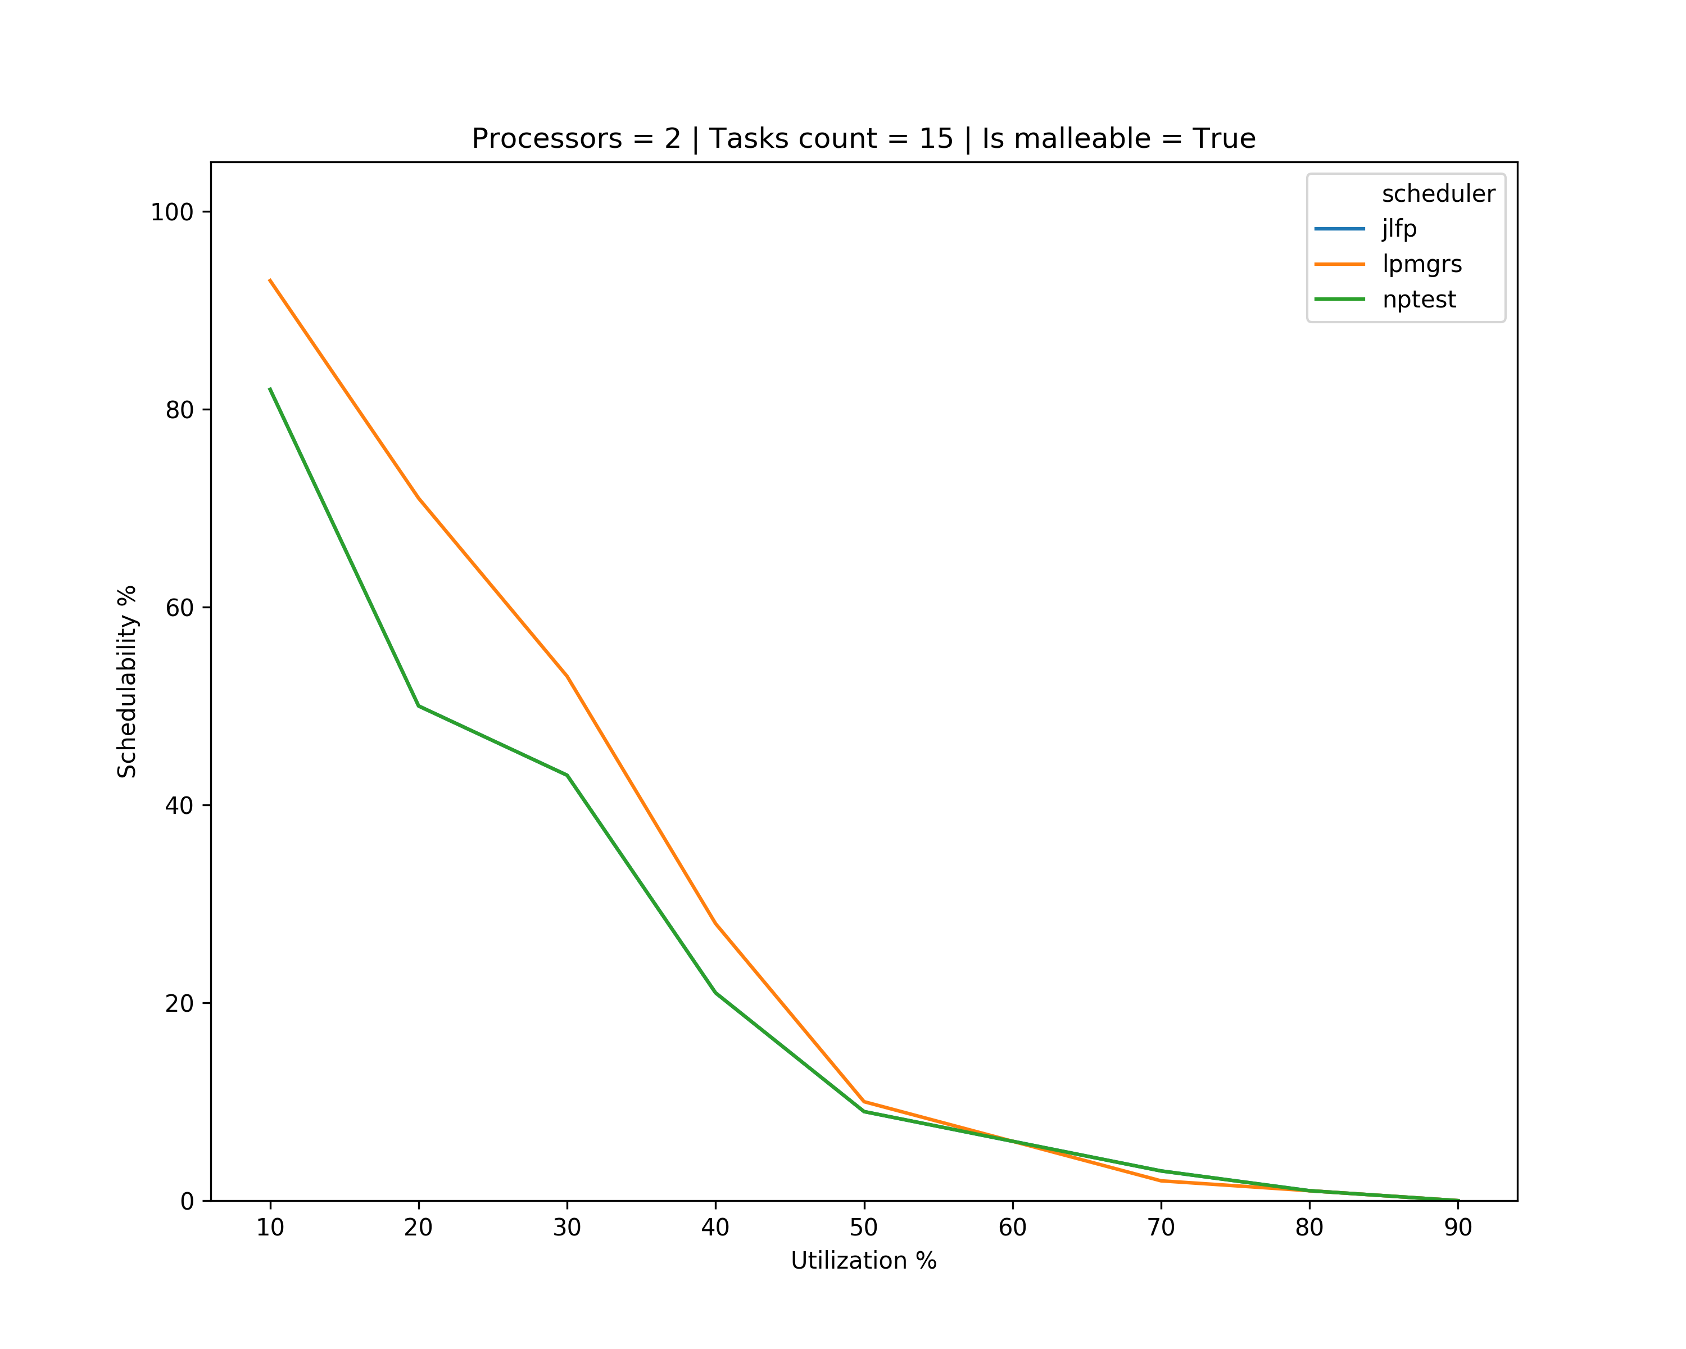
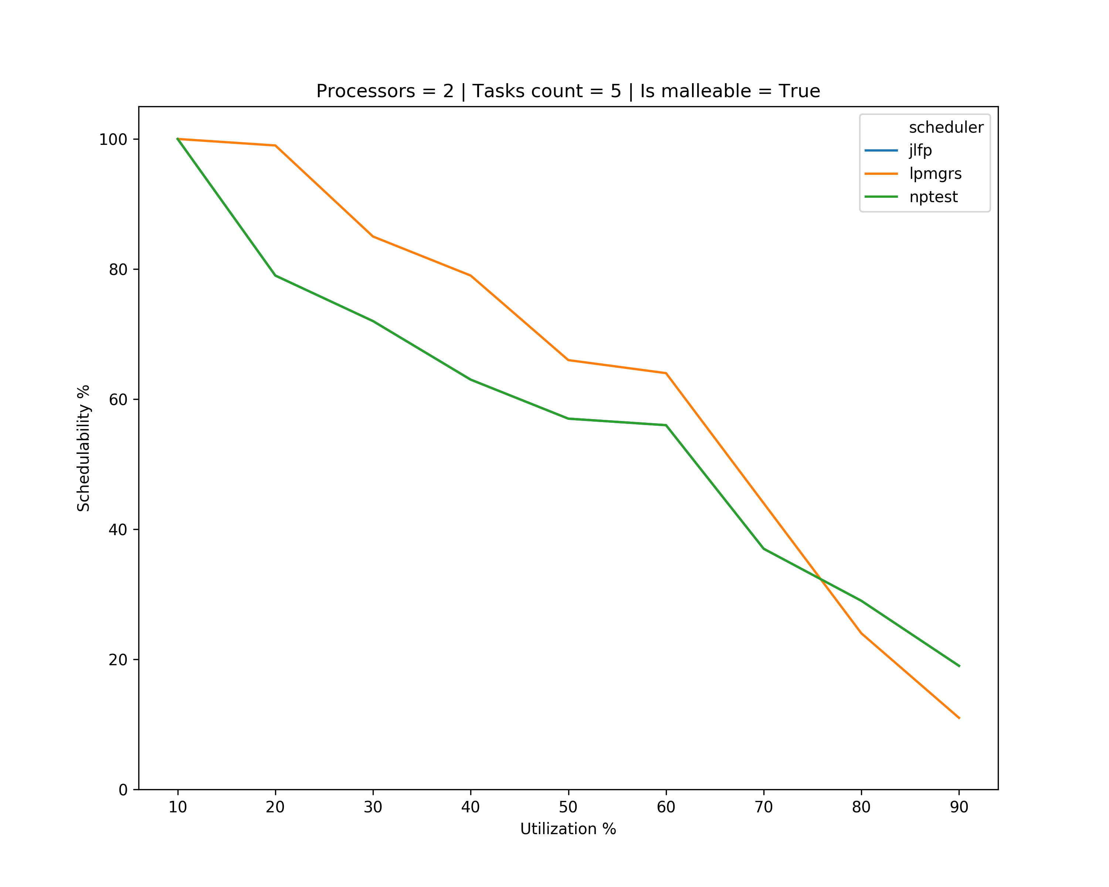
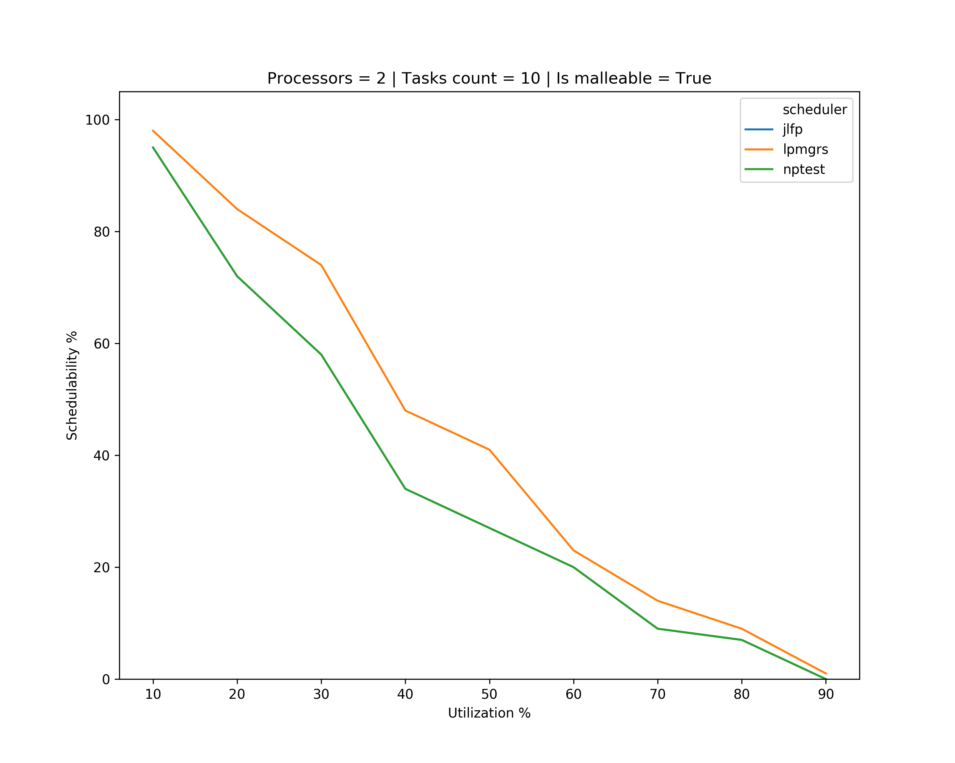
Results – multicore

Slide 23
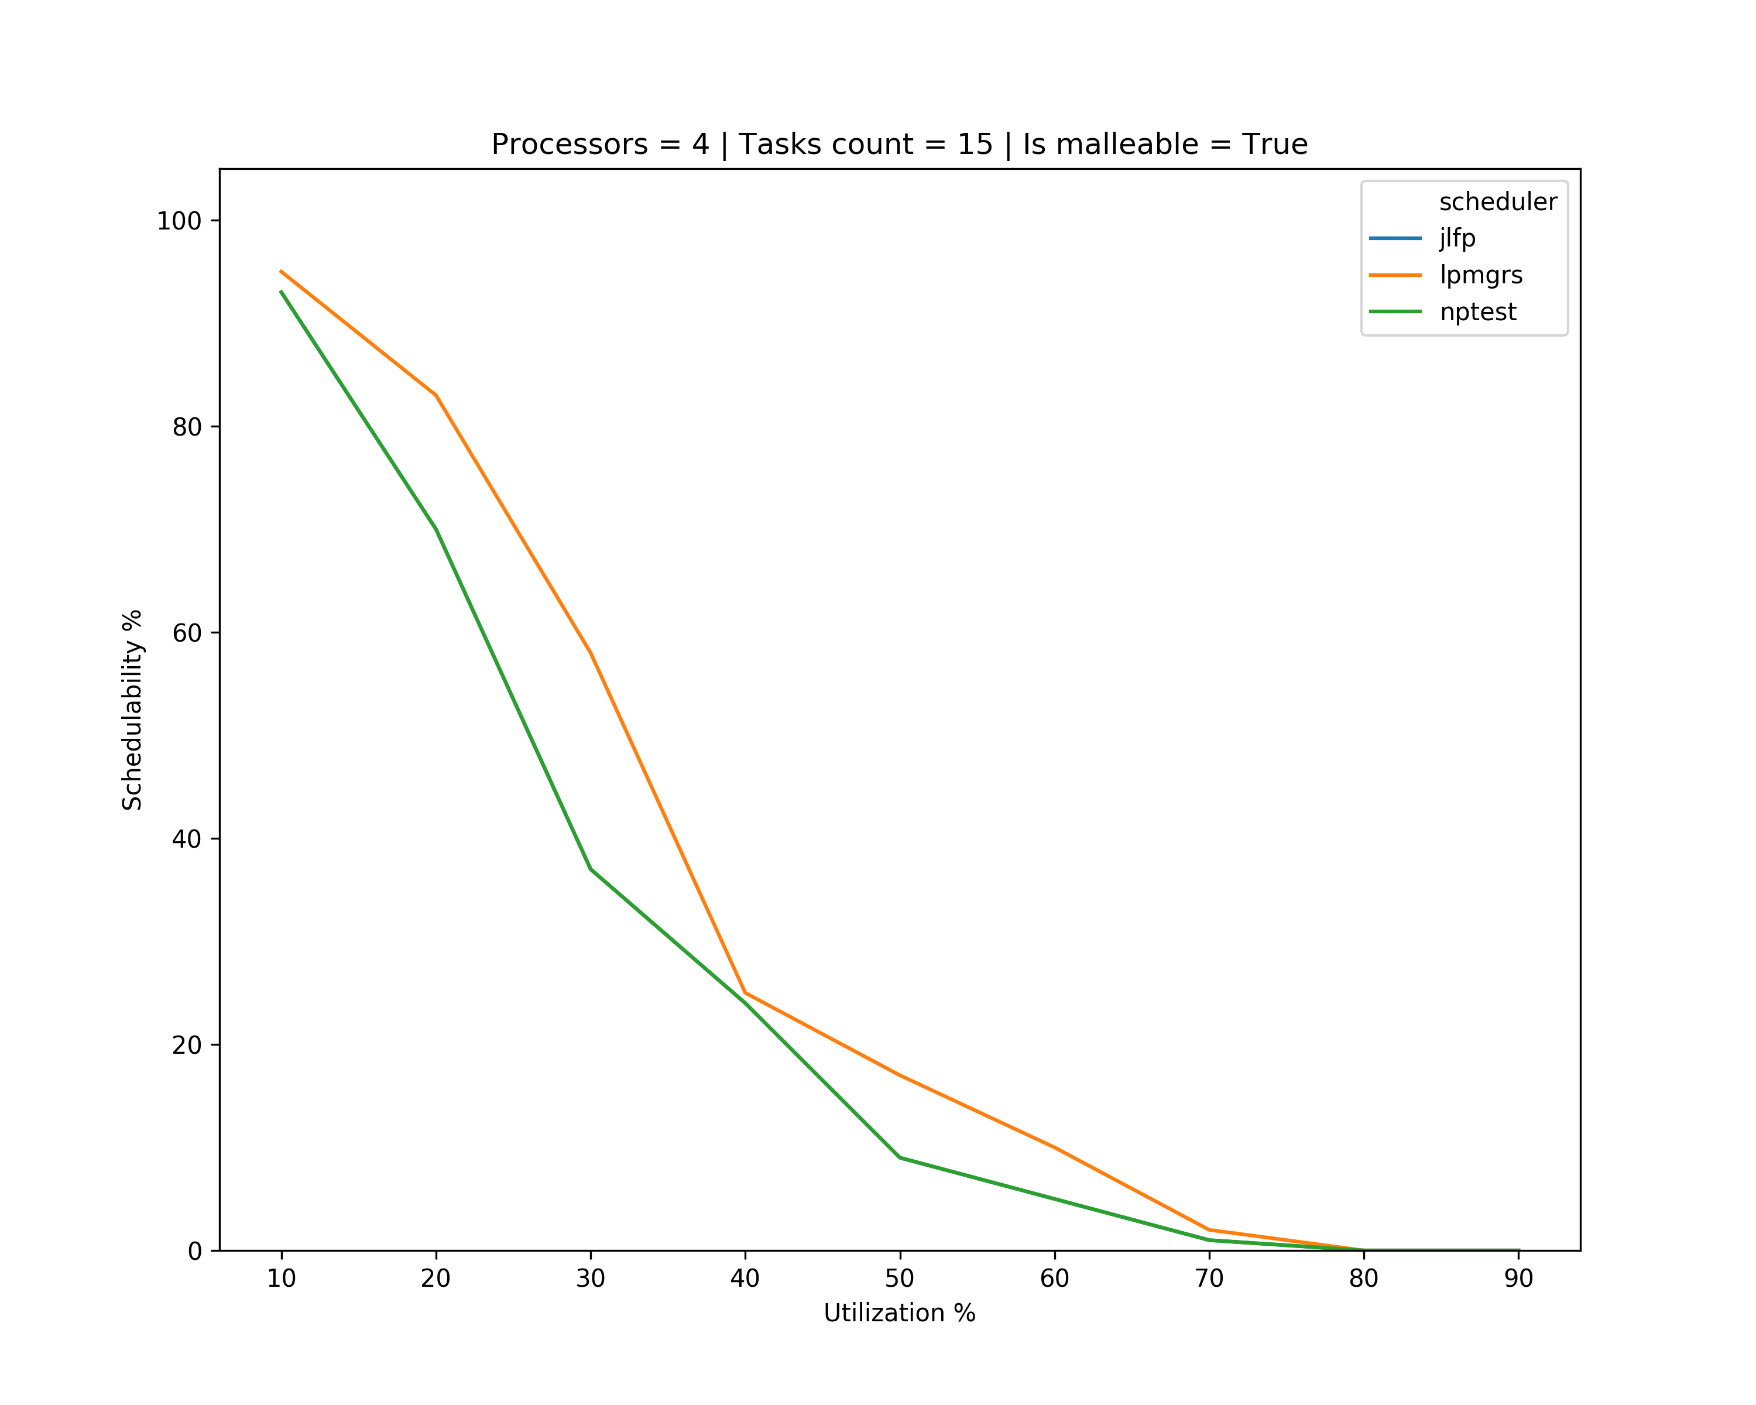
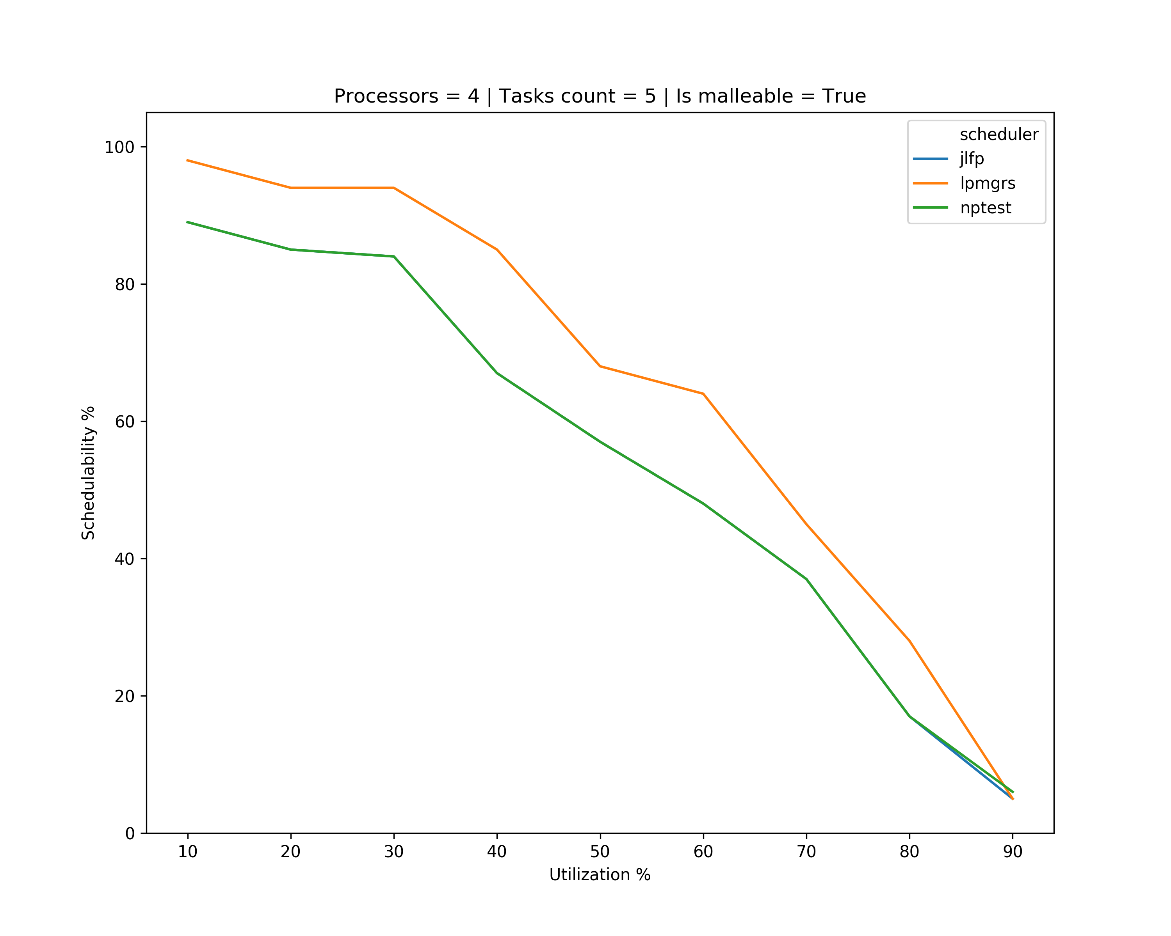
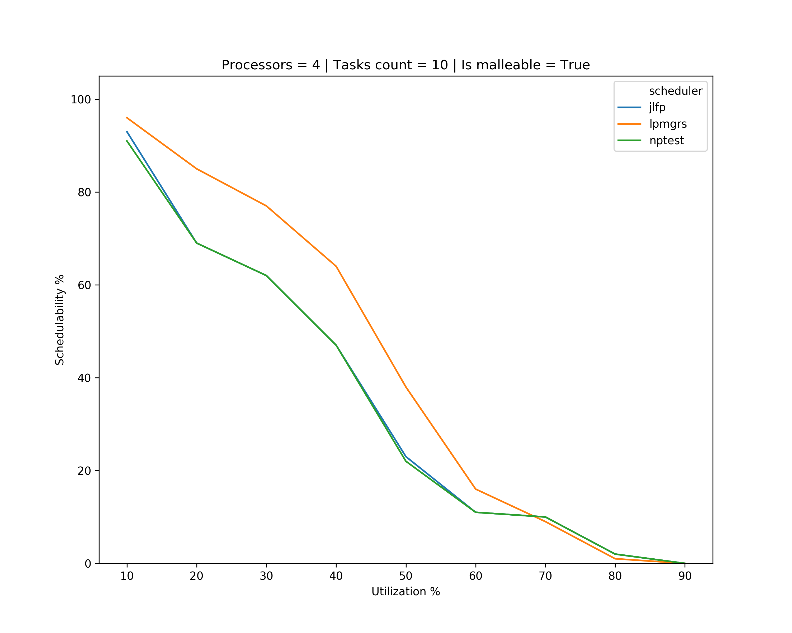
Results – multicore

Slide 24
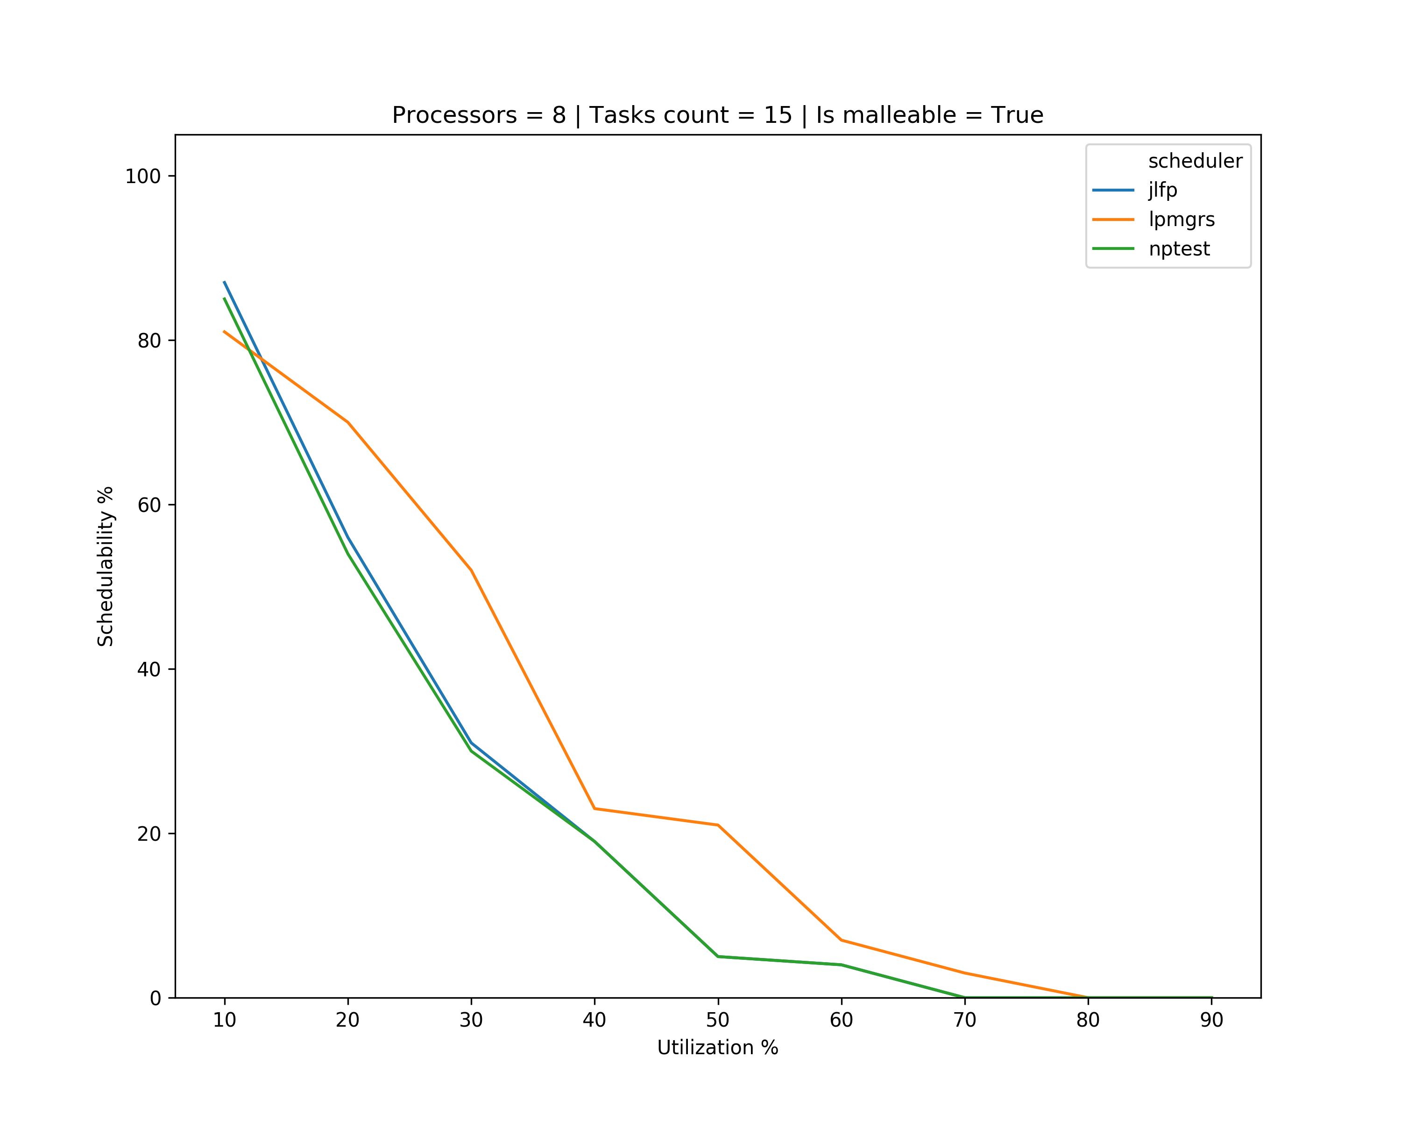
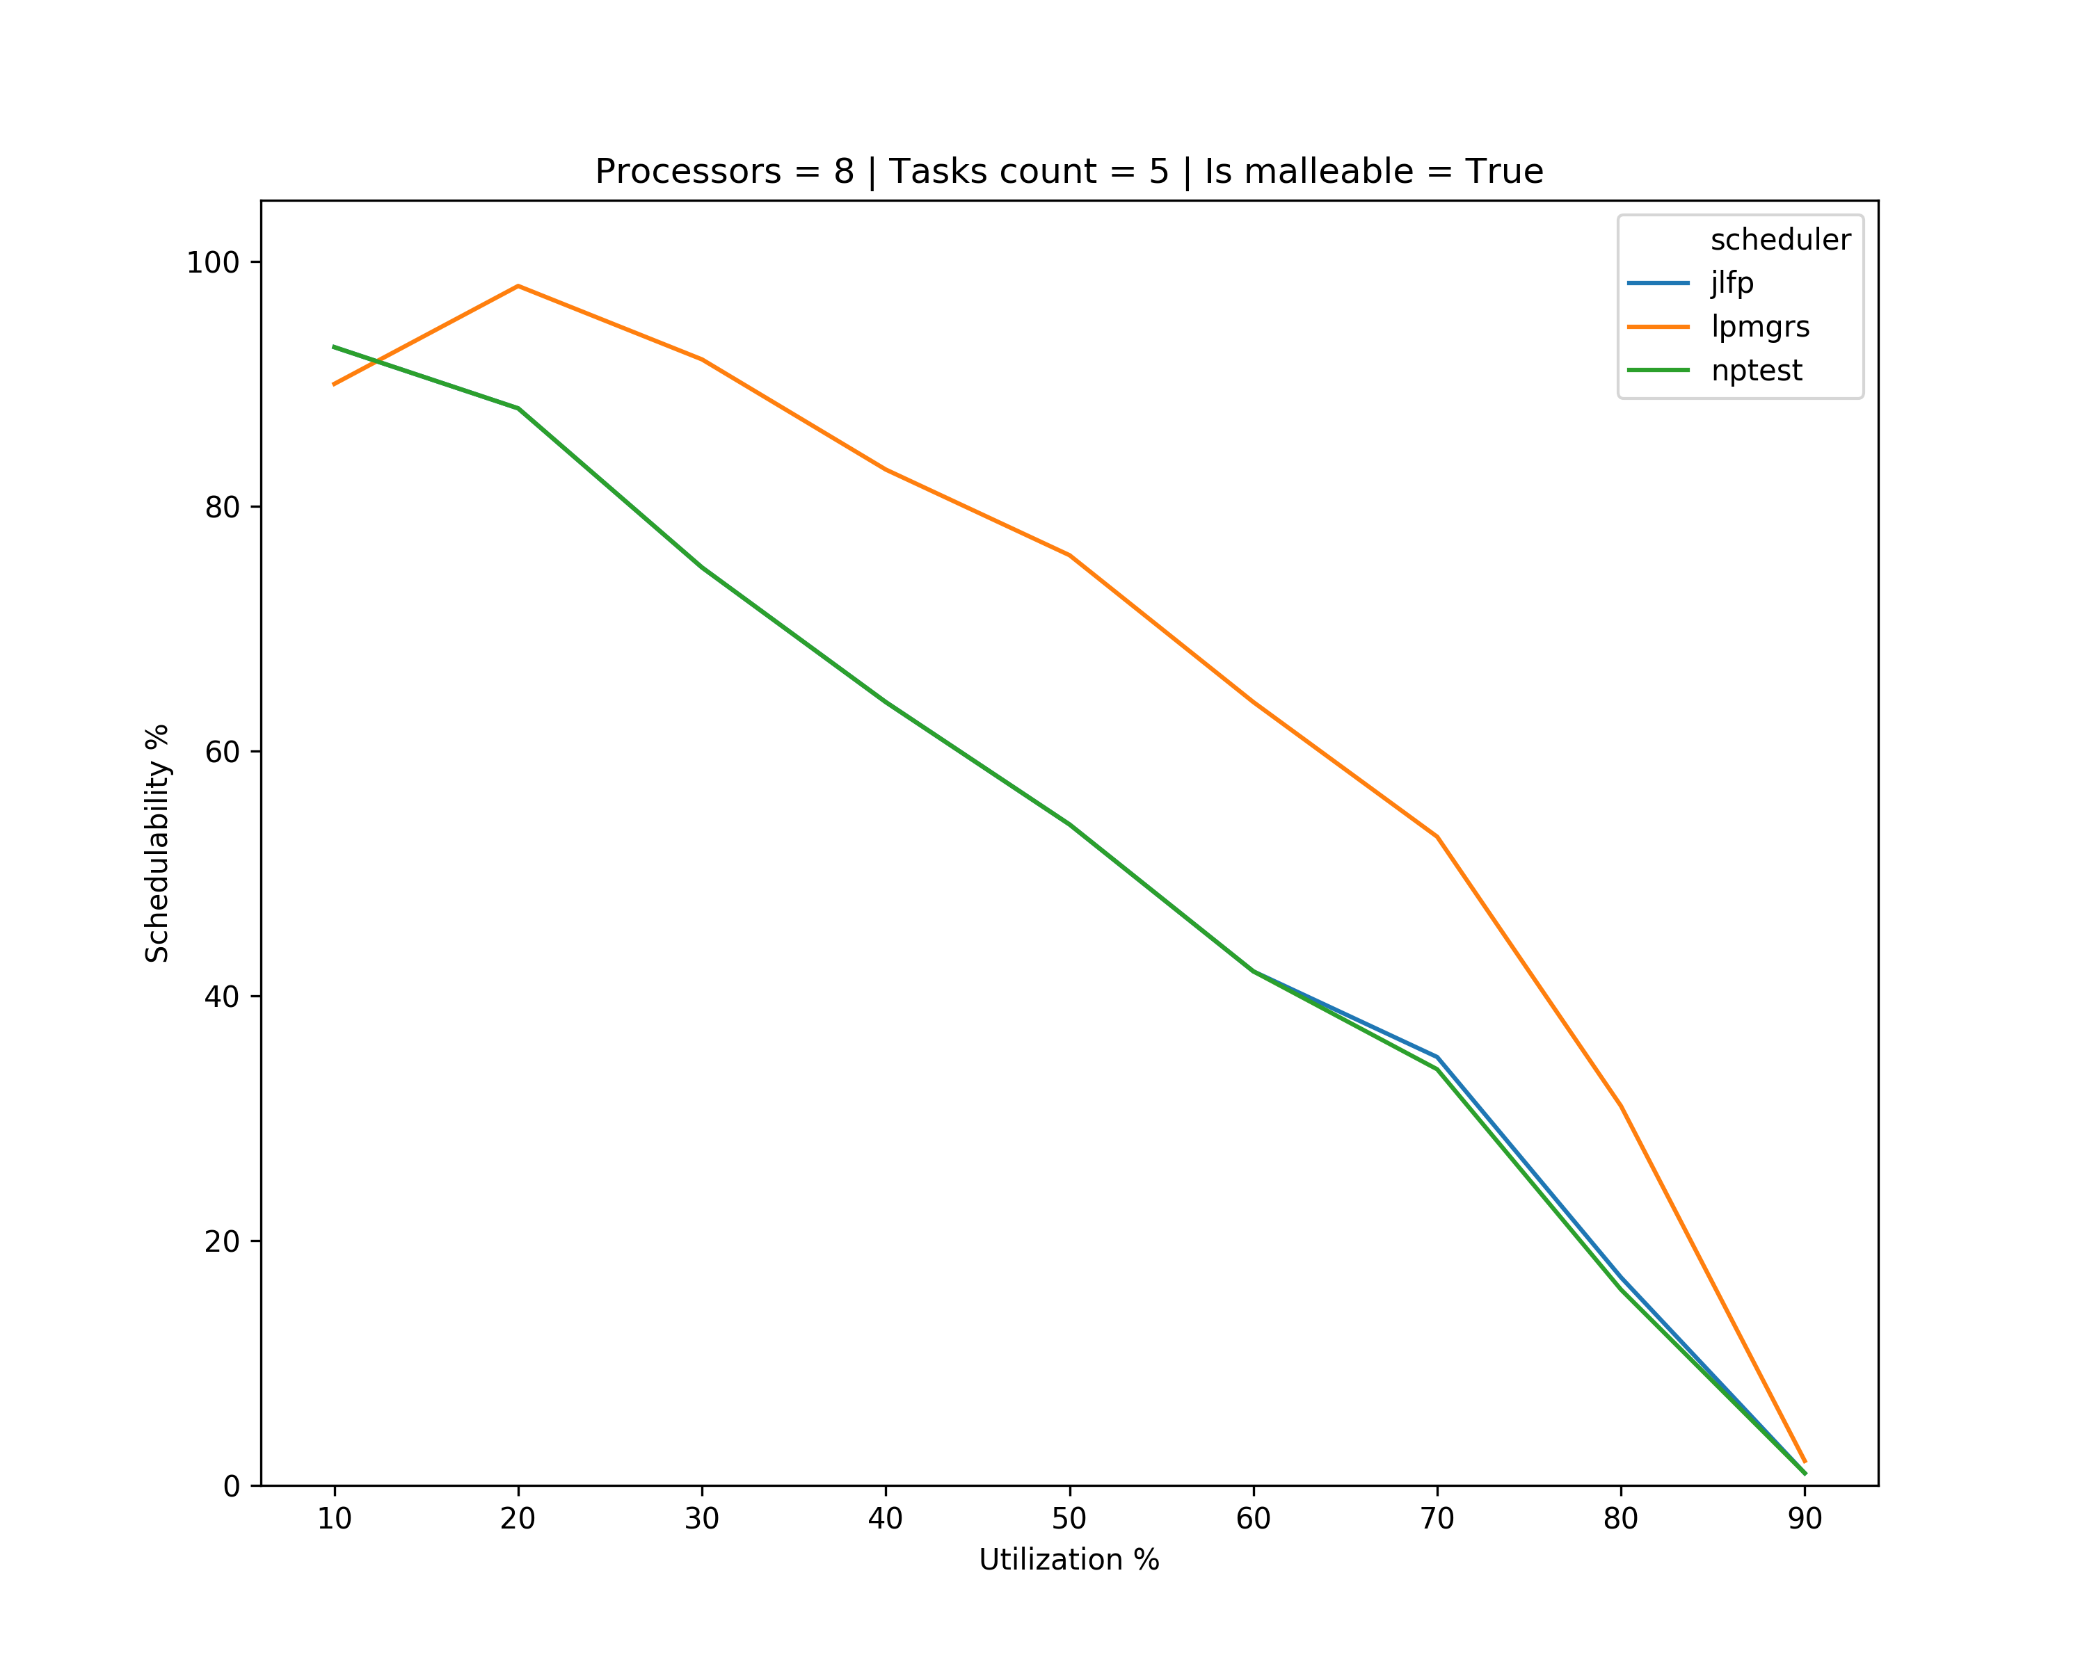

Results – multicore

Slide 25

Notation
Set using LaTeX mathcal?: $𝒮^{name}$
Element of set: $s_{i}^{name}$
Task: $τ_{i}$
Subtask:
Option A: $τ_{i}$
Option B: $τ_{i,j}$
Job of subtask:
Option A: $J_{i,j}$
Option B: $J_{i,j,k}$
Job $j$ of task $i$ released with $p$ cores: $J_{i,j}^{p}$
Called job-scheduled in code
Better naming?
Another option is to call the task a batch or a supertask as it groups multiple tasks through the precedence constraints

Slide 26
What’s next?
Start start working towards schedulability analysis for LPMGRS
Start working on generating tasks with precedence constraints
Once finished generate results with more task sets

Slide 27
Tasks with precedence constraints
Cannot find DAG generator in Björn’s code
Expand non-terminal nodes to
Terminal nodes
Parallel sub-graphs. Does this mean generating new nodes?
Until
Max-depth recursion
Max-depth critical path
Max nodes
What’s the difference?

Slide 28

Tasks with precedence constraints
Parameters
$n_{par}$ Max number of forked elements at once
$p_{term}=0.4$ Probability of creating a terminal node
$p_{add}=0.1$ Probability of random edge between two siblings
Release time
Set it at time of first subtask?
Set it so subtasks that are precedence constraints are released before their successors?
Period: unique per task

